Slide 1
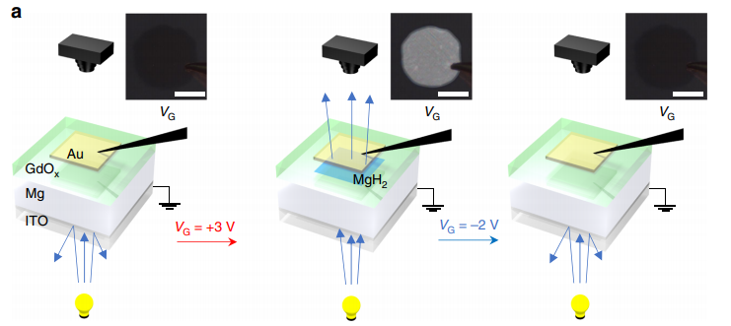
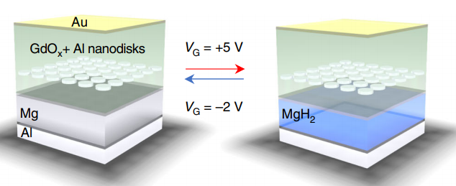
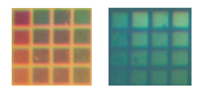
IRG-3. Voltage Control of Optical Properties by Ionic Gating
MIT MRSEC
DMR-1419807
2019
Geoffrey Beach
Massachusetts Institute of Technology
Intellectual Merit
Devices with locally-addressable and dynamically tunable optical properties underpin emerging technologies such as high-resolution reflective displays and dynamic holography. Using a simple device structure, it has been shown that electrical control of optical properties can be achieved through electrochemical hydrogen gating, sourced from moisture in the air. The discovery can enable device scaling into the deep subwavelength regime, and has potential applications in addressable plasmonic devices and reconfigurable metamaterials.
Switchable mirror
Switchable colors using plasmonic arrays
Huang, M., Tan, A. J., Büttner, F., Liu, H., Ruan, Q., Hu, W., Mazzoli, C., Wilkins, S., Duan, C., Yang, J. K. W., and Beach, G. S. D. “Voltage-Gated Optics and Plasmonics Enabled by Solid-State Proton Pumping.” Nature Communications, 10(1): 5030, November 2019. <doi:10.1038/s41467-019-13131-3>
Notes:
It was recently demonstrated that a solid-state proton pump can be realized utilizing H₂O hydrolysis in ambient atmosphere catalyzed by a GdOx/Au interface, where it was shown that the magnetic properties of thin buried metal layers could be gated nondestructively with a modest voltage. Here we show that a similar mechanism enables local, reversible hydrogen gating of optical properties in a wide range of metallic and plasmonic devices by covering the structure with a transparent gate oxide capped with a top electrode and applying a small voltage. We demonstrate the simplicity and utility of the mechanism by realizing nonvolatile voltage-gated color pixels based on tunable interference cells and plasmonic arrays. We further discover a large reversible change in the optical path length of the GdO_{x} upon hydrogen insertion, equivalent to a > 20% change in its index of refraction, which is matched only by liquid crystal cells and complex phase-change materials. Our approach permits switching speeds on the order of tens of ms, and device thicknesses down to several tens of nm. It promises highly localized control of a wide range of optical properties for applications such as high-resolution reflective displays, hyperspectral imaging, and dynamic holography.

