Slide 1
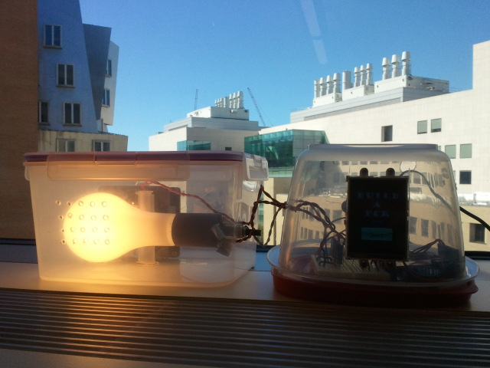
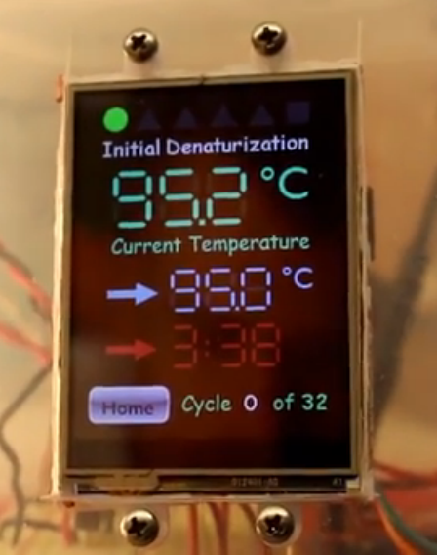
The MIT MRSEC is Bringing Biotech to the K-12 Classroom, A. Belcher
MRSEC researchers are working with teachers to design a new hands-on science and technology curriculum designed to bridge the gap between high-tech and K-12 education. As a first effort towards this initiative, MIT postdoc Dr. Stephen Steiner, Acera School teacher Kate Semine, and Prof. Angela Belcher have developed a low-cost ($100) device for performing polymerase chain reaction (PCR) amplification of DNA using locally obtainable off-the-shelf components. The device heats and cools DNA samples (e.g., extracted from strawberries) using an incandescent light bulb and a cooling fan controlled by a microcontroller that actively monitors temperature with a thermistor. The device features a programmable touchscreen interface that incorporates key vocabulary from lessons, uses color coding and shape symbology, and displays real-time updating of thermocycle steps to make the PCR process easy to follow for a wide age range of users. The device was built with a tectonic design philosophy (i.e., its inner workings are easy to intuit by inspection), is easy to assemble, and requires no soldering or access to a machine shop to build. A common-core-compatible curriculum, design plans, and associated program will be made available for dissemination free-of-charge online in the future.
This work was supported primarily by the MRSEC Program of the National Science Foundation under award number DMR-0819762.

