Slide 1
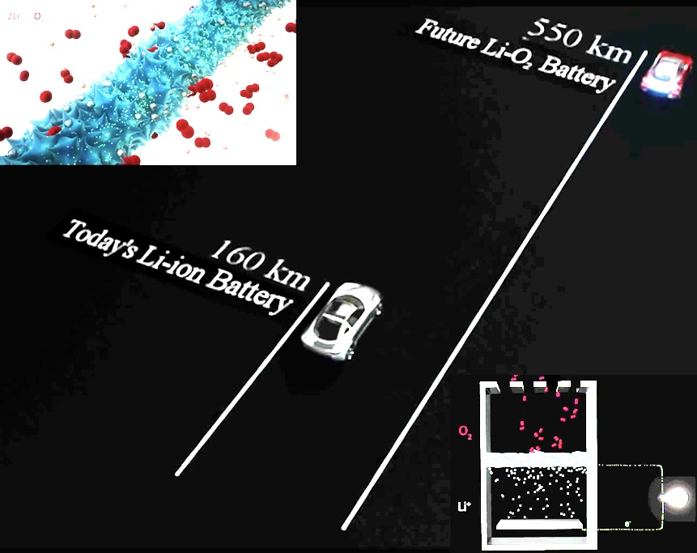
Better Batteries Through Biology, A. Belcher and Y. Shao-Horn (IRG I)
Lithium-oxygen batteries have a great potential to enhance the gravimetric energy density of fully packaged batteries by 2-3 times that of lithium-ion cells, thus greatly increasing the range of electric vehicles.
MIT MRSEC researchers have been genetically engineering biology to build and assemble new catalyst electrode materials with improved performance. They report an electrode design principle to improve specific capacity and cycling performance of lithium-oxygen batteries by utilizing high efficiency metal oxide nanocatalysts assembled by the M13 virus with earth abundant elements at room temperature. By further engineering the virus to incorporate 3-5 wt% of palladium nanoparticles, this hybrid nanocatalyst achieved 20% higher specific capacity at 6 times higher current density, compared to traditionally formed manganese oxide electrode materials. This biological approach could open up new possibilities for catalysis design and assembly of battery materials for future electric vehicles.
Image from an MIT animation describing the development and use of the virus lithium air battery found at http://www.youtube.com/watch?v=pUVrUIV4xu4
Oh, D., Qi, J., Lu, Y.C., Zhang, Y., Shao-Horn, Y., Belcher, A. “Biologically Enhanced Cathode Design for Improved Capacity and Cycle Life for Lithium-Oxygen Batteries.” Nature Communications, 4(2756), 2013.
This work was supported primarily by the MRSEC Program of the National Science Foundation under award number DMR-0819762.

