Slide 1
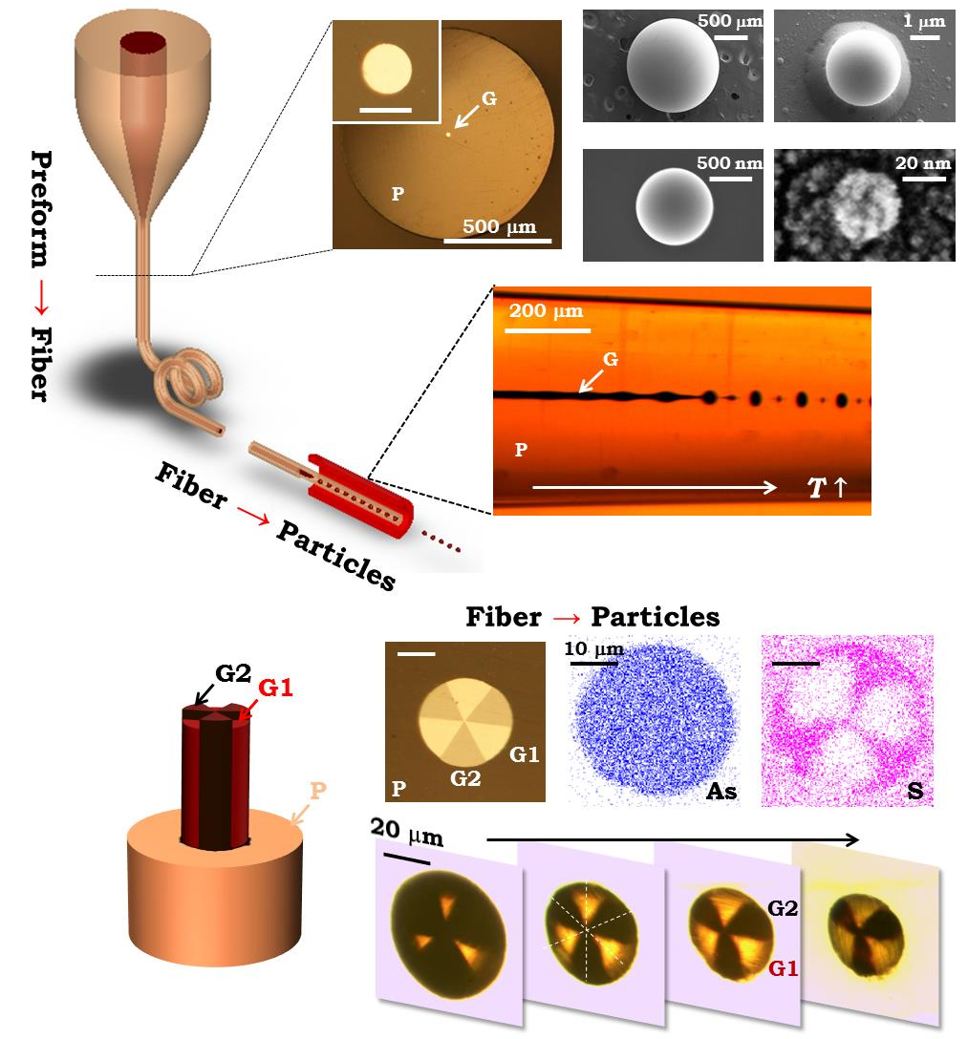
Harnessing In-Fiber Fluid Instabilities To Create Multimaterial
Particles From Fibers, A. Abouraddy and Y. Fink (IRG-III)
From drug delivery to catalysis to optoelectronics, the need for efficient fabrication pathways for particles over a wide range of sizes, from a variety of materials, and in many different structures is critical to functionality. Researchers in IRG-III have exploited the inherent scalability of fiber production and an in-fiber Plateau–Rayleigh capillary instability for the fabrication of uniformly sized, structured spherical particles spanning an exceptionally wide range of sizes: from 2 millimeters down to 20 nanometers.
By arranging a variety of structures and materials in a macroscopic scaled-up model of the fiber, composite structured spherical particles, are produced such as core–shell particles, two-compartment ‘Janus’ particles, and multi-sectioned ‘beach ball’ particles (see figure). Moreover, producing fibers with a high density of cores allows for an unprecedented level of parallelization. This new process makes it possible for the first time to produce nanostructures containing diverse materials in prescribed complex architectures and manufactured in large quantities. This development has significant implications for photovoltaics, electronic devices, medicine and health-care, targeted drug delivery, chemical sensing and catalysis, photonics, and cosmetics.
Top: Instability process used to create structurally and compositionally well defined particles from meter long fibers. Bottom: “Beach ball” type particles created via this process.
J. J. Kaufman, G. Tao, S. Shabahang, E.-H. Banaei, D. S. Deng, X. Liang, S. G. Johnson, Y. Fink, and A. F. Abouraddy, “Structured spheres generated by an in-fibre fluid instability,” Nature 487, 463-467 (2012).
This work was supported by the MRSEC Program of the National Science Foundation under award number DMR-0819762.
Notes:
The fiber core and cladding correspond to the dispersed and continuous phases, respectively, and are both frozen in situ on cooling, after which the particles are released when needed.

