Slide 1
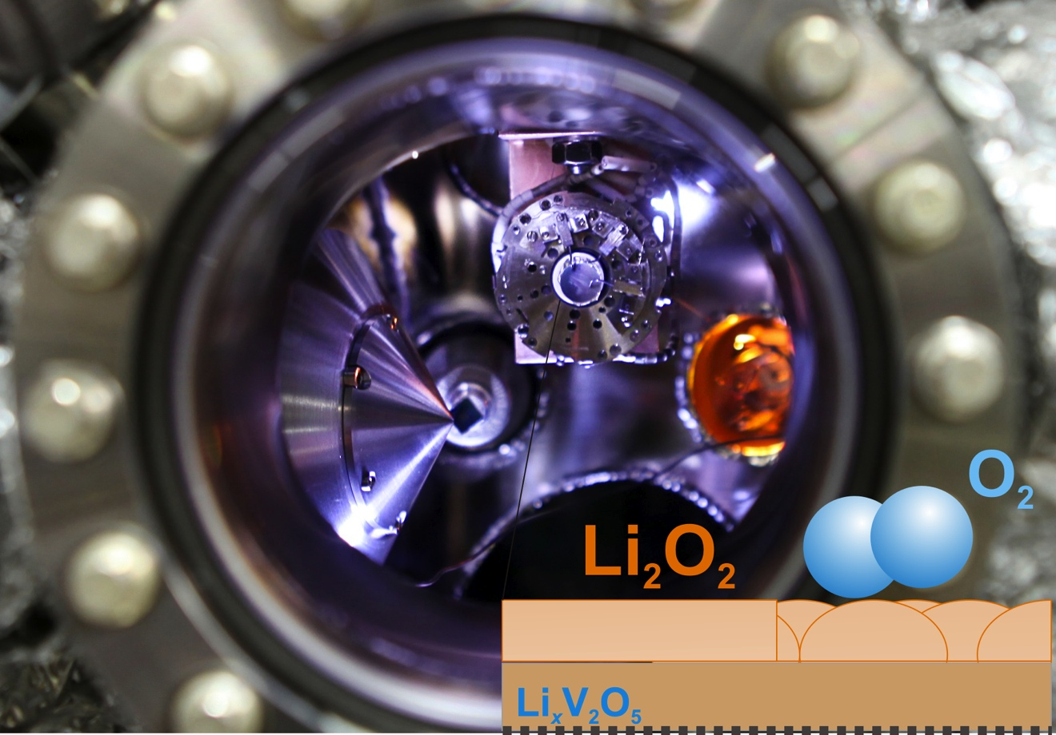
New Technique Provides Better Understanding of Problems with Lithium-Air Rechargeable Batteries, Y. Shao-Horn (IRG-I)
The lack of fundamental understanding of the role of oxygen in non-water based electrolytes significantly hinders the development of rechargeable lithium-air batteries. This IRG has developed a new X-ray photoelectron spectroscopy (XPS) technique that makes it possible to study the lithium/oxygen chemistry occurring during battery operation as a function of applied voltage and controlled oxygen pressure.
This study provides the first evidence of reversible lithium peroxide formation and decomposition in situ on an oxide surface of a solid-state cell and connects the electrical potential of the battery to oxygen redox chemistry in the presence of lithium ions at room temperature.
The new technique developed has shed light on issues associated with the use of lithium-air batteries and opens the door to numerous opportunities for gaining mechanistic insights into air-based electrochemical reactions for efficient energy storage.
Image depicting a solid-state lithium-air battery inside the in situ ambient pressure X-ray photoelectron spectroscopy chamber filled with oxygen for investigation of lithium-oxygen redox reactions. (Right bottom: a schematic illustrating the formation of lithium peroxide on the surface of a lithium vanadium oxide electrode)
Y.C. Lu, E.J. Crumlin, G.M. Veith, J.R. Harding, E. Mutoro, L. Baggetto, N.J. Dudney, Z. Liu and Y. Shao-Horn, In Situ Ambient Pressure X-ray Photoelectron Spectroscopy Studies of Lithium-Oxygen Redox Reactions, Scientific Reports, 2, 715, (2012)
This work was supported primarily by the MRSEC Program of the National Science Foundation under award number DMR-0819762.
Notes:
Here we employ a solid-state Li4+xTi5O12/LiPON/LixV2O5 cell and examine in situ the chemistry of Li-O2 reaction products on LixV2O5 as a function of applied voltage under ultra high vacuum (UHV) and at 500 mtorr of oxygen pressure using ambient pressure X-ray photoelectron spectroscopy (APXPS). Under UHV, lithium intercalated into LixV2O5 while molecular oxygen was reduced to form lithium peroxide on LixV2O5 in the presence of oxygen upon discharge. Interestingly, the oxidation of Li2O2 began at much lower overpotentials (~240 mV) than the charge overpotentials of conventional Li-O2 cells with aprotic electrolytes (~1000 mV).

