Slide 1
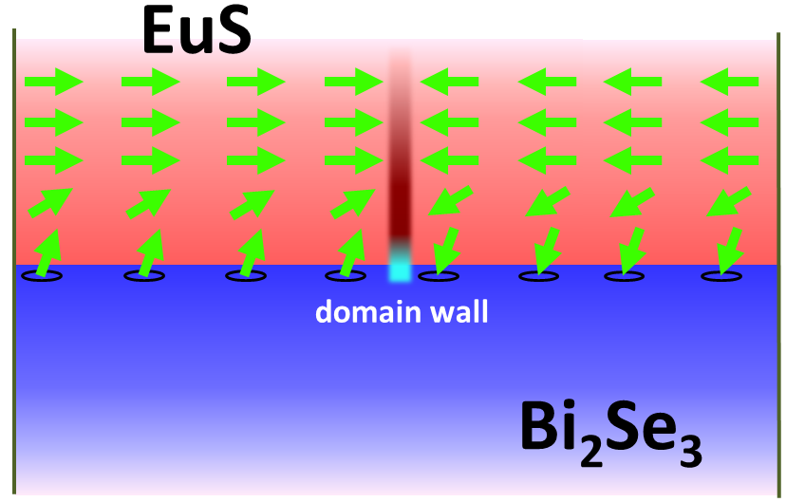
Conducting Highways are Created on the Surface of Magnetic Topological Insulators, J.S. Moodera, P. Jarillo-Herrero (Initiative II)
Topological insulators (TIs) are a novel class of quantum materials characterized by an insulating bulk and metallic conducting states at the surface. This metallic behavior however, can be changed by applying a magnetic field or, equivalently, by coupling the TI to a ferromagnetic material. In this work, for the first time, MRSEC researchers have succeeded in turning the TI surface states into an insulating state by coupling the TI to a ferromagnetic insulator. Moreover, because the ferromagnetic insulator has magnetic domains, a novel type of conducting channel appears on the surface of the TI exactly at the domain boundary. These topological conducting states have long been theoretically proposed but only now observed. These results pave the way to the observation of many theoretically predicted novel properties specific to TIs, and may also lead to future device applications.
Schematic of the TI (Bi₂Te₃) and magnetic insulator (EuS) bilayer. The green arrows represent magnetic domain directions whereas the boundary between the two is the region of the highly conducting channel (red region with blue arrows).
Wei, P., Katmis, F., Assaf, B.A., Steinberg, H., Jarillo-Herrero, P., Heiman, D., and Moodera, J.S. “Exchange-Coupling-Induced Symmetry Breaking in Topological Insulators”, Physical Review Letters 110, 186807-12 (2013)
This work was supported primarily by the MRSEC Program of the National Science Foundation under award number DMR-0819762.

