Slide 1
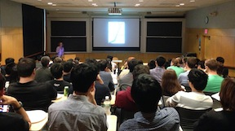
Science Image Specialist Felice Frankel Teaches Masterclasses on the Visual Communication of Materials Science and Engineering
Nearly 300 postdoctoral researchers and graduate students attended masterclasses on the visual communication of materials science and engineering between October 2013 and January 2014. At programs offered in partnership with the Departments of Mechanical Engineering, Chemical Engineering, and Materials Science and Engineering, Felice Frankel, research specialist at the MIT MRSEC, presented 90-minute talks addressing common errors students and faculty make in the graphics and images used in their presentations and publications. Her book, Visual Strategies, a Practical Guide in Graphics for Scientists and Engineering was the foundation of companion workshops that engaged smaller working groups in directed discussion and critique of images submitted by participants.
The MIT MRSEC and the Department of Materials Science and Engineering cosponsored the masterclass “Visual Communication of Materials Science and Engineering”
Participants in the masterclasses report that they found them extremely helpful and were grateful for the advice on enhancing their visual communication skills from such a highly published science image specialist. The overwhelming success of the fall masterclasses generated demand for a fourth class that Frankel presented during MIT’s Independent Activities Period in January.
Examples of submitted figure (above) and a redesigned figure (right). Redesigned figure addresses key concepts, including simplifying figures and composing to aid readers to better understand complex information.
This work was supported primarily by the MRSEC Program of the National Science Foundation under award number DMR-0819762.

