Slide 1
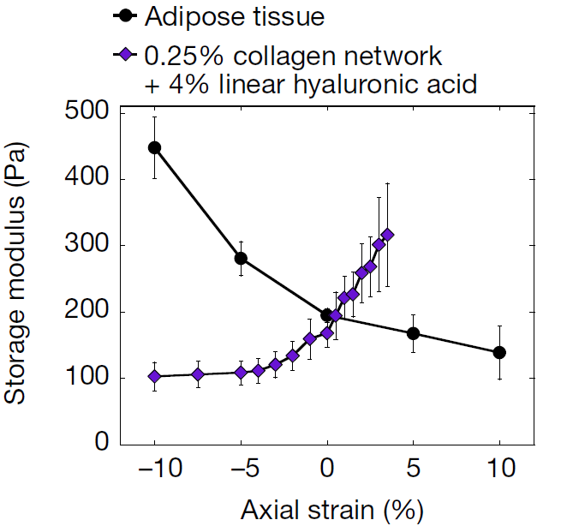
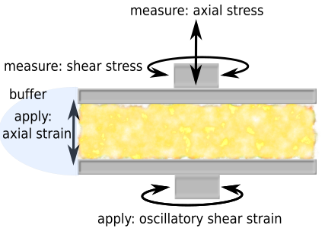
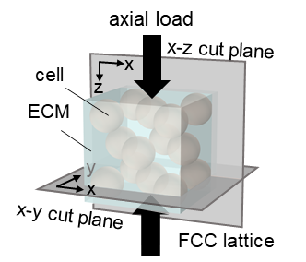
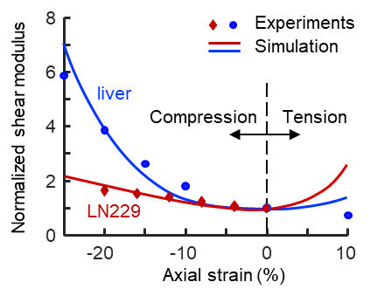
Emergence of Tissue-like Mechanics from Fibrous Networks Confined by Close-packed Cells
DMR: 1720530
2020
The Janmey and Shenoy groups in IRG-2 studied multiaxial response of soft tissues (top left image). Measurements (Janmey) and a theoretical model (Shenoy) show that the tissue rheology emerges from an interplay between strain-stiffening polymer networks and the volume-conserving cells within them. Polymer networks that soften in compression but stiffen in extension can be converted to materials that stiffen in compression but not in extension by including either cells or inert particles within the network to restrict the relaxation modes of the surrounding fibrous networks (top right image). This result agrees with the predicted response of the network model from the Shenoy group (bottom images). The emergence of an elastic response in these composite materials has implications for how tissue stiffness is altered in disease and can lead to cellular dysfunction.
Anne van Oosten, Xingyu Chen, Vivek Shenoy, Paul Janmey University of Pennsylvania
Representative volume element
A. S. G. van Oosten, X. Chen, L. Chin, K. Cruz, A. E. Patteson, K. Pogoda, V. B. Shenoy and P. A. Janmey, Emergence of tissue-like mechanics from fibrous networks confined by close-packed cells, Nature (2019)

