Slide 1
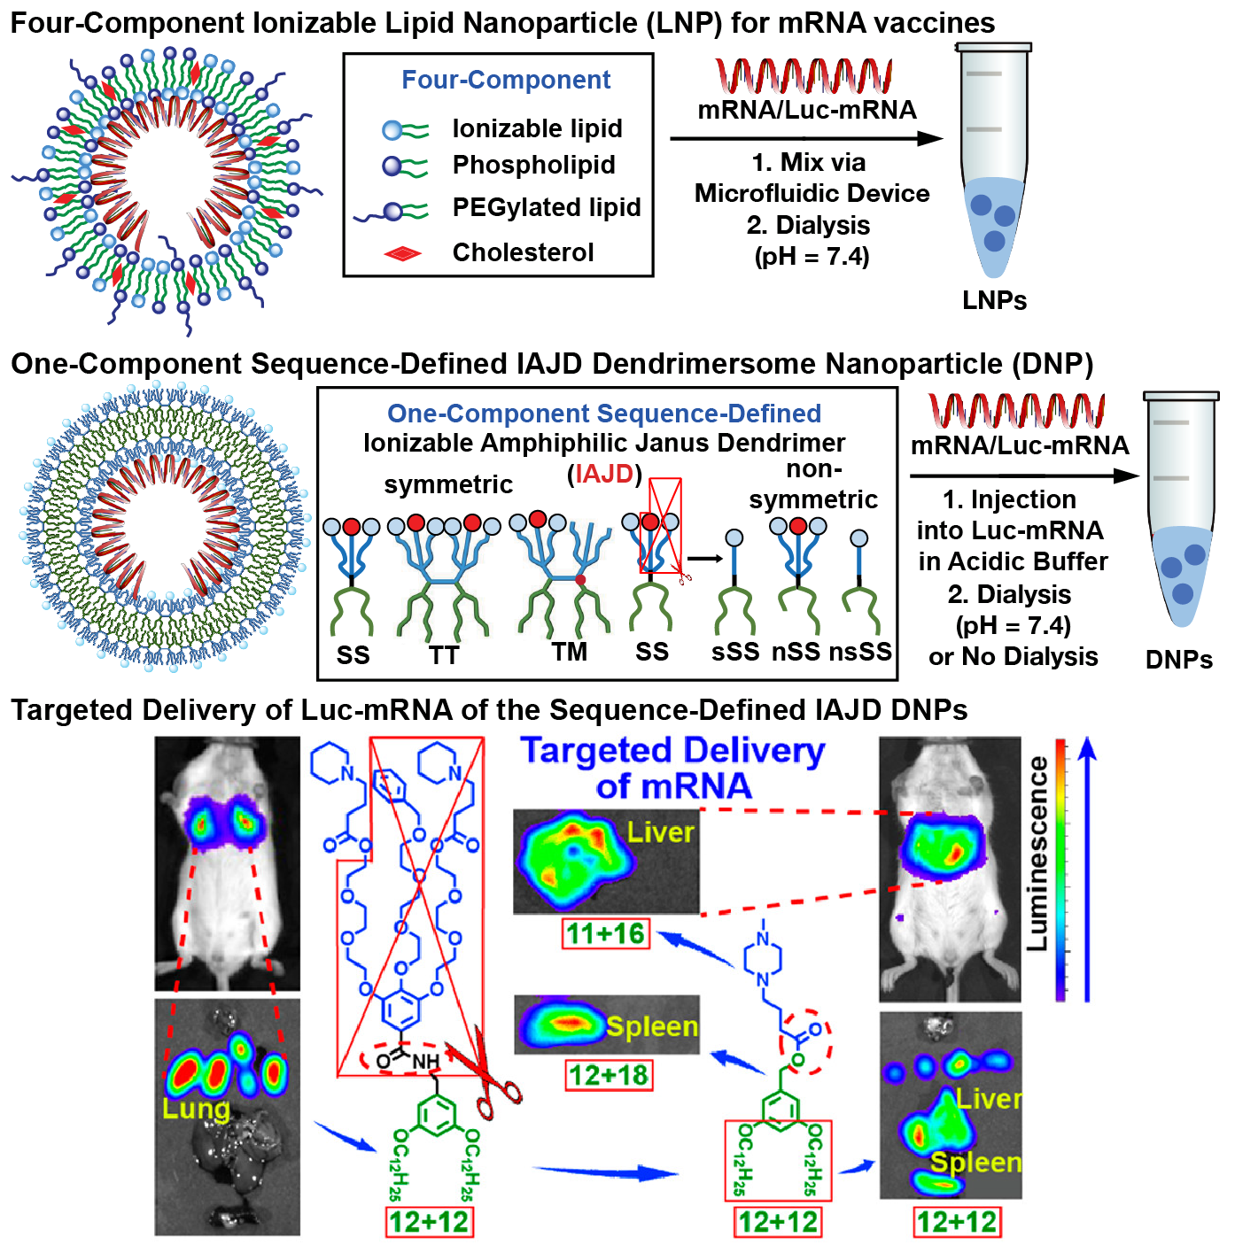
Packaging and Release of mRNA and of other Macromolecules from Supramolecular Virus-Like Assemblies
DMR: 1720530
2022
Virgil Percec, University of Pennsylvania
We developed one-component, sequence-defined Ionizable Amphiphilic Janus Dendrimers (IAJDs) and their assemblies with mRNA. These Dendrimersome Nanoparticles (DNPs) were investigated for the delivery of mRNA for vaccines and nanotherapeutics. The DNPs have the potential to make less expensive, more stable, and easily stored vaccines against viruses compared to the current 4-component Lipid Nanoparticles, LNPs. We have shown that the structural design of the IAJD molecules allows the formation of DNPs that selectively deliver Luc-mRNA to the lung, liver, spleen, and lymph nodes. Simplifying the IAJD structure allows us to change the delivery from lung to liver and spleen. The DNPs elaborated in this work are excellent candidates for more efficient and less expensive vaccines than the current ones.
Percec Laboratory (1) J. Am. Chem. Soc., 2021, 143, 12315–12327.; (2) J. Am. Chem. Soc., 2021, 143, 17975–17982.; (3) J. Am. Chem. Soc., 2022, 144, 4746–4753.

Slide 2
Packaging and Release of mRNA and of other Macromolecules from Supramolecular Virus-Like Assemblies
DMR: 1720530
2022
Virgil Percec, University of Pennsylvania
High School Teacher Daaiyah White from Mastery Charter Schools was supported by this grant to participate in this research. We also welcomed Hayley Neubauer, a chemistry undergraduate student at Gettysburg College and Isis P. Carmona-Sepúlveda, an undergraduate student from Puerto Rico, as REU summer interns in summer 2021. The last two undergraduate students subsequently became graduate students in chemistry.
The three JACS papers referenced below received support from this effort. Penn has filed patent applications on work described in the references.
NSF-REU Employees and Undergraduates
High School Teacher
Daaiyah White
Science & Technology Instructional Leader & Teacher
Undergraduate Students
Hayley Neubauer
Recently graduated with a
Bachelor of Science in Chemistry
Isis P. Carmona-Sepúlveda
Now graduate student
at Penn State University
Percec Laboratory (1) J. Am. Chem. Soc., 2021, 143, 12315–12327.; (2) J. Am. Chem. Soc., 2021, 143, 17975–17982.; (3) J. Am. Chem. Soc., 2022, 144, 4746–4753.

