Slide 1
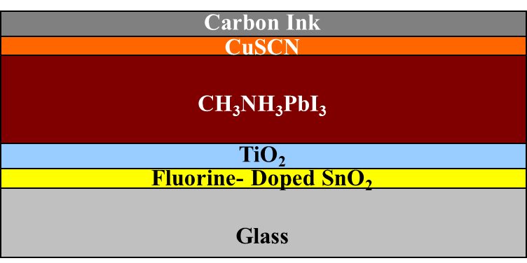
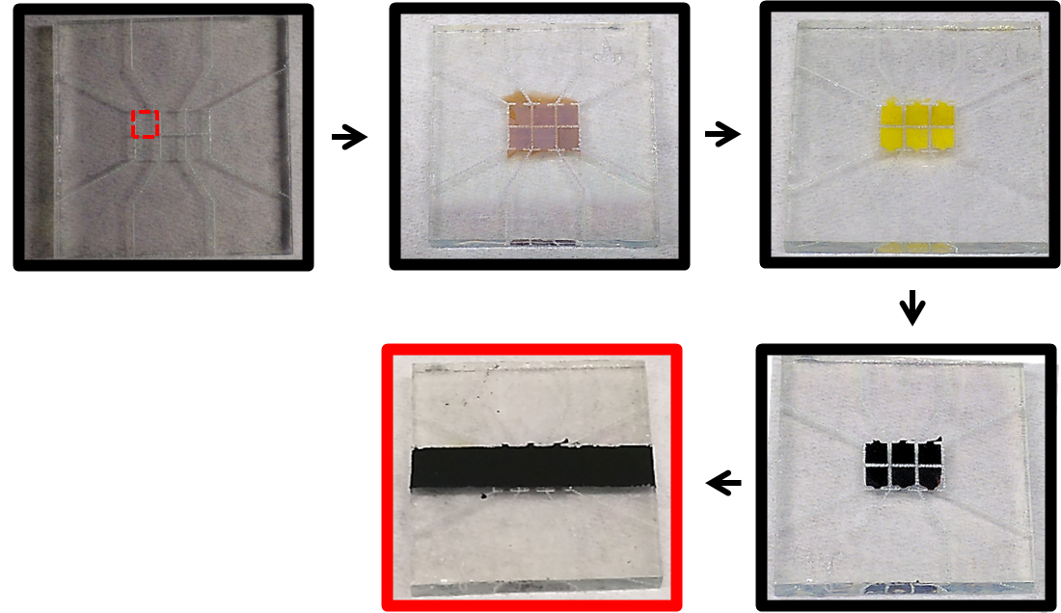
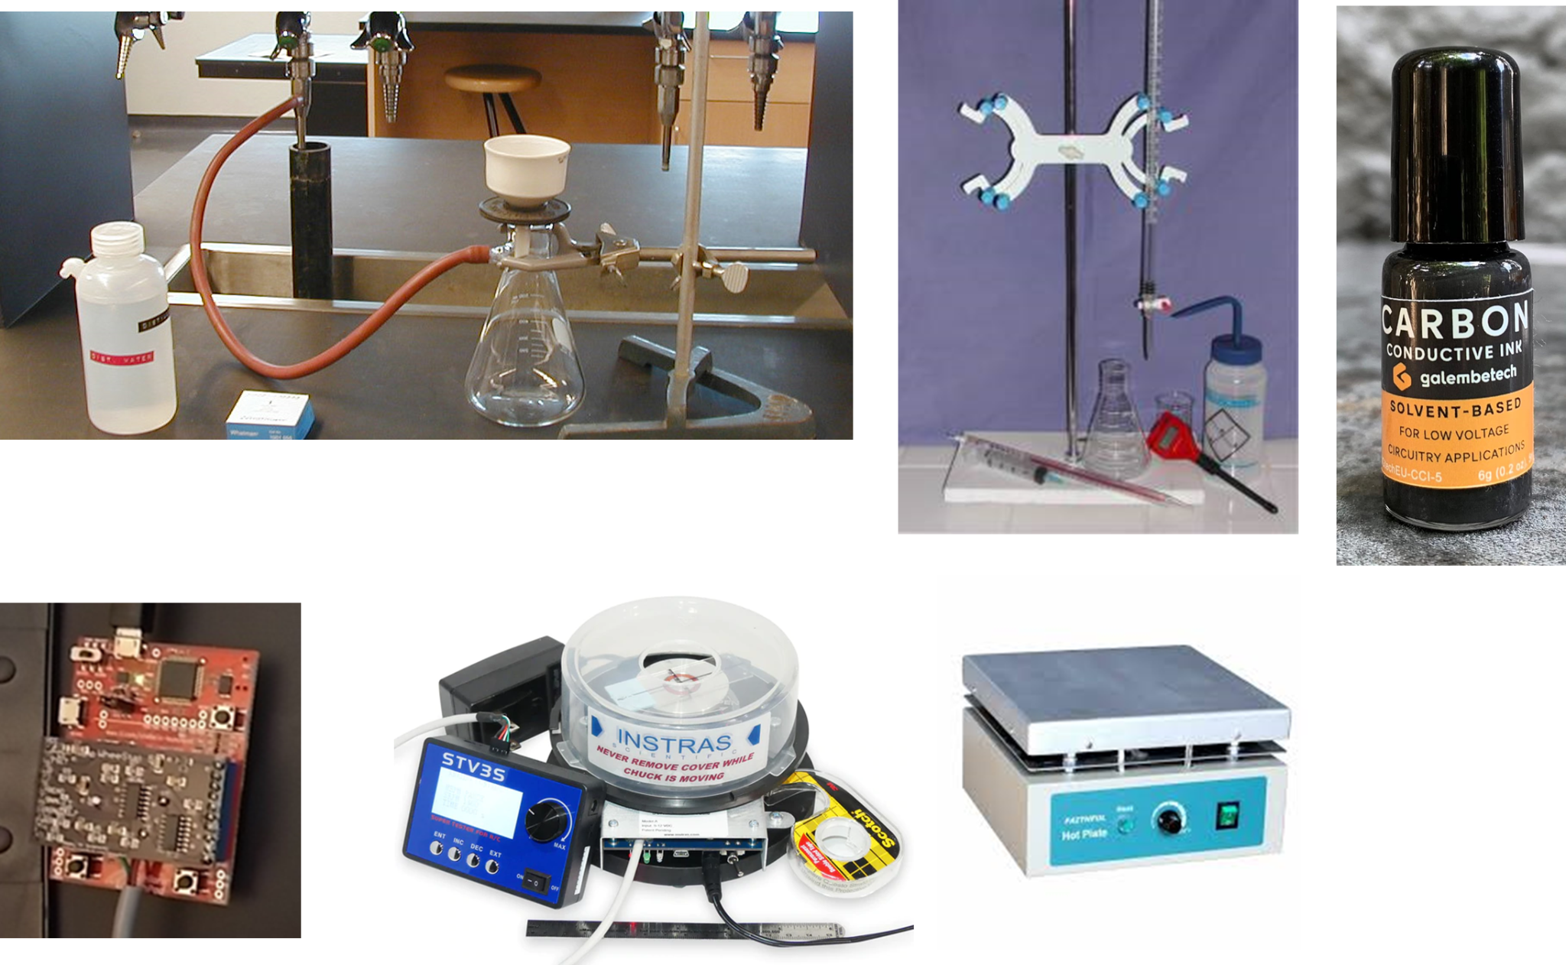
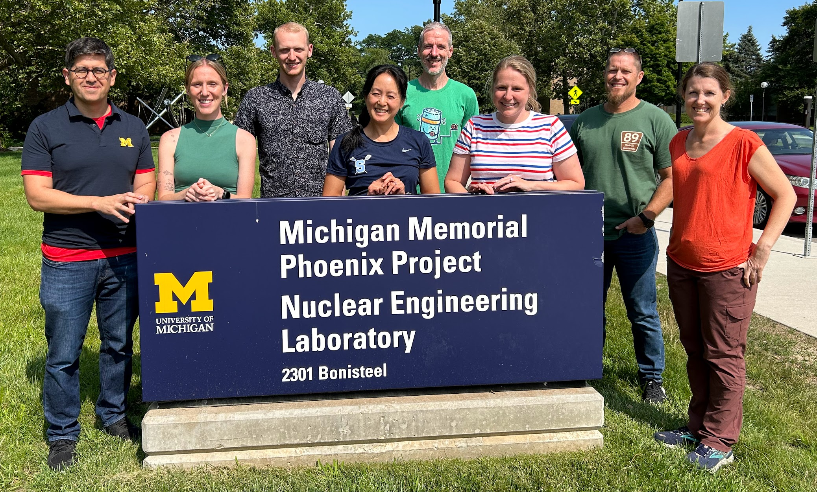
University of Michigan MRSEC DMR-2309029
2024 CMI Teacher’s Workshop on High School Curriculum on Thin Film Photovoltaics
Stephen Maldonado & Akesha Moore, University of Michigan
A short course for high school instructors with activities that can be taken back to their own classrooms was hosted by the CMI in July 2024. The intent was to share learning and instructional content based on the same materials and concepts actively being developed in cutting-edge research labs across the globe but with components accessible, usable, and understandable at the high school level.
The short course this year focused on three objectives. First, the participating high school instructors were trained on how to synthesize (from scratch) organometallic perovskite films and the associated materials necessary for thin film photovoltaics. Second, the teachers were taught how to assemble those materials into a working device that can be measured and evaluated. The teachers were then able to assess the performance of their devices. Third, the teachers were able to revisit each day’s activity and discuss how it could be performed by their students.
Device Structure
Fabrication Steps
Equipment Used
The Cohort

