Slide 1
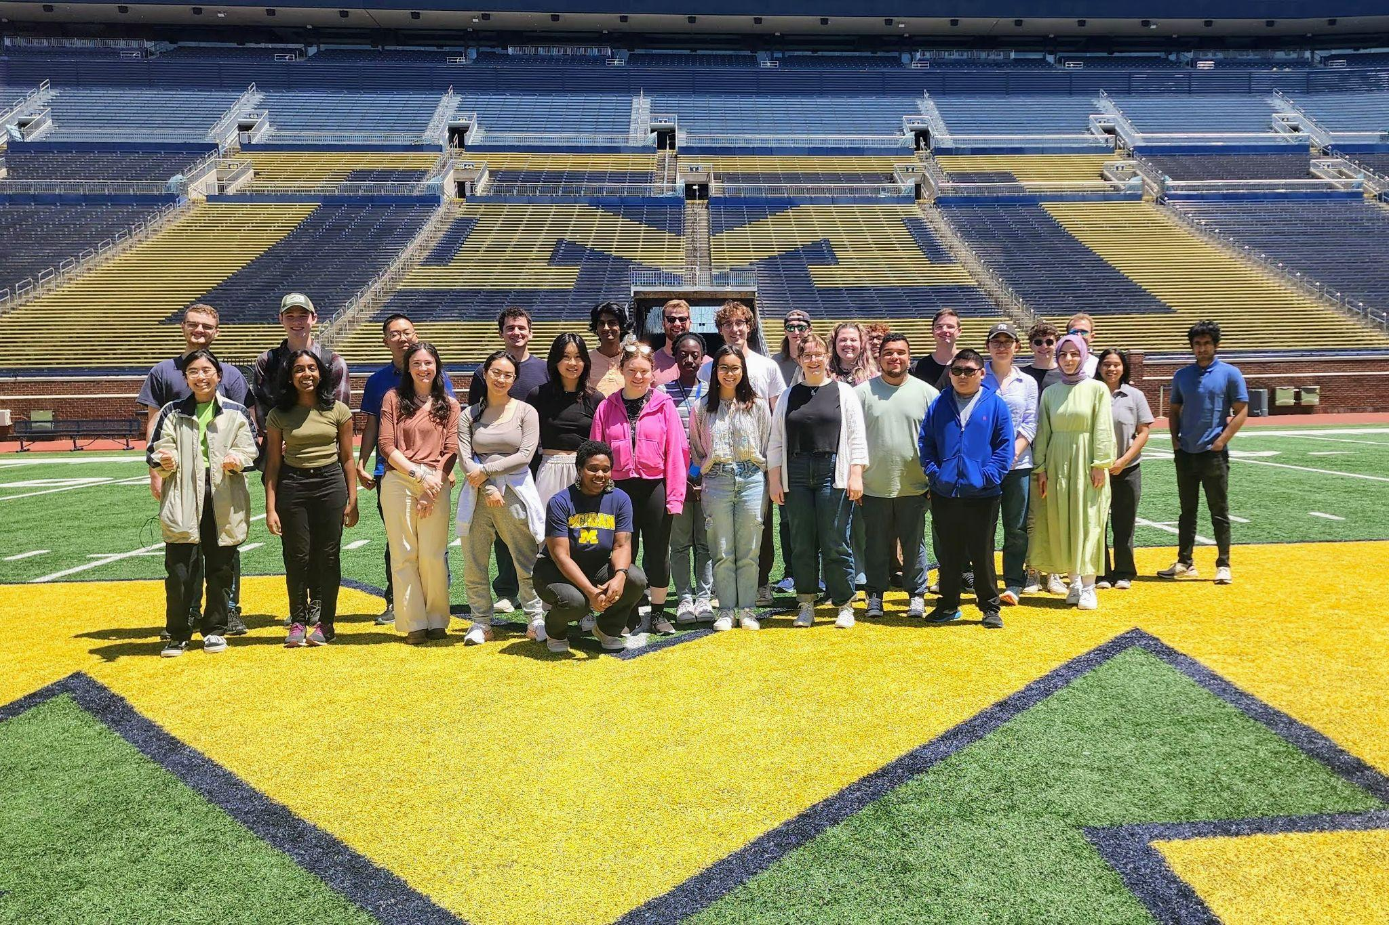
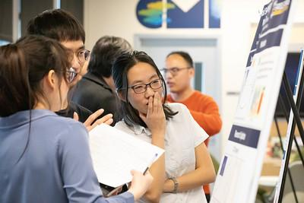
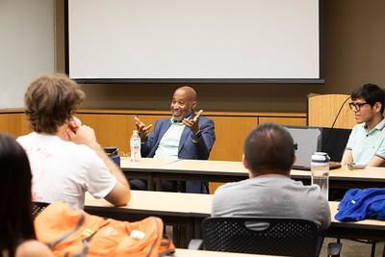
University of Michigan MRSEC
DMR-2309029
Developing STEM Researchers within and beyond the MRSEC
The Center for Materials Innovation (CMI) is committed to enhancing diversity and improving educational opportunities across STEM fields that comprise materials research at UM and beyond. CMI programs include professional development components to enhance student experiences and prepare them for transitions through academia, industry, and government. These activities include tours of special campus spaces and labs, panels of current UM graduate students, speakers from beyond the University, and opportunities for students at all levels to showcase their research.
In addition to supporting the development of 22 graduate students throughout the year, CMI-MRSEC is hosting 10 REU (undergraduates) and 9 REY (high school students) during summer 2024. Our summer programming has included 4 other summer undergraduate research programs (including 3 NSF-REU/REM programs), with more than 20 undergraduate students, as well as graduate students and faculty from across UM.
Stephen Maldonado & Akesha Moore, University of Michigan
Notes:
Top Left: 2024 CMI-REU Cohort, along with other UM REU cohorts, tour the Michigan Stadium.
Bottom Left: Dr. Peter F. Green, Deputy Laboratory Director for Science and Technology at NREL, speaks to participants about clean energy advancements, career opportunities, and science outreach.
Top Right: CMI graduate students discuss poster during MRSEC Kick-Off Poster Session.
Bottom Right: Panel of graduate students share their experience matriculating into and through graduate school and answered questions from undergraduates

