Slide 1
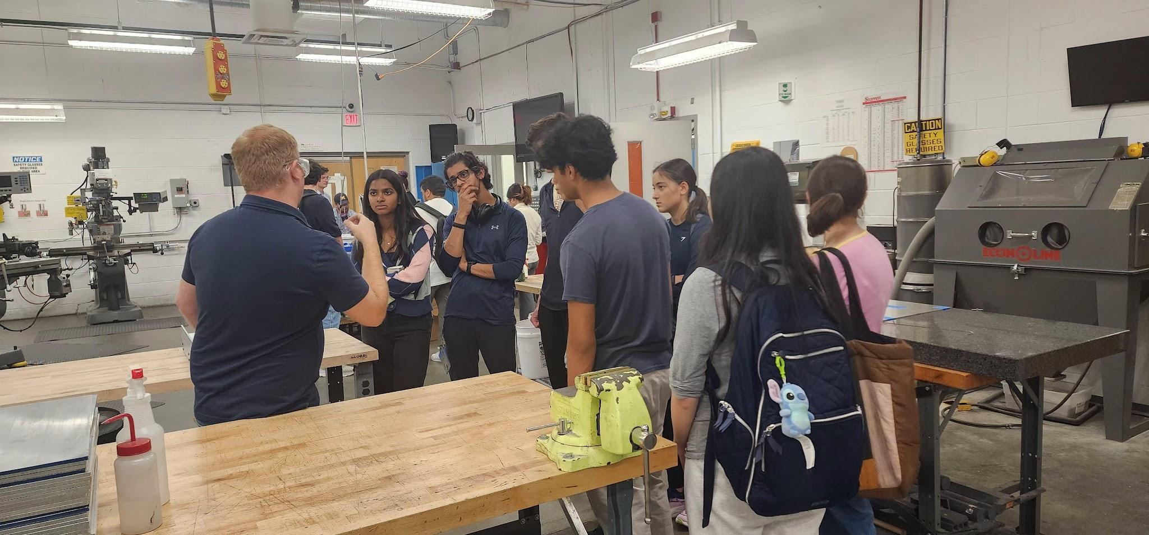
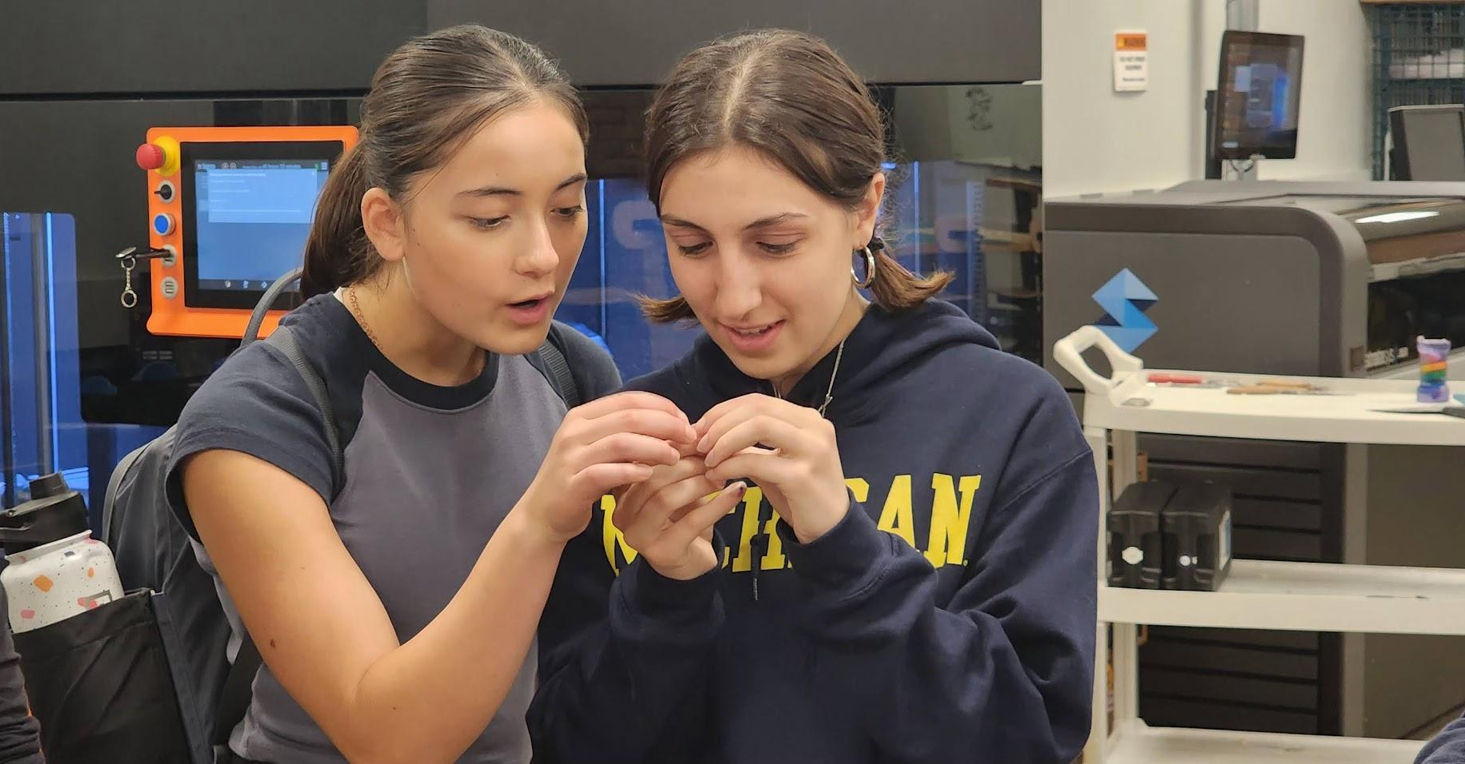
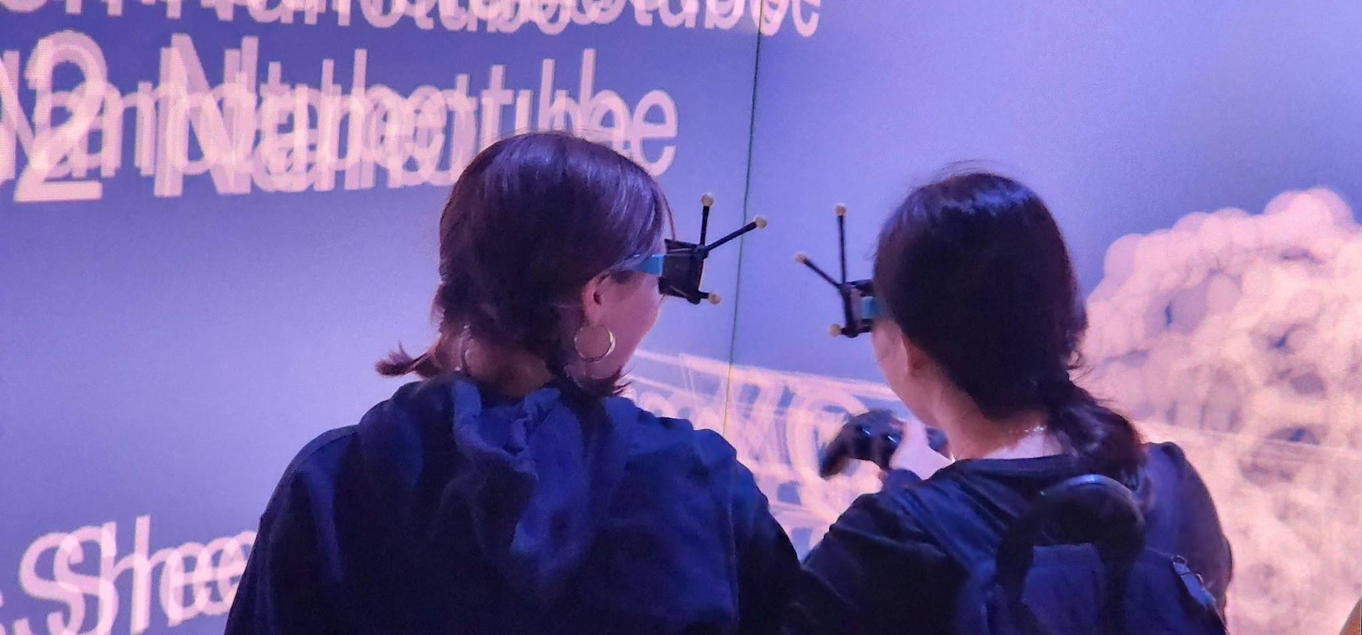
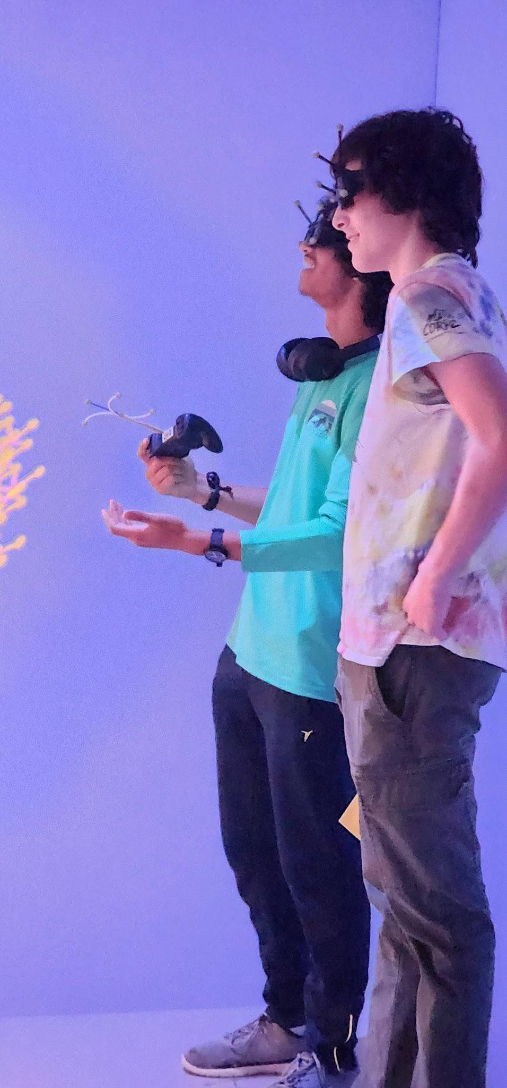
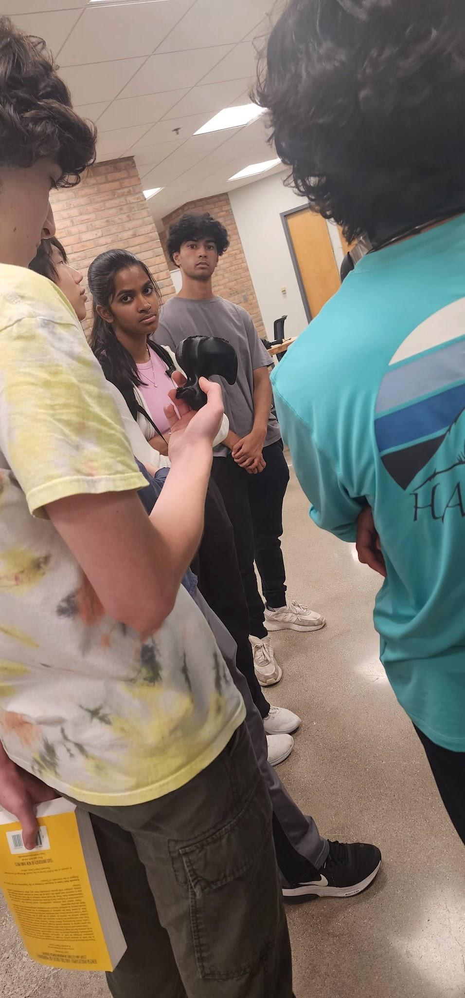
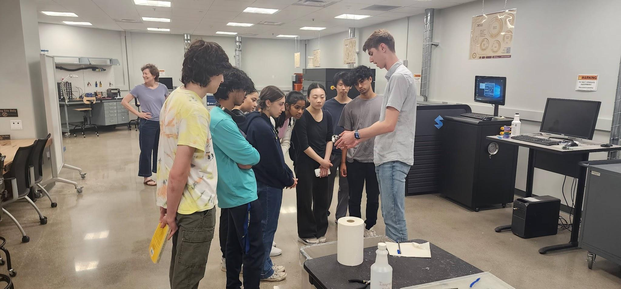

University of Michigan MRSEC DMR-2309029
High School Research Interns Exploring UM’s CoE
The CMI-MRSEC hosted 9 high school students in labs for 7 weeks during their Research Experiences for Youth (REY) program. The REY participants explored UM’s college of engineering campus through visits of the following spaces
Van Vlack Lab - classroom for MSE labs and computational courses, a collaborative space for student projects, and a site to conduct demonstrations for MSE courses.
ME Undergraduate Machine Shop - spaces used by UM undergrads for precision measurements, cutting and drilling, milling machine and lathe
Duderstadt Center - UM’s state-of-the-art multimedia facility providing access to Groundworks Media Lab, Design Labs, Audio Studios, Video Studio, Personal Studio, Fabrication Underground, Multimedia Rooms, Visualization Studio, and the Gallery
Wilson Student Project Center - facility in which students experience hands-on development and fabrication, enhance engineering theories, and use practical application of knowledge.
Stephen Maldonado & Akesha Moore, University of Michigan
Notes:
Top Left: REY students getting an overview of the ME Undergraduate Machine Shop
Mid Left: REY students exploring the Visualization Studio’s augmented/virtual reality cave.
Bottom Left: REY students touring the Fabrication Studio
Top Right: REY students looking at small object designed in the Fabrication Studio
Bottom Right: REY students exploring the Visualization Studio’s augmented/virtual reality cave.
Bottom Right: REY students looking at and passing around a 3D printed duck

