Slide 1
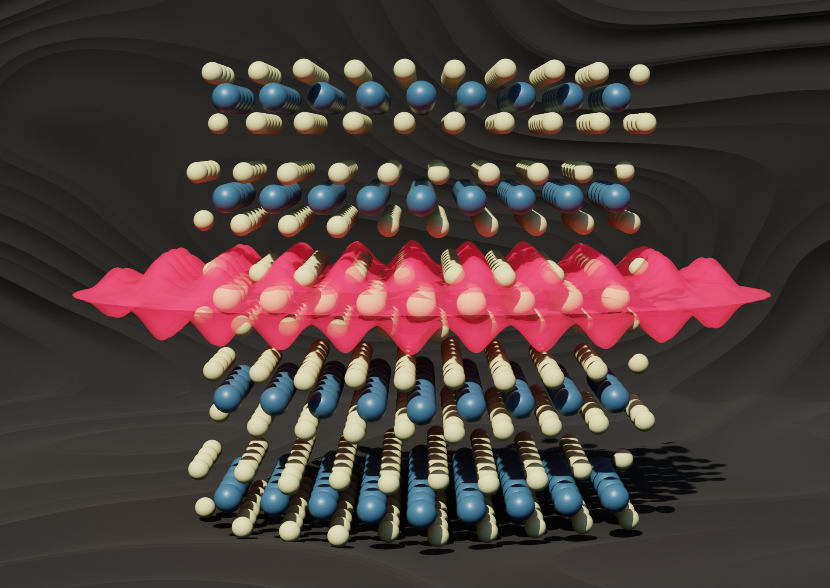
(U. Michigan) MRSEC
DMR-2309029
Endotaxial stabilization of 2D charge density waves with long-range order (doi.org/10.1038/s41467-024-45711-3)
Suk Hyun Sung, et al. John T. Heron, Kai Sun, Robert Hovden
Rather than the typical approach of exfoliating and peeling off individual atomic layers to make a 2D material, the researchers grew the 2D material inside of another matrix. The work has dubbed this new class of materials "endotaxial" from the Greek roots "endo", meaning within, and "taxis", meaning in an ordered manner. Moreover, the electrons of the sandwiched 2D TaS2 crystal layer spontaneously clumped together to form their own 2D crystal, known a charge density wave—a repeating pattern in the distribution of electrons in a solid material.
More specifically, an ordered charge density wave (CDW) was stabilized in two-dimensions that resulted in dramatically enhancement and an increased material resistivity. By enhancing CDW order, it became possible to heat and melt the charge density waves. In-situ TEM, allowed observation of CDW melting through a continuous and reversible process. From these results, new regimes of CDW phases are derived and consistent with predicted emergences of quantum order.
Nature Communications, 15, Article number: 1403 (2024)
Notes:
What Has Been Achieved:
Rather than the typical approach of exfoliating and peeling off individual atomic layers to make a 2D material, the researchers grew the 2D material inside of another matrix. The work has dubbed this new class of materials "endotaxial" from the Greek roots "endo", meaning within, and "taxis", meaning in an ordered manner. Moreover, the electrons of the sandwiched 2D TaS2 crystal layer spontaneously clumped together to form their own 2D crystal, known a charge density wave—a repeating pattern in the distribution of electrons in a solid material. More specifically, an ordered incommensurate charge density wave (oIC-CDW) was realized in 2D with dramatically enhanced amplitude and resistivity. By enhancing CDW order, the hexatic nature of charge density waves becomes observable. Upon heating via in-situ TEM, the CDW continuously melts in a reversible hexatic process wherein topological defects form in the charge density wave.
Importance of the Achievement:
From these results, new regimes of the CDW phase diagram for 1T-TaS₂ are derived and consistent with the predicted emergence of vestigial quantum order. This exotic quantum phenomena could prove useful as a transistor in either classical or quantum computing, acting as a gate to control voltage flow.
How is the achievement related to the IRG, and how does it help it achieve its goals? The work has demonstrated a novel quantum state in this new class of "endotaxial" materials.
Where the findings are published:
Endotaxial stabilization of 2D charge density waves with long-range order (doi.org/10.1038/s41467-024-45711-3)
Nature Communications, 15, Article number: 1403 (2024)

