Slide 1
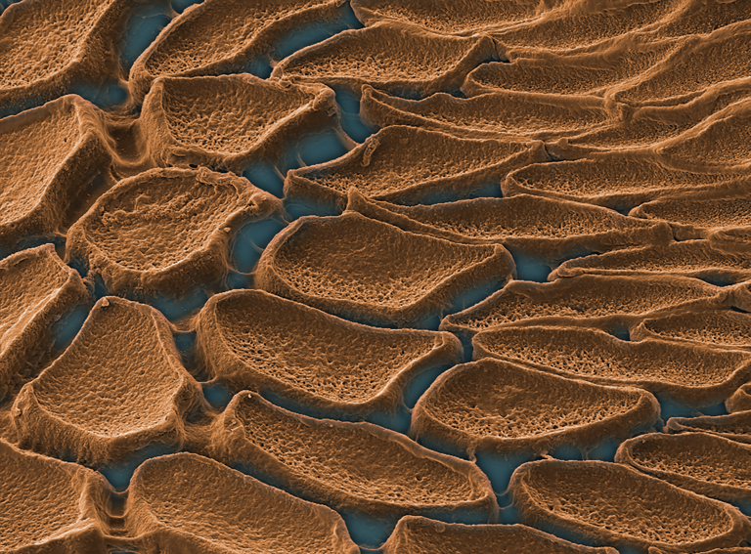
University of Michigan MRSEC
DMR-2309029
Thermomechanical Properties of Squid Sucker Proteins
Margot Helft et al., Abdon Pena-Francesch
Materials Science & Engineering, University of Michigan
Squids have teethed structures inside their suckers that they use to latch on their prey. These teeth are made of structural proteins that form a reversibly crosslinked network with outstanding mechanical properties.
In Helft, et al., Integrative and Comparative Biology (2024), the team investigated changes in nano/microstructure and mechanical properties with temperature, revealing a reversible softening due to a glass transition at mild temperatures (35 °C). This thermomechanical transition relies in dense hydrogen-bonding interactions that stabilize the protein network, and provide mechanical and self-healing properties that surpass many synthetic polymers.
Understanding the structure-property relationships that govern this biological material will guide the molecular design of dynamic polymer networks in IRG2 with reversible thermomechanical properties and crosslinking mechanisms.
This project has been co-authored by 2 undergraduate students and 2 PhD students in MSE, MACRO, and Biophysics at UM.
Integrative and Comparative Biology (2024): icae005
Squid sucker tissue produces structural proteins that form predatory teeth structures with high modulus and strength.
Alt-text: Electron microscopy image of sucker cells (cells colored in brown).
Notes:
What Has Been Achieved: This article studies the reversible structure and mechanical properties of a biological dynamic polymer network. This biological material based on structural protein polymers has a glass transition at 35 °C, causing a reversible thermomechanical transition and a change in modulus spanning several orders of magnitudes.
Importance of the Achievement: The properties exhibited by this protein biopolymer (reversible thermomechanical transition at low temperatures) are desirable for the recycling, reshaping, and repair of dynamic materials. This work draws structure-property relationships across length scales (nano, micro, macro) as a function of temperature to understand the underlying structural processes in the polymer network. Furthermore, this project has involved 2 undergraduate students (including first author) and 2 PhD students that have been trained in microscopy, mechanical characterization, and spectroscopy applied to biopolymers.
How is the achievement related to the IRG, and how does it help it achieve its goals? IRG2 has the main objective of designing synthetic covalent adaptable polymer networks (CANs) with tunable structure and properties to enable recycling and repairing of polymers. While many synthetic CANs have high transition temperatures and slow processes, the biological dynamic polymer studied here has very fast thermomechanical transitions at mild temperatures (much more energy efficient). These findings will inspire the design of synthetic CAN networks leveraging fundamental structure-property relationships uncovered here.
Where the findings are published: Helft, Margot, et al. "Thermomechanical and Morphological Properties of Loligo vulgaris Squid Sucker Ring Teeth." Integrative and Comparative Biology (2024): icae005. https://doi.org/10.1093/icb/icae005

