Slide 1
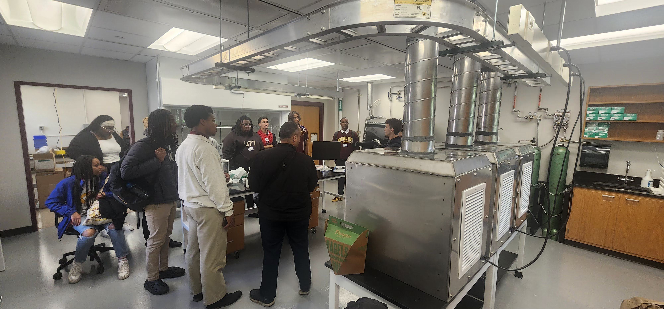
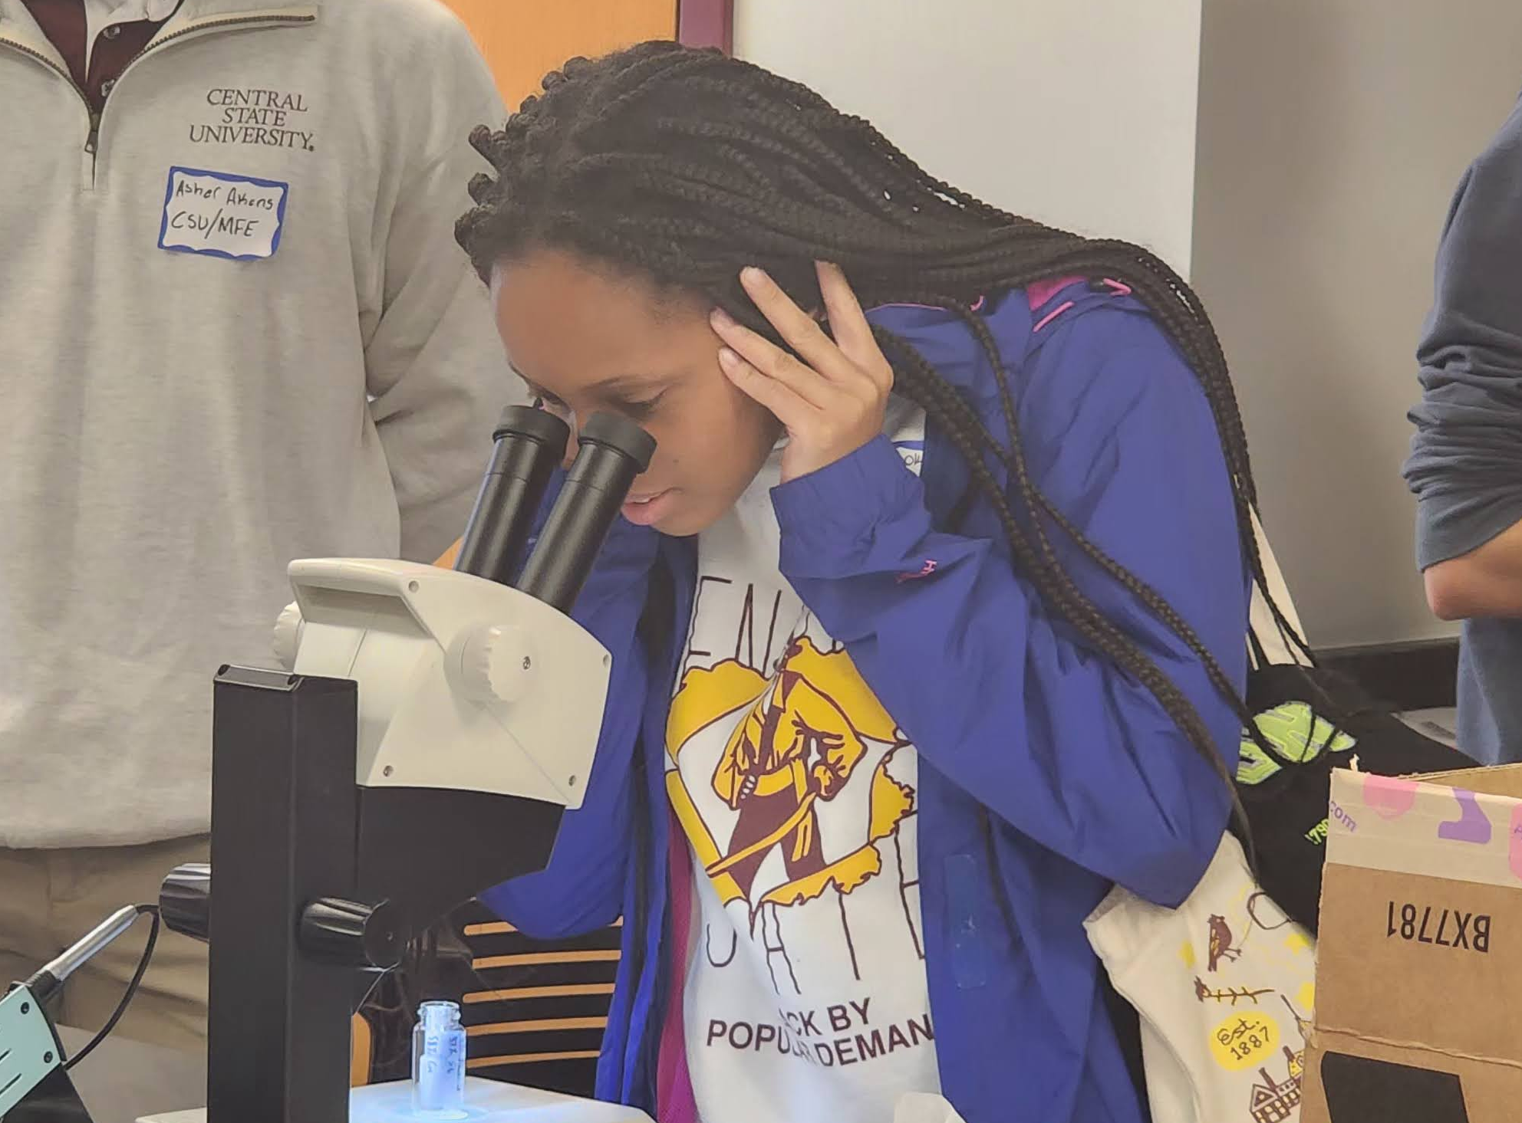
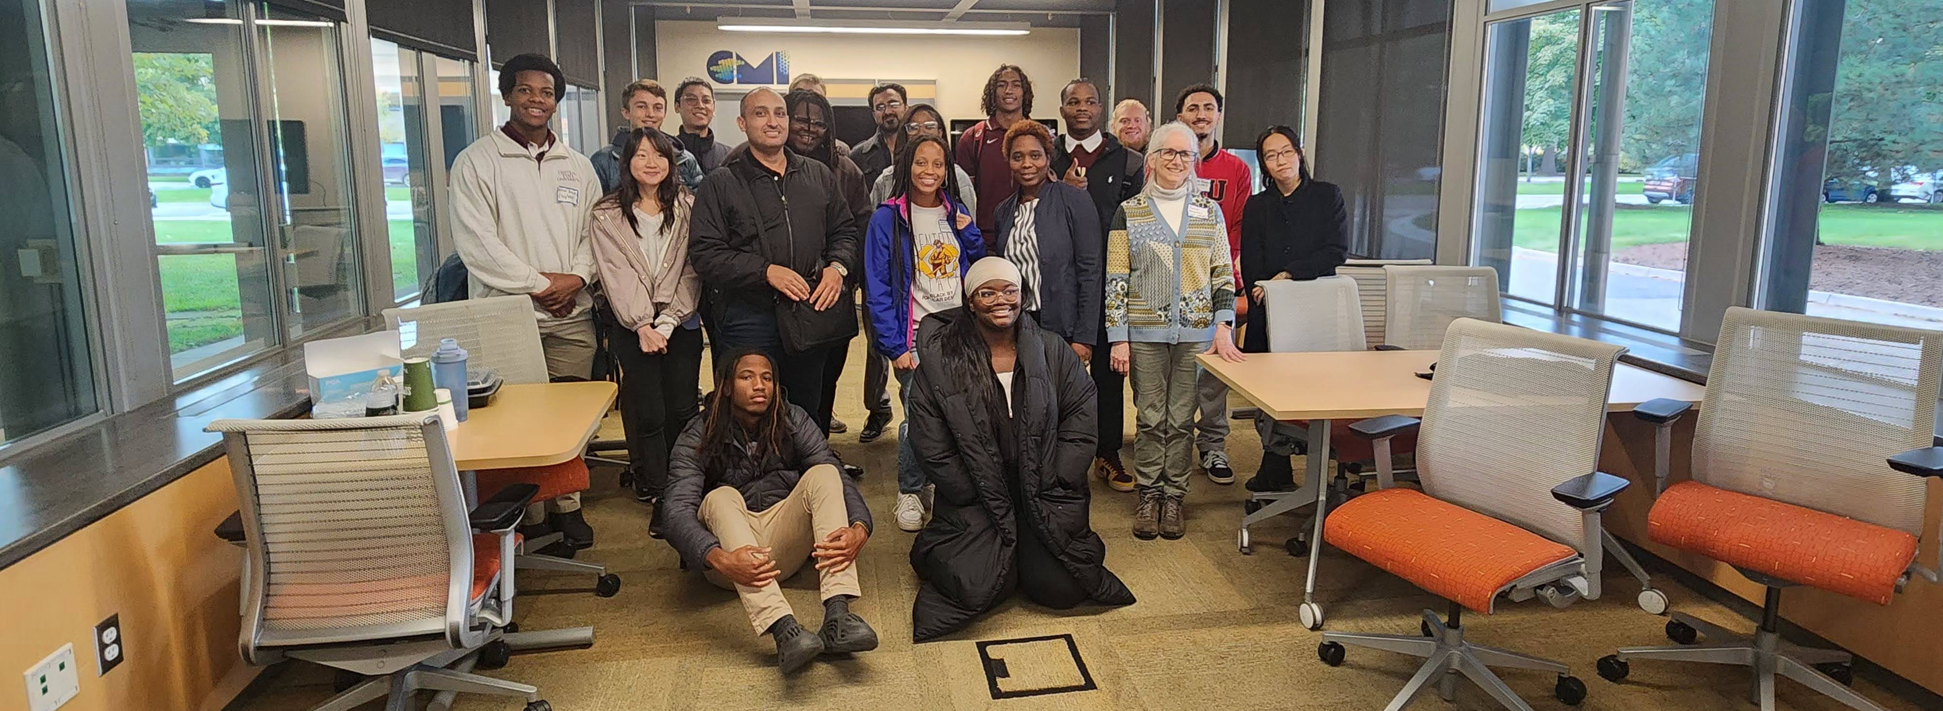

University of Michigan MRSEC DMR-2309029
UM CMI – Central State University (CSU) Partnership
Rachel S. Goldman, University of Michigan
We expanded our formal interactions with faculty and students at Central State University (CSU), the only public HBCU in Ohio.
Following several Zoom meetings with Profs. Mohammadreza Hadizadeh (Physics), Saleh Alemstri (Manufacturing Engineering), and Mubbashar Khan (Electronic Engineering Technology), we hosted a student student cohort visit during Fall Break 2024. During the Summer of 2025, we will be hosting 4 CSU undergraduate students in our REU program.
Since CSU is a primarily undergraduate institution, the partnership with the UM CMI-MRSEC gives CSU students insight on the graduate school experience and access to advanced research topics.
Figure 1. Photos from CSU visit to UM CMI on October 15, 2024.
Notes:
What Has Been Achieved: Prof. Khan led a cohort of 10 engineering undergraduate students for a day and a half trip to Ann Arbor. These students met with CMI faculty for an introductory meal and then partnered with CMI graduate students to visit the CMI labs and to tour CMI-relevant instrumentation and user facilities. An evening discussion session was held along with dinner. The CSU visitors stayed the night on campus and then returned to Ohio the next morning. The trip was possible due to the proximity of the CSU campus in southwestern Ohio, approximately 3 hr from Ann Arbor, MI by car. Still, despite the proximity, there have been no prior CSU students in STEM graduate programs at UM. Importance of the Achievement: The result from the visit was the establishment of a formal partnership where CSU would support the summer research of CSU undergraduates at UM as part of the CMI REU program. This interaction serves multiple purposes. Primarily, this agreement gives participating CSU students an opportunity to build relationships at UM to help prepare future applications to graduate programs. Additionally, these research projects can help seed future UM-CSU collaborative grant applications.
How is the achievement related to the IRG, and how does it help it achieve its goals? The CSU undergraduates will perform research in labs in both IRGs.
Where the findings are published: N/A

