Slide 1
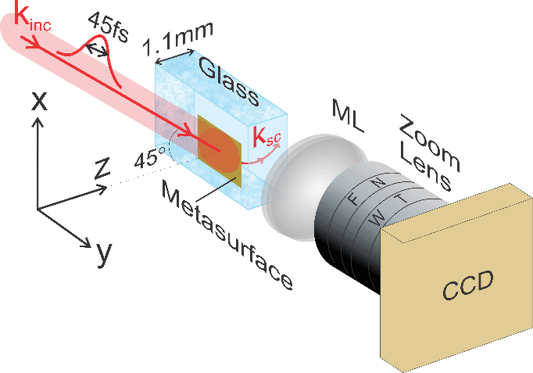
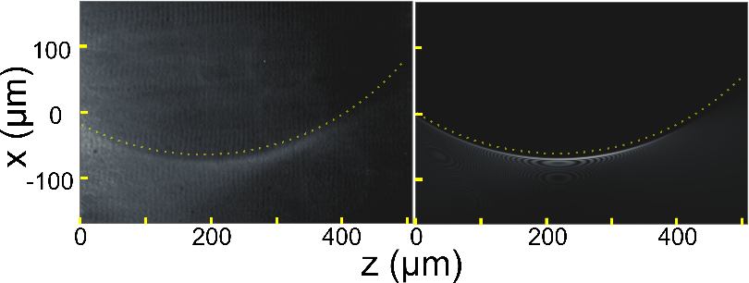
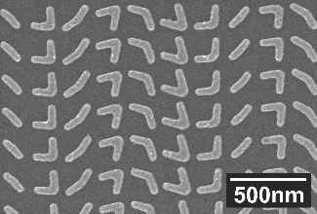
Metasurface Generation of Accelerating Light
M. Henstridge¹, C. Pfeiffer², D. Wang³, A. Boltasseva³, V. Shalaev³, A. Grbic², and R. Merlin¹
¹Department of Physics, University of Michigan
²Department of Electrical Engineering and Computer Science, University of Michigan
³School of Electrical and Computer Engineering and Birck Nanotechnology Center, Purdue University
Experimental (left) and theoretical (right) accelerating beams generated by our metasurface. The radius of curvature is 400 µm.
Artificially designed planar devices known as metasurfaces can control the output of an incident beam to generate prechosen patterns. We designed and fabricated a metasurface that accelerates light along a partial circular trajectory and imaged the resulting beam. This compact, flat-optic approach allows for simple integration of accelerating light into photonic devices, thus opening new opportunities for the advanced manipulation of light.
The metasurface, consisting of plasmonic nanoantennas shown in the inset, was fabricated onto a glass substrate and illuminated by ultrafast laser pulses. The trajectory of the accelerating beam was imaged using a standard setup consisting of two lenses and a CCD.
Sponsored by NSF-MRSEC
through contract DMR-1120923
Notes:
We demonstrate the generation of accelerating optical laser pulses inside a glass substrate patterned with a metasurface consisting of v-shaped plasmonic nanoantennas. Tuning the nanoantenna’s geometry allows for phase coverage from 0 and 360 degrees, thus allowing for complete control of the cross-polarized scattered field. The metasurface was designed to generate a half-Bessel beam that accelerates along a portion of a circular trajectory inside the glass when illuminated with a Gaussian beam of wavelength 800 nm at an incident angle of 45 degrees. The nanoantennas were fabricated with standard electron-beam lithography on ITO-coated glass, followed by electron-beam evaporation of 3 nm Ti / 30 nm Au and lift-off processes. To facilitate the imaging of the accelerating beam from inside the glass, one of the edges of the ITO-coated glass slide was polished down to optical quality prior to fabrication, and the leading edge of the metasurface was fabricated within 1mm from the polished edge of the slide. The beams were imaged by collecting Rayleigh-scattered light from defects inside the glass. The imaged beam trajectories agree very well with those predicted by theory.

