Slide 1
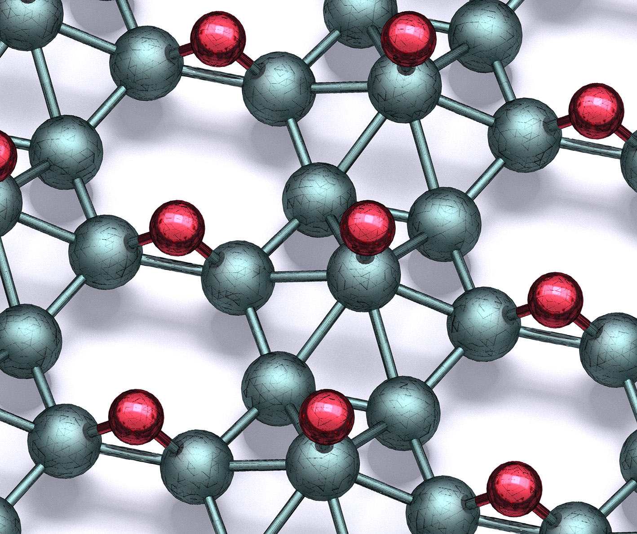
Synthesis of Borophane Polymorphs through Hydrogenation of Borophene
DMR-1720139
2021
IRG-1, Northwestern University MRSEC
Polymorphs of two-dimensional boron, or borophene, have attracted significant attention because of their diverse superlattice structures and correlated electron properties. However, ordered chemical modification of borophene has not previously been reported. In a 3 PI collaboration within NU-MRSEC IRG-1, “borophane” polymorphs have been synthesized by hydrogenating borophene with atomic hydrogen in ultrahigh vacuum. Borophane polymorphs are metallic and can be reversibly returned to pristine borophene through thermal desorption of hydrogen. Hydrogenation also provides chemical passivation as borophane is shown to be resistant to oxidation for multiple days following ambient exposure, thus enabling full exploration of its potential for nanoelectronics, energy storage, sensors, and quantum information technology.
Science, 371, 1143-1148 (2021).
Through ultrahigh vacuum scanning tunneling microscopy, scanning tunneling spectroscopy, inelastic electron tunneling spectroscopy, and density functional theory calculations, the atomic structure of borophane has been identified.
Notes:
For more information, please see the following publication (NU-MRSEC IRG-1 PIs in bold): Q. Li, V. S. C. Kolluru, M. S. Rahn, E. Schwenker, S. Li, R. G. Hennig, P. Darancet, M. K. Y. Chan, and M. C. Hersam, “Synthesis of borophane polymorphs through hydrogenation of borophene,” Science, 371, 1143-1148 (2021).

