Slide 1
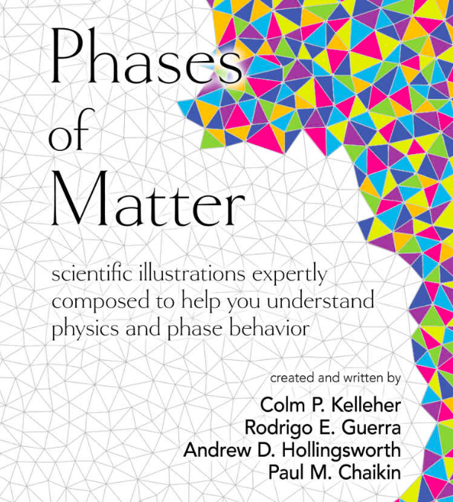
Phases of Matter – Adult Coloring Book
NYU MRSEC 1420073
2017-2018
New York University
MRSEC investigators team-up to create an adult coloring book. The coloring book, “Phases of Matter”, designed to help the general pubic understand physics and phase behavior.
Interested to learn what are Colloids? Phases? Grain boundaries?
Designed to reduce stress, sharpen your concentration and nourish creativity. Phase of Matter is a set of twenty-seven distinctive stress-relieving patterns of phases of matter portraying the beauty of physics.
NYU-MRSEC distributes to visiting high school teachers, faculty and the general public to help create dialogue about physics and materials science.
Kellerher, C.P. (2017) Phases of Matter
New York, NY, Green Frog Publishing

