Slide 1
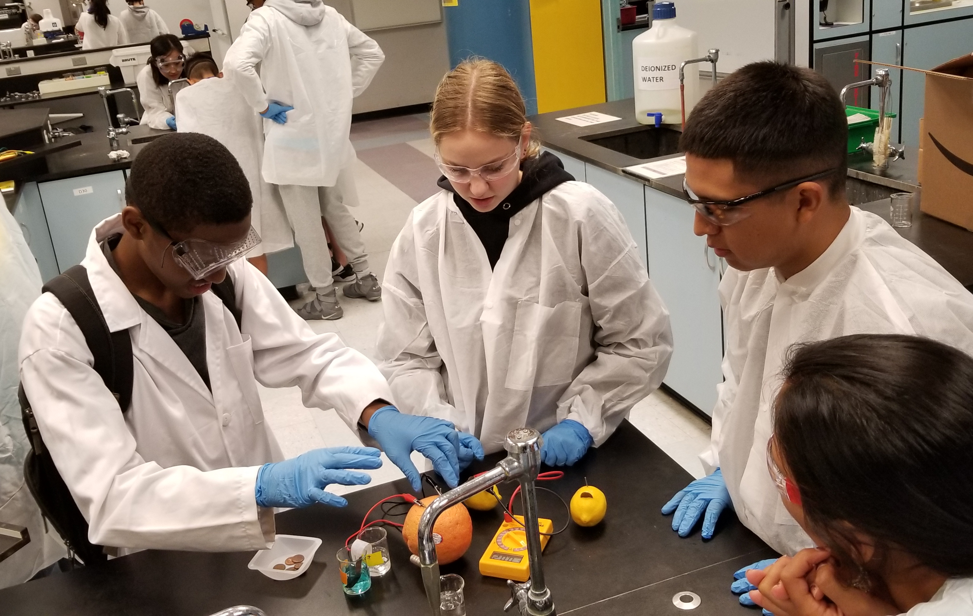
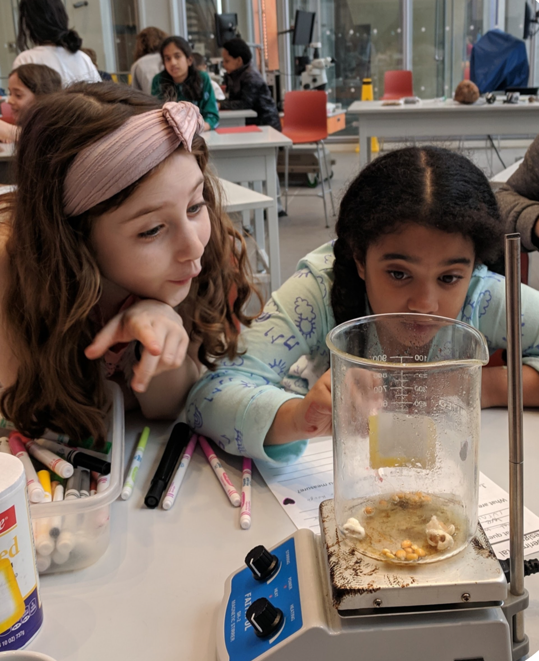
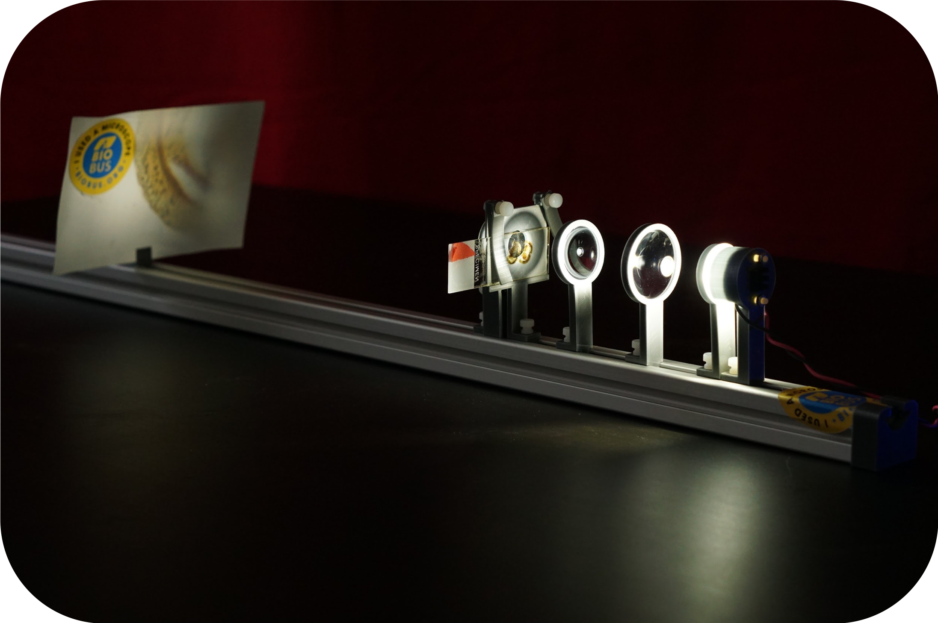
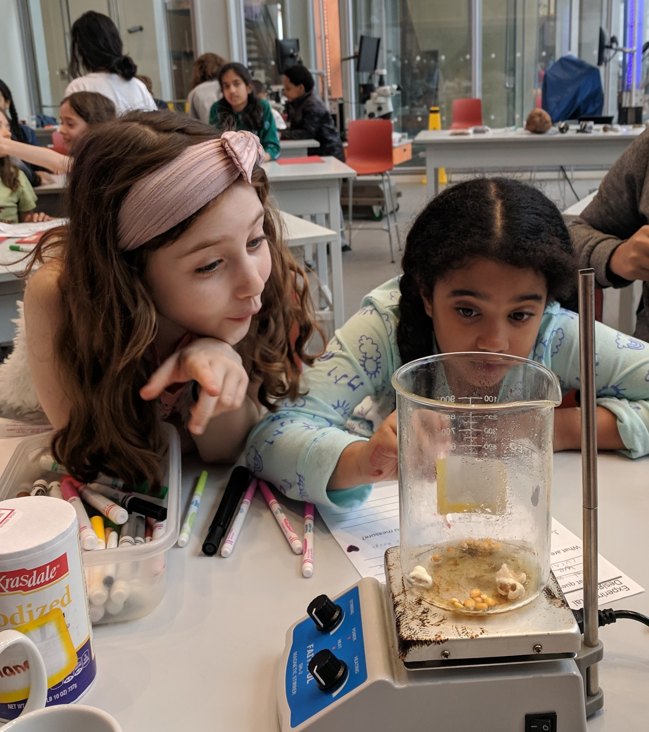
NYU-MRSEC & BioBus Collaboration
NYU MRSEC 1420073
2019-2020
Scientific Frontiers Program, New York University & BioBus
NYU-MRSEC investigators have worked alongside BioBus scientists to develop new K-12 materials science-related curricula since 2009. This collaboration brought exciting and educational engineering projects to over 1,000 NYC students in 2019-2020.
“Food science”, a food-based materials science curriculum developed in collaboration with MRSEC investigators in 2017 is now a lesson offered aboard the BioBus mobile labs. BioBus also expanded this lesson into a 5-sessions hands-on exploration of the physics, chemistry and biology of food. Impact: 713 K-12 participants (6th-8th, 12th)
NYU-MRSEC opened its doors to BioBus Middle School Summer Camp in August 2019. Students conducted experiments on electrochemistry, crystallization and holographic technology alongside MRSEC researchers. Impact: 12 K-12 participants (6th-8th)
The Center continues supporting the Do-It-Yourself Microscope Project to provide a platform in which students learn to build working microscopes from modular parts and use them to perform experiments on various systems. Impact: 534 K-12 participants (5th-9th)
(Top Left) Students learned about electrochemistry with MRSEC researchers during a week-long BioBus 2019 Middle School Summer Camp. (Bottom Left) A modular DIY microscope built from a BioBus-designed DIY optical kit. (Right) Sunday Science at BioBase Harlem. The MRSEC-funded program employed a food-based curriculum adapted from a MRSEC-BioBus collaboration.

