Slide 1
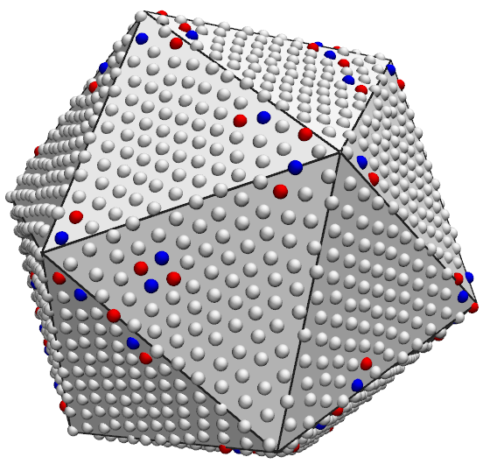
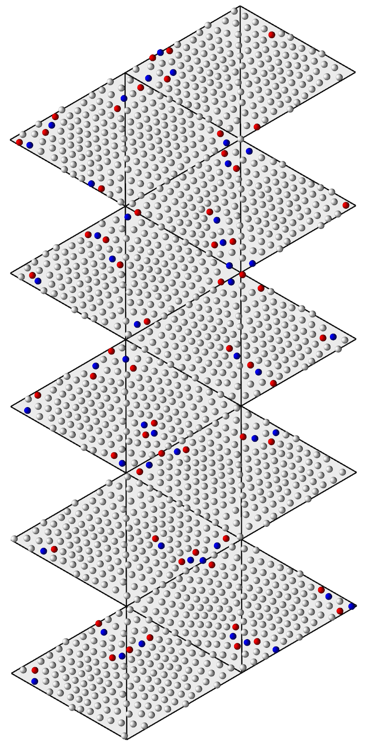
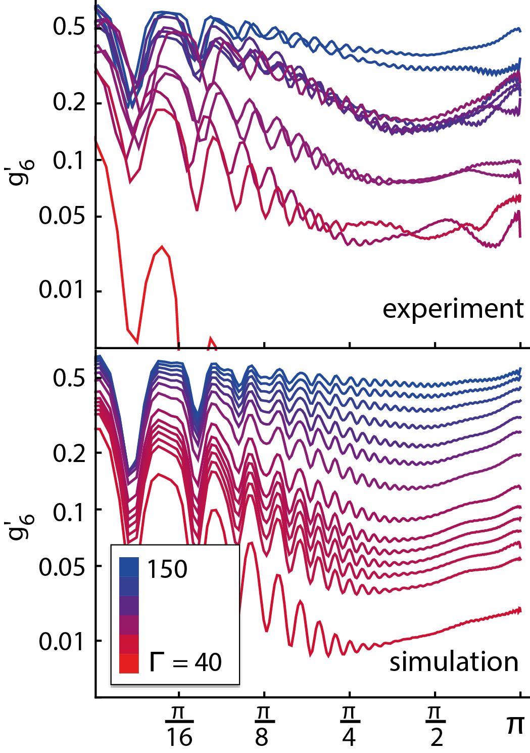
Freezing on a Sphere
NYU MRSEC 1420073
2017-2018
Andrew D. Hollingsworth & Paul M. Chaikin, New York University
A crystal is defined by the regular and periodic ordering of the atoms, molecules, or particles that compose them. If bent or strained, this order and regularity is disturbed, and defects appear that relieve some of the applied stress.
Moreover, when a crystal is assembled on a closed surface, like a sphere, disclinations – defects that drastically warp the orientation of the crystal – appear. The topology of the sphere (or of any closed surface) guarantees their existence, and their presence ruins the metrics of long-range order that define crystals.
However, because disclinations repel each other, they organize and break the rotational symmetry of the sphere. We have devised a way to use this broken symmetry to redefine these metrics, and thus redefine what it means to be a crystal on a sphere.

