Slide 1
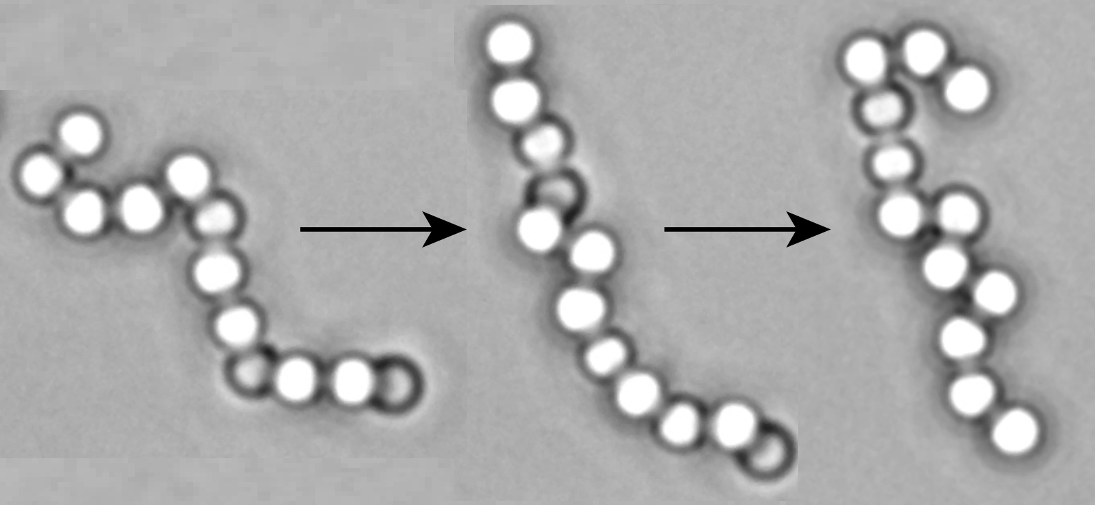
Freely-jointed polymers made of droplets
DMR-1420073
2018 -2019
Angus McMullen, Miranda Holmes-Cerfon, Francesco Sciortino, Alexander Y. Grosberg, and Jasna Brujic, New York University
A goal of colloidal self-assembly is to fabricate in bulk complex three-dimensional structures that current manufacturing methods cannot produce. One way to assemble such a material is to take a flexible polymer made of colloids and ‘fold’ it into a designed configuration, just like polypeptides fold into proteins. This requires a flexible colloidal polymer.
Here, we control the valence of DNA-functionalized emulsion droplets to make flexible colloidal polymers. We examine their conformational statistics to show that they are freely-jointed. We demonstrate that their end-to-end length scales with the number of bonds in agreement with 2D Flory theory, and that their diffusion follows the Zimm model. In future work, we will investigate the folding of these polymers, allowing us to both learn about protein folding and fabricate complex colloidal structures.
Figure. Three different configurations of a freely-jointed polymer made of micron-scale oil droplets. PDMS oil droplets self-assemble in bulk into these colloidal polymers through specifically designed DNA linkages. The polymers are flexible because of the fluid nature of the monomers.
Physical Review Letters, 2018, 121, 138002
Notes:
Very Important: New regulations require entering also “Alternative Text” for each image or other object to make them accessible to people with visual disabilities. Please see instructions on attached file for how to do that.

