Slide 1
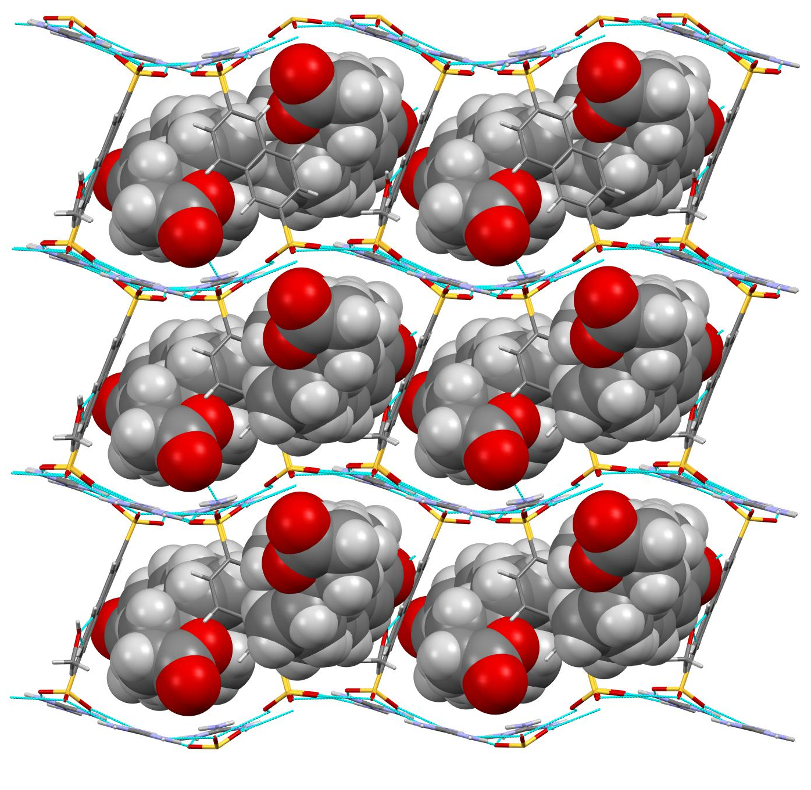
A hydrogen-bonded framework toolkit for molecular structure determination
NYU MRSEC 1420073
2019-2020
Y. Li, S. Tang, A. Yusov, J. Rose, A. Borrfors,
C. T. Hu, M. D. Ward
MRSEC investigators reported that a versatile toolkit of guanidinium organosulfonate (GS) hydrogen-bonded host frameworks can form inclusion compounds with complex “stubborn” molecules that cannot be crystallized or form suitable single crystals for X-ray diffraction analysis by themselves, enabling determination of their molecular structure.
Straightforward single-step crystallization, enabling rapid stoichiometric inclusion of a wide range of target molecules with full occupancy, affording well-refined structures. Moreover, anomalous scattering by the framework sulfur atoms enables reliable assignment of absolute configuration of stereogenic centers.
A new utility for hydrogen-bonded frameworks, using materials science to address a critical need of synthetic chemistry in academic and industrial laboratories, circumventing many of the limitations of the so-called crystalline sponge method that relies
drospirenone
Single crystal structure of drospirenone molecules trapped in a GS frameworks. Drospirenone is an active pharmaceutical ingredient used in birth control drugs.
Nature Communications, 2019, I, 4477.

