Slide 1
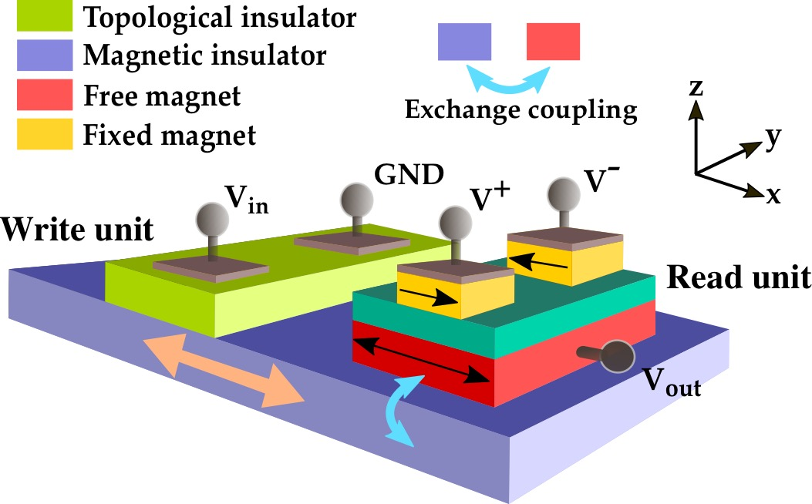
A Fully Voltage-Controlled Spin Logic Device
NYU MRSEC 1420073
2018-2019
An important goal in electronics is to reduce power use without sacrificing performance.
In spintronics this can be accomplished by increasing the rate of charge to spin conversion. We show that one of the most efficient means of converting charge to spin information uses a topological insulator and voltages instead of currents.
Rakheja, Flatté and Kent, New York University
Approach —
An insulating magnetic layer has an interface with a topological insulator.
This can open a gap in the topological insulator surface states, making the material insulating.
A voltage applied to the topological insulator exerts a large force on the magnet, reorienting its magnetization in less than a nanosecond.
We show that a full set of logic functions can be implemented with such an approach.
Our modeling shows energy per switch of ~20 atto-Joules and delay less than 500 ps → a 10x performance improvement compared to state-of-the-art spin devices.
This is a non-volatile spintronic logic device. In the “Write unit,” voltage, V_{in}, applied across the topological insulator (green layer) is converted into spin torque, which then reverses the magnetization of the magnetic insulator (purple layer). In the “Read unit,” magnetization information is read out as voltage V_{out} by providing appropriate voltage signals at the nodes V⁺/V⁻. Depending on the polarity (sign) of V⁺/V⁻, this logic device can “copy” or “invert” inputs.
Phys. Rev. Appl. 2019, 11, 054009
Notes:
(1) We developed a new type of non volatile spintronic logic device in which logic information is stored in the magnetization state of a magnetic insulator.
(2) The magnetization state can be manipulated or “written” by applying a spin torque to the magnet.
(3) The way we generate this spin torque is by integrating the magnetic insulator with a topological insulator layer, such as bismuth selenide, which has a large spin-orbit coupling.
(4) A voltage signal is applied across the topological insulator which is converted into spin torque, which then acts to modify the state of the magnetic insulator.
(5) During this writing process, only voltage signals or electric fields are used and there is no flow of charge current, which means that there is virtually no dissipation in the device.
(6) The magnetic insulator can create a gap in the surface states of the topological insulator to prevent charge leakage and therefore lead to very low dissipation.
(7) We also have a read unit to read the information stored in the magnetic insulator. We have a magnetic tunnel junction, the free layer of which is exchange coupled to the magnetic insulator.
(8) The voltage signals V+ and V- are applied on the read unit and the state of the magnetization vector is read as an output voltage “Vout”.
(9) Energy in this device is dissipated in charging and discharging the capacitance of the output node, which can come from loading the output or wires and other parasitics.
(10) Our physics-based modeling combined with equivalent circuit approach shows that the voltage-controlled topological spin switch can operate at 20 atto joules energy per bit with a delay under 500 ps. These performance metrics are significantly better than those obtained in contemporary spin-based devices such as all-spin logic, charge-spin logic and ideas being persued by Intel on magneto-electric spin-orbit logic.

