Slide 1
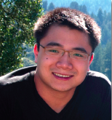
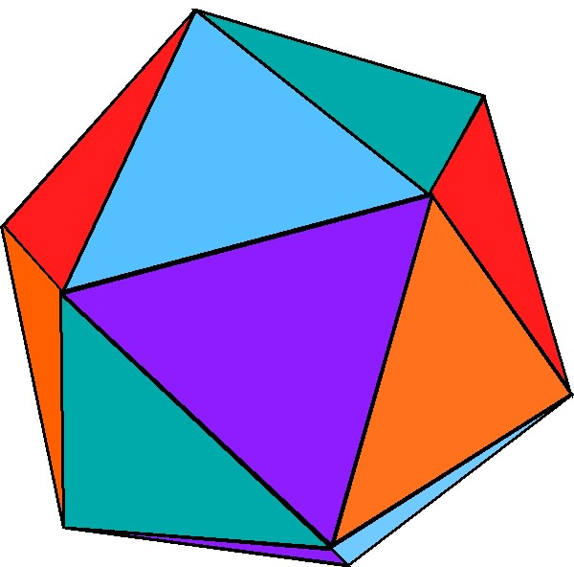
Impact Beyond the Classroom through Dissemination of Science Apps: NYU MRSEC 0820341
•“Lewis dots” smartphone app showcased at the New York Technology Meetup, a special University-themed roundup in November 2011
Interactive “hands on” approach to understanding chemistry
Modules that employ “Lewis Dots” in the classroom
• Selected by STERN Business School to participate in the NYU Innovation Venture Fellows Program to help develop a business plan/venture on educational apps
• Received NSF ICORPS grant
• Carlo Yuvienco, PhD student is the entrepreneurial lead, Andrew Cohen, CEO of Brainscape is the entrepreneurial mentor, Jin Montclare, PI
Developing a Technology Platform for Science Education
NEW YORK UNIVERSITY MRSEC

