Slide 1
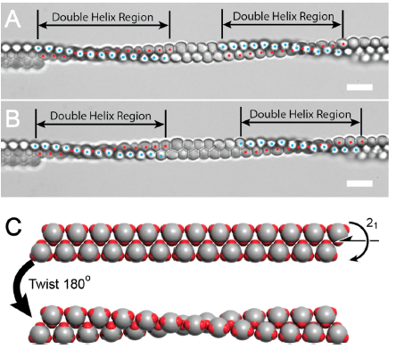
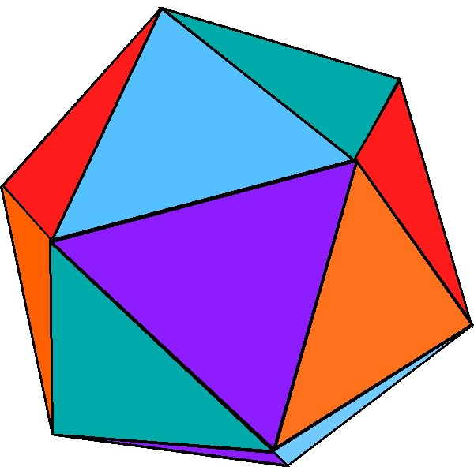
Patchy Particle Assembly with a Twist: NYU MRSEC 1420073
Colloidal particles equipped with two, three, or four negatively charged patches, which endow the particles with 2-fold, 3- fold, or tetrahedral symmetries, form 1D chains, 2D layers, and 3D packings when polarized by an AC electric field.
Two-patch particles, with 2-fold symmetry, pack into the cmm plane group and 3D packings with I4mm space group symmetry, in contrast to uncharged spherical or ellipsoidal colloids that typically crystallize into a face-centered ABC layer packing.
Three-patch particles with 3-fold symmetry form chains having 2₁ screw axis symmetry. These chains pair in a manner such that the pair has 2₁ screw axis symmetry, in an arrangement that aligns the patches that would favor Coulombic interactions along the chain.
Surprisingly, some chain pairs of three-patch particles form double-helix regions (see figure) that result from mutual twisting of the chains about each other, illustrating a kind of polymorphism that may be associated with nucleation from short chain pairs.
P. Song, Y. Wang, Y. Wang, A. D. Hollingsworth, M. Weck, D. J. Pine, M. D. Ward, J. Am. Chem. Soc. 2015, 137, 3069
NEW YORK UNIVERSITY MRSEC
Notes:
(A) Paired chains of three-patch particles containing two double helix regions formed at E = 250 V/cm and f = 100 kHz. The double helix regions in the two paired chains are denoted by red and blue dots. (B) The same paired chains after 35 s at E = 250 V/cm. © Model of a chain pair with 21 screw axis along the center of the double chain, with head-to-head packing across the screw axis (upper) and the twist structure of three-patch particles when forming a helix region with a pitch of 13 particles. Scale bars = 5 μm.

