Slide 1
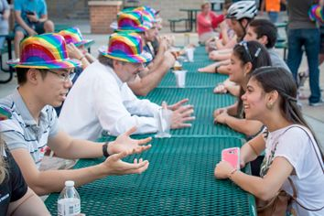
Science Night Live! : Bringing Science to the Public
Nebraska MRSEC
DMR 1420645
2017
Rebecca Lai and Jocelyn Bosley
University of Nebraska-Lincoln
Nebraska MRSEC sponsored and organized Science Night Live!, an evening outreach and public engagement event in Lincoln’s popular downtown Railyard district. This unique event brought together over 50 faculty and student researchers with 250 attendees of all ages, creating opportunities for Nebraska scientists to engage the general public with science in ways that challenged stereotypes about who scientists are, how science is done, and why basic research is valuable. Science Night Live! included hands-on science modules and interactive displays; “soapbox science” and “scientist speed-dating” activities in which attendees interacted directly with scientists; and on-stage performances. Through this popular first-time event, MRSEC has expanded the impact of its existing science communication programs, such as Science Slams, in a public forum. To learn more about Science Night Live!, see this interview with Jocelyn Bosley, MRSEC Assistant Director for Education and Outreach, on Lincoln’s Channel 8 Eyewitness News: https://www.youtube.com/watch?v=zZVT-2PSRU0.
Attendees converse with scientists from UNL and across the country during a “scientist speed-dating” activity at Science Night Live! in the Lincoln Railyard.

