Slide 1
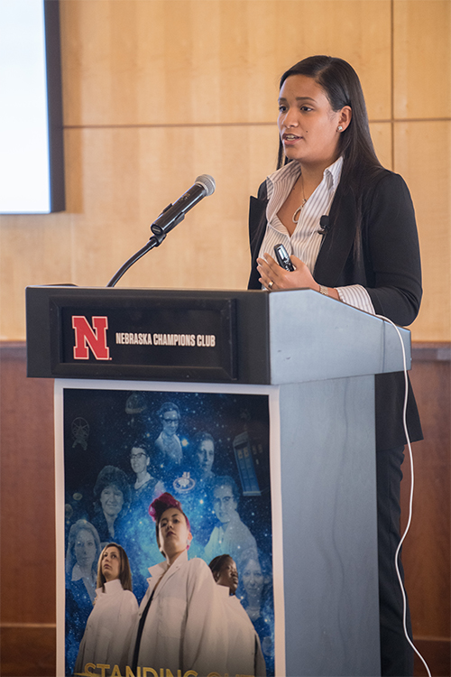
Tenth Annual Conference for Undergraduate Women in Physical Sciences (WoPhyS)
Nebraska MRSEC
DMR-1420645
2019
Rebecca Lai and Jocelyn Bosley, Univ. of Nebraska-Lincoln
At Nebraska MRSEC’s Conference for Undergraduate Women in Physical Sciences (WoPhyS), participants present research accomplishments, attend keynote talks, participate in graduate school preparation workshops, and tour UNL facilities and labs.
The tenth annual WoPhyS conference, held October 11-13, 2018, set a new attendance record, drawing 113 registered participants from across the United States, including 14 invited student speakers and 78 poster presentations. In addition, the conference hosted 11 keynote speakers from academia, industry, and national labs, including a special talk by WoPhyS founder Prof. Axel Enders.
The WoPhyS ‘18 conference theme, Standing Out on the Shoulders of Giants, celebrated the history of the conference and the larger history of women’s contributions to the physical sciences. A video commemorating the conference’s tenth year, with commentary from WoPhyS alumnae, can be found at https://youtu.be/7TiSEyaywmY.
University of Puerto Rico, Rio Piedras undergraduate Shyline Santana gives an invited talk at the 2018 WoPhyS conference.

