Slide 1
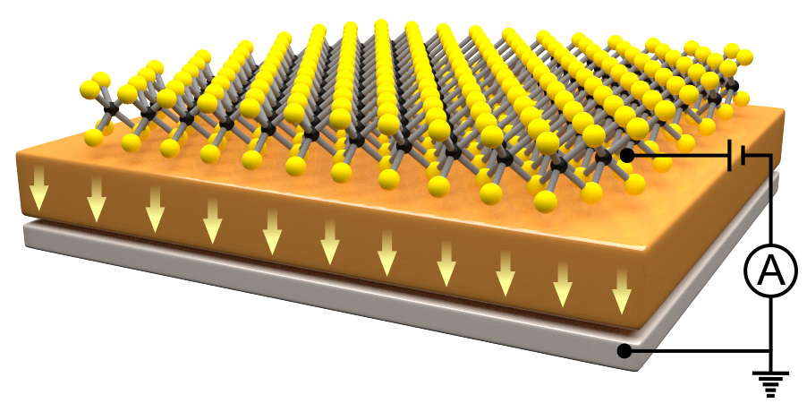
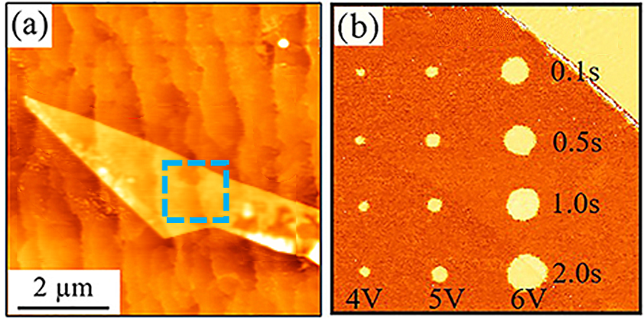
Hybrid 2D-Ferroelectric Structures for Information Technology
Nebraska MRSEC
DMR-1420645
2017
A. Gruverman, A. Sinitskii, and E. Y. Tsymbal , Univ. Nebraska-Lincoln, and C.-B. Eom, Univ. Wisconsin-Madison
Ferroelectric materials possess an electric polarization switchable by an applied electric field. This property is preserved down to the nanometer scale, opening avenues for novel applications in nanoelectronics. Nebraska MRSEC researchers have implemented hybrid electronic devices comprising two-dimensional (2D) materials and ferroelectric thin films of barium titanate (BaTiO₃) that exhibit polarization-controlled non-volatile modulation of the electronic properties. Using 2D transition metal dichalcogenides, such as MoS₂, the researchers showed that electrical switching of polarization in the hybrid MoS₂/BaTiO₃ structures leads to a drastic change in resistance, which remains stable in the absence of electric field. These resistive changes can be localized to the nanoscale dimensions, thus opening a pathway towards non-volatile, high-density, energy-efficient memory devices.
A hybrid MoS₂/BaTiO₃ ferroelectric tunnel junction showing (a) its nanoscale topography and (b) local polarization switching for different amplitude and duration of the applied voltage pulse.

