Slide 1
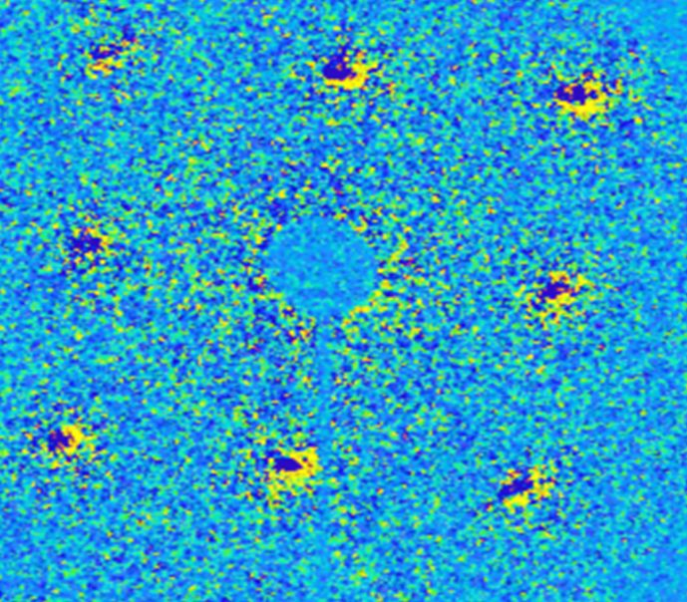
Capturing Structural Dynamics of Materials with Ultrafast Electron Diffraction
Nebraska MRSEC
DMR 1420645
2019
Martin Centurion
University of Nebraska-Lincoln
“Phase transition” is a term which is commonly used to describe transformations between solid, liquid, and gaseous states of matter. However, even in solids, phase transitions may occur between different structural phases, resulting in a discontinuous change of certain material properties, such as electrical conductivity and heat capacity, which can be used in technological applications. Many phase transitions in solids involve ultrafast motion in the atomic positions towards a new equilibrium configuration. Nebraska MRSEC supports a seed project focusing on capturing these changes, on femtosecond time scales, with atomic resolution. The MRSEC researchers have setup an instrument to perform ultrafast electron diffraction measurements on condensed matter samples. The performance of the instrument was demonstrated in a first measurement of the ultrafast changes in the diffraction pattern of photoexcited single-crystal gold. A femtosecond laser pulse is used to heat the sample on a very fast timescale, and a femtosecond electron pulse probes the structure a short time after. This instrument has the capability to resolve ultrafast structural changes with femtosecond resolution.
Changes in the diffraction pattern of gold 10 picoseconds after photoexcitation (1 picosecond = 1 trillionth of a second). The intensity of the diffraction peaks decrease (dark blue regions) due to the heating induced disorder, and the intensity around the peaks increases (yellow regions).

