Slide 1
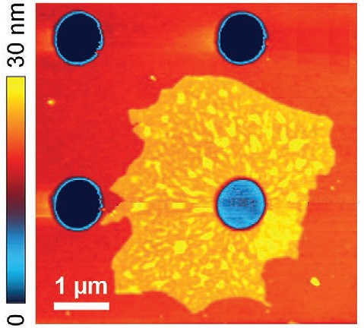
Nanoscale Properties of MXene Membranes
Nebraska MRSEC
DMR-1420645
2020
MXenes are two-dimensional (2D) ceramics made of transition metal carbides and nitrides. Unlike other 2D ceramics, MXenes have inherently good conductivity and thus are promising for various applications. Probing the local physical properties of MXenes monolayers is important for the understanding of their functional performance.
Nebraska MRSEC researchers in collaboration with their colleagues at Drexel University have developed an improved method for synthesis of monolayer membranes of Nb₄C₃T_{x} MXene. Using an approach based on Atomic Force Microscopy (AFM) they tested the electrical properties of the MXene membranes, such as electron mobility and conductance. AFM nanoindentation measurements facilitated evaluation of their elastic modulus, which turned out to be the highest among the solution-processed 2D materials. These results open a possibility of using Nb₄C₃T_{x} MXenes for nanomechanical applications and provide guidance for a search of new MXenes with improved functionalities.
A. Sinitskii and A. Gruverman, University of Nebraska-Lincoln
Y. Gogotsi, Drexel University
Atomic Force Microscopy (AFM) image of an Nb₄C₃T_{x} MXene flake covering an 820 nm microwell in a Si/SiO₂ substrate. The color map reflects AFM measured height on the sample. The blue spot indicates an AFM-indented area of the flake atop of the microwell.
A. Lipatov, M. Alhabeb, H. Lu, S. Zhao, M. J. Loes, N. S. Vorobeva, Y. Dall'Agnese, Y. Gao, A. Gruverman, Y. Gogotsi, A. Sinitskii, “Electrical and elastic properties of individual single‐layer Nb₄C₃T_{x} MXene flakes,” Adv. Electron. Mater. 1901382 (2020)

