Slide 1
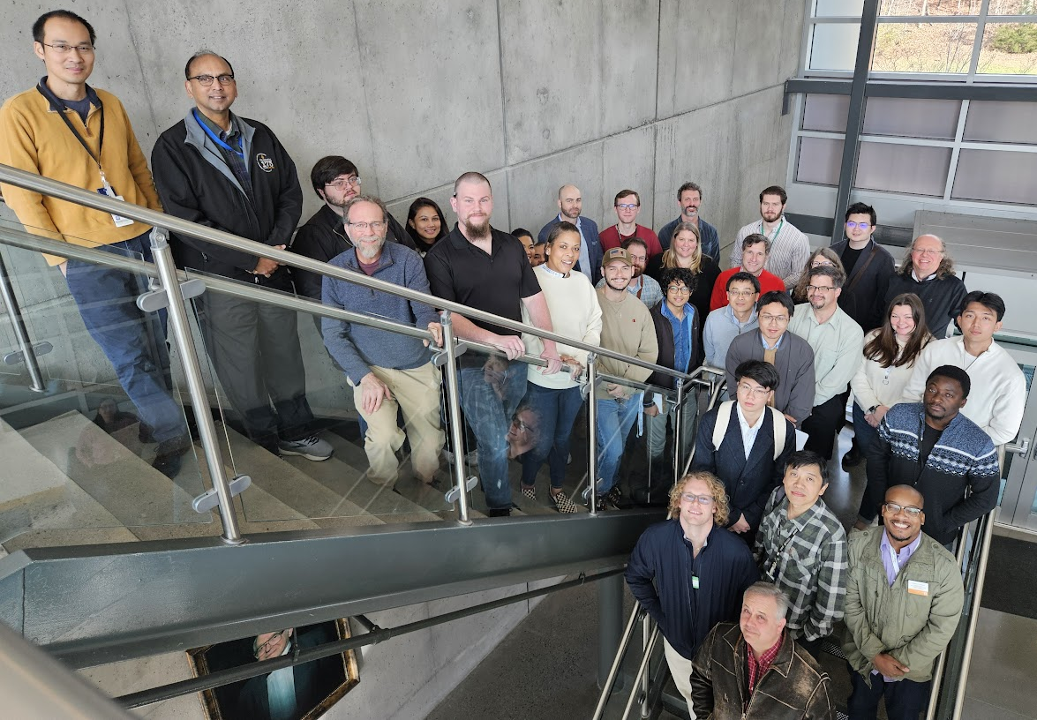
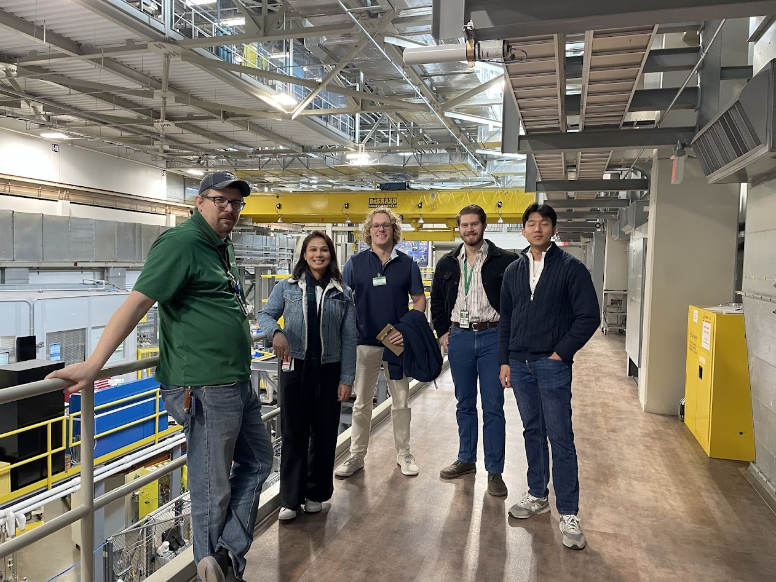
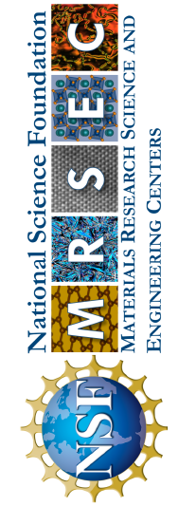
UTK-MRSEC
DMR-2309083
CAMM Partners with ORNL to Host “Neutron Day”
CAMM’s ECOR Team & Antonio dos Santos of ORNL coordinated the event
UTK-MRSEC The Center for Advanced Materials & Manufacturing (CAMM) partnered with Oak Ridge National Laboratory (ORNL) to host the inaugural "Neutron Day," an event designed to deepen collaboration and foster interdisciplinary research connections. This full-day event was organized by CAMM’s Education, Community, Outreach, & Recruitment team, along with Antonio dos Santos, an ORNL neutron scientist. Attendees included CAMM principal investigators, graduate students, postdoctoral researchers, and participants from the Institute for Advanced Materials and Manufacturing.
The day featured a series of concurrent sessions aligned with CAMM’s interdisciplinary research groups, focusing on relevant topics such as additive manufacturing, advanced materials characterization, and quantum material design. These sessions offered attendees a chance to engage with ORNL experts, explore new methodologies, and discuss challenges and opportunities to collaborate in their research.
One of the event’s highlights was a session dedicated to extreme sample environments, showcasing the unique capabilities that can be coupled with beamlines at ORNL’s High Flux Isotope Reactor (HFIR) and Spallation Neutron Source (SNS). Attendees gained insights into how neutron science can address complex material challenges, with case studies and collaborative brainstorming further enriching the discussions.
Another standout session focused on computational modeling and its role in predicting material behavior. This session emphasized the synergy between theoretical and experimental approaches, encouraging cross-disciplinary dialogues among participants.
Several of CAMM's graduate students delivered lightning talks, presenting their research to an audience of ORNL scientists. These brief, impactful presentations sparked engaging discussions and provided a platform for students to receive feedback from leading experts.
"Neutron Day" exemplified CAMM's commitment to fostering a collaborative and inclusive research community, building bridges between academia and national laboratory expertise, and supporting the next generation of materials scientists.
Notes:
What Has Been Achieved: These sessions offered attendees a chance to engage with ORNL experts, explore new methodologies, and discuss challenges and opportunities to collaborate in their research.
Importance of the Achievement: This event was one of the exciting ways that CAMM is building bridges between academia and national laboratory expertise, and supporting the next generation of materials scientists. Neutron Day was a great starting point for fostering cross-discipline collaboration amongst CAMM’s researchers and experienced neutron scientists at Oak Ridge National Lab.
How is the achievement related to the IRG, and how does it help it achieve its goals? Neutron Day included sessions related to the research of each IRG. ORNL Neutron Scientists provided talks on their current research and gave students the opportunity to ask questions and learn how their own research aligns. These opportunities to build relationships and gain familiarity with ORNL have already resulted in successful beamline proposals.
Where the findings are published: N/A

