Slide 1
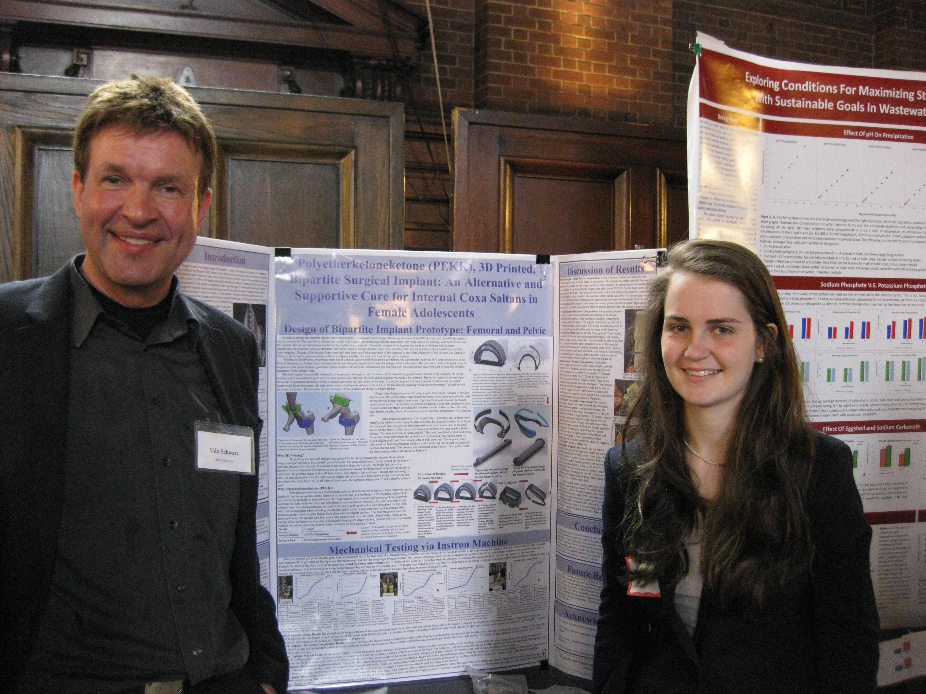
New Haven Science Fair Participation
MRSEC DMR-1119826
2017
Schwarz, Yale University
CRISP continued its interactions with industrial companies that aim to commercialize broadly new and simpler approach for force microscopy measurements. Separately, CRISP continued to train graduate students in research, writing, and presentation skills by providing the opportunity to attend a number of international conferences.
Schwarz participated as a judge in the New Haven Science Fair (photo on right). Held in May 2016, over 8,000 New Haven students from 43 schools participated and interacted with more than 160 volunteers for mentoring, presenting, and judging. The program is dedicated to improving the quality of education, particularly science and math education, in New Haven Public Schools.
High school student Sophie Edelstein, who won the American Society of Metals (ASM) Award, with science fair judge Udo Schwarz. The ASM Award is given for the best project that “uses science to investigate materials interaction, materials response, and materials application to understand and solve problems of interest.”
Notes:
The New Haven Science Fair Program was started in 1995 with seven test schools. This past year over 8,000 New Haven students and 43 schools participated, utilizing more than 160 volunteers for mentoring, presenting, and judging. The program is dedicated to improving the quality of education, particularly science and math education, in New Haven Public Schools.
​
The New Haven Science Fair Program is a partnership involving businesses, universities, associations, foundations, and private citizens working with teachers, students, administrators, and students' parents. The goal of the program is to work with children and teachers from Pre-K through Grade 12 to help them carry out investigative hands-on science fair projects in order to promote skills in critical thinking, scientific process, and communication.
​
In 2001-2002, the New Haven Science Fair Mentor Program was awarded the Presidential Award for Excellence in Science, Mathematics and Engineering Mentoring--the only PreK-12 program in the country to receive this prestigious award. In 2003, New Haven was recognized as an All-America City on the basis of the accomplishments of three programs in New Haven, including the Olin Yale-Bayer-NHPS Partnership.

