Slide 1
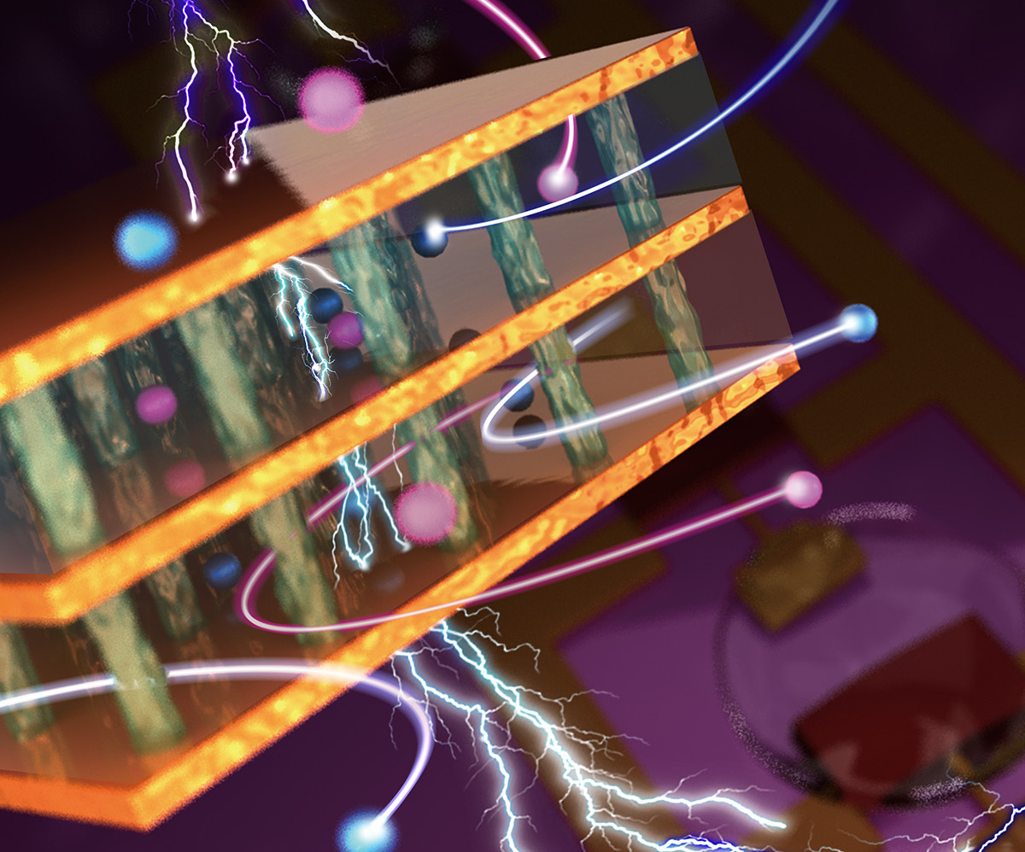
Northwestern University MRSEC DMR-1720139
Vertical Organic Electrochemical Transistors and Logic Circuits
IRG-1, Northwestern University MRSEC
By employing redox-active and redox-inactive polymers in a mixed-dimensional heterostructure architecture, Northwestern University MRSEC IRG-1 has achieved vertical organic electrochemical transistors (vOECTs) for the first time. These vOECTs allow p-type and n-type devices to be stacked into high-density complementary logic circuits, including inverters and ring oscillators, with exceptional gain, stability, and operating frequency. This mixed-dimensional architecture opens many possibilities for fundamental studies of organic semiconductor redox chemistry and physics in nanoscopically confined spaces without macroscopic electrolyte contact. Moreover, this work demonstrates the potential of vOECTs as a viable alternative to conventional inorganic transistors for digital logic circuits, especially in low-cost, flexible, and energy-efficient electronic applications such as wearable and implantable sensors.
Nature, 613, 496 (2023).
The mixed-dimensional architecture of the vertical organic electrochemical transistor enables high-density logic circuits with exceptional gain and speed.
Notes:
What Has Been Achieved: Here, p-type and n-type vertical organic electrochemical transistors (vOECTs) with balanced and large footprint current densities exceeding kA/cm2 at < -0.7 V, short transient times of <1 ms, transconductances of 0.2-0.4 S, and stable switching cycles (>50000) are realized by combining a redox-active p-type or n-type polymer blended with a redox-inactive photocurable/photopatternable polymer as the semiconducting channel, implemented in a mixed-dimensional architecture. These vOECTs enable vertically stacked complementary logic circuits, including inverters and ring oscillators.
Importance of the Achievement: The successful demonstration of vertically stacked complementary vOECT logic circuits, including inverters and ring oscillators, is a significant step towards the development of practical organic electronic devices that can be used in a variety of applications, such as low-cost and flexible sensors. The high gain, stability, and operating frequency of these circuits demonstrate the potential of vOECTs as a viable alternative to conventional inorganic transistors for digital logic circuits.
How is the achievement related to the IRG, and how does it help it achieve its goals?
The use of mixed-dimensional heterojunctions in the vOECTs play a central role in achieving the improved performance. In particular, the fundamental insights into the physics and chemistry of mixed-dimensional heterojunctions that have been developed in Northwestern University MRSEC IRG-1 over the past 5 years were critical in realizing the vOECT design.
Where the findings are published: W. Huang, J. H. Chen, Y. Yao, D. Zheng, X. D. Ji, L. W. Feng, D. Moore, N. R. Glavin, M. Xie, Y. Chen, R. M. Pankow, A. Surendran, Z. Wang, Y. Xia, L. B. Bai, J. Rivnay, J. F. Ping, X. G. Guo, Y. H. Cheng, T. J. Marks, and A. Facchetti, “Vertical Organic Electrochemical Transistors for Complementary Circuits,” Nature, 613, 496 (2023).

