Slide 1
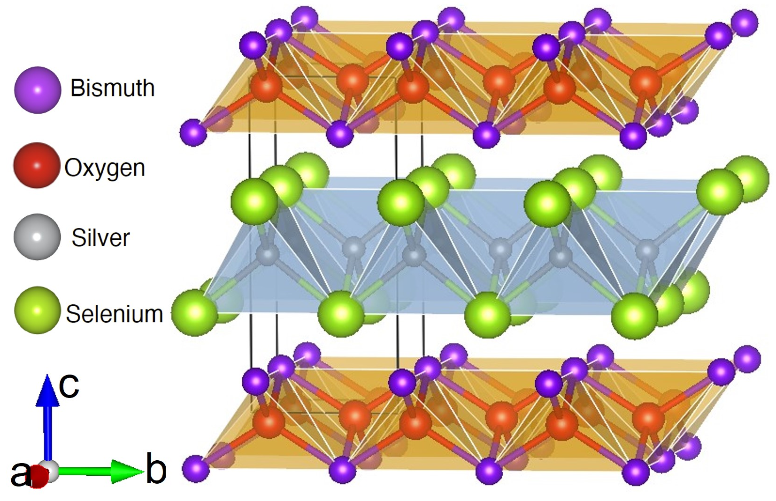
Northwestern University MRSEC DMR-1720139
Accelerated Discovery of Thermoelectric Heteroanionic Materials
IRG-2, Northwestern University MRSEC
Northwestern University MRSEC IRG-2 has developed an efficient theoretical framework based on high-throughput density functional theory calculations and machine learning methods to accelerate the discovery of heteroanionic materials. In addition, property calculations such as electronic and thermal conductivities have been performed on the discovered candidate materials to explore their potential in thermoelectric applications. For example, in a collaborative effort involving five IRG-2 PIs, a comprehensive study has identified BiAgOSe to be an exceptionally low thermal conductivity material from both theoretical and experimental perspectives. To understand the mechanism behind the low thermal conductivity in BiAgOSe, IRG-2 performed lattice dynamical simulations that revealed exceptionally low sound velocity and high phonon-phonon scattering rate in BiAgOSe.
J. Am. Chem. Soc. 144, 2569 (2022).
High-throughput density functional theory and machine learning methods identified BiAgOSe to be an exceptionally low thermal conductivity material with high potential for thermoelectric applications.
Notes:
What Has Been Achieved: Northwestern University MRSEC IRG-2 has developed an efficient theoretical framework based on high-throughput density functional theory calculations and machine learning methods to accelerate the discovery of heteroanionic materials. In this particular project, five IRG-2 PIs completed a comprehensive study that identified BiAgOSe to be an exceptionally low thermal conductivity material from both theoretical and experimental perspectives. To understand the mechanism behind the low thermal conductivity in BiAgOSe, lattice dynamical simulations revealed exceptionally low sound velocity and high phonon-phonon scattering rate in BiAgOSe.
Importance of the Achievement: This work reported and demonstrated that BiAgOSe has an exceptionally low thermal conductivity for the first time. In addition to providing a new promising candidate for thermoelectric material, this study also established an efficient experimental and theoretical framework that can be generalized to the discovery of additional heteroanionic materials.
How is the achievement related to the IRG, and how does it help it achieve its goals? Northwestern University MRSEC IRG-2 aims to discover new heteroanionic materials. This work established a framework that includes all aspects of the discovery process: (1) a new heteroanionic material was predicted by high-throughput density functional theory calculations; (2) the predicted material was synthesized and characterized experimentally; (3) additional theoretical work established the underlying physical mechanism behind the exceptional properties of this new heteroanionic material.
Where the findings are published: C. Zhang, J. He, R. McClain, H. Xie, S. Cai, L. N. Walters, J. Shen, F. Ding, X. Zhou, C. D. Malliakas, J. M. Rondinelli, M. G. Kanatzidis, C. Wolverton, V. P. Dravid, and K. R. Poeppelmeier, “Low Thermal Conductivity in Heteroanionic Materials with Layers of Homoleptic Polyhedra,” J. Am. Chem. Soc. 144, 2569 (2022).

