Slide 1
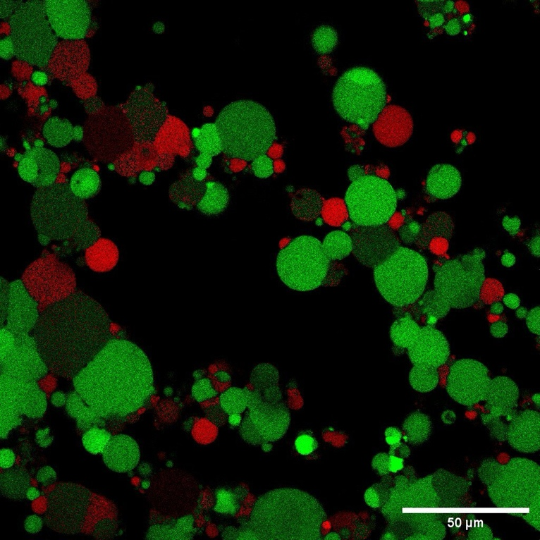
Northwestern University MRSEC DMR-2308691
Encapsulating Cell-Free Reactions in Hydrogels
IRG-1, Northwestern University MRSEC
A critical element of Northwestern University MRSEC IRG-1 is interfacing cell-free systems with abiotic materials in a way that supports cell-free reaction efficiency and kinetics. In this work, the capacity of bilayer-based compartments (e.g., liposomes, polymersomes) is being assessed to support encapsulated cell-free reactions upon their inclusion in a larger hydrogel matrix. In particular, giant unilamellar vesicles (GUVs) have been assembled from a phospholipid mixture to enable transcription and translation of a fluorescent protein after GUVs are encapsulated in an alginate hydrogel. This hydrogel/vesicle system is serving as a platform to investigate how vesicle stability and reaction kinetics are impacted as a function of vesicle composition, cell-free extract type, and hydrogel matrix composition. This work is setting the stage for more advanced cell-free reactions that will be initiated based on the presence of an externally detected or added small molecule.
(Left) Schematic of a water-in-oil emulsion method to encapsulate cell-free reaction components in vesicles. (Right) Fluorescence microscopy of giant unilamellar vesicles containing a membrane dye (red) expressing green fluorescent protein (green) in an alginate hydrogel.
Notes:
What has been achieved: Northwestern University MRSEC IRG-1 is exploring how compartmentalized cell-free reactions can be supported in different material environments. In particular, a significant portion of effort has been spent identifying materials for vesicle and hydrogel production that support vesicle stability within an assembling hydrogel matrix. Successful expression of green fluorescent protein has been achieved when the cell-free system was encapsulated. In contrast, encapsulation of the cell-free system directly within the hydrogel leads to inhibition of the reaction due to dilution and interaction with hydrogel components.
Importance of the achievement: This work demonstrates the power of compartmentalization to support cell-free reactions in environments that would otherwise inhibit the reaction, either due to dilution of the components or due to inhibition of the reaction by material components. This work sets the stage for future work that will encapsulate more advanced cell-free reactions that are initiated based on the presence of an externally detected or added small molecule.
How is the achievement related to the IRG, and how does it help it achieve its goals? Northwestern University MRSEC IRG-1 is focused on the design of materials that have biological capabilities imparted by encapsulated biological reactions. This achievement supports a critical step in this goal by demonstrating how a lipid-based compartment can maintain stability and support an encapsulated protein expression reaction within a new material.
Where the findings are published: A manuscript based on this work is under preparation.

