Slide 1
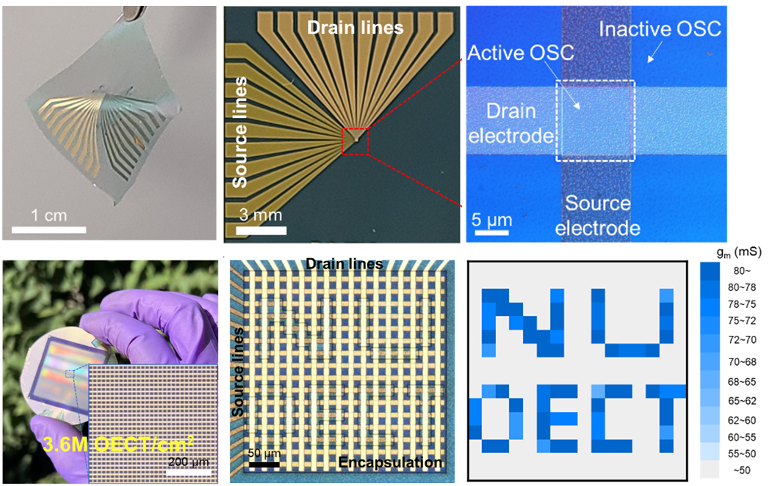

Northwestern MRSEC
DMR-2308691
Monolithically Integrated Ultra-High-Resolution Vertical Organic Electrochemical Transistor Arrays and Complementary Circuits
IRG-2, Northwestern University MRSEC
Northwestern University MRSEC IRG-2 has realized ultra-high-density and mechanically flexible vertical organic electrochemical transistor (vOECT) arrays and complementary circuits through electron-beam patterning of the conjugated organic semiconductors by electron-beam exposure. The high energy electron-beam disrupts the conjugation in the exposed organic semiconductor area, creating an electronic insulator while retaining ionic conductivity and topological continuity with the redox-active unexposed areas. Applying this spatially selective electron-beam exposure strategy to organic mixed ionic/electronic conductors in the vOECT array fabrication process provides ultra-high-resolution patterning and modulation of the charge transport. The resulting p-type and n-type vOECTs enable active-matrix arrays with superlative electronic switching characteristics. In this manner, this work opens new possibilities to expand the application of vOECTs to the fields of neuromorphic computing, stretchable electronics, wearable electronics, and bioelectronic sensing.
Nature Electronics, 7, 234 (2024).
Ultra-high-density vertical organic electrochemical transistor arrays and complementary circuits are fabricated by electron-beam patterning of organic mixed ionic/electronic conducting materials.
Notes:
What has been achieved: The function of organic electrochemical transistors involves the interplay of both electronic and ionic transport, which enables high transistor channel electrical currents and low operating voltages. The recent development of vertically arranged source and drain electrodes results in vertical organic electrochemical transistors (vOECTs) within Northwestern University MRSEC IRG-2 greatly enhances performance in terms of higher currents and switching speeds. Here we report a route to ultra-high-density (up to ~7.2M OECT/cm²) and mechanically flexible vOECT arrays and circuits via a facile and generalizable patterning by electron-beam exposure. The high energy electron-beam disrupts the conjugation in the exposed organic semiconductor area, creating an electronic insulator while retaining ionic conductivity and topological continuity with the redox-active unexposed areas. The resulting p-type and n-type vOECTs enable active-matrix arrays with superlative electronic switching characteristics. In particular, the vOECT active-matrix arrays exhibit high transconductances of 0.08 – 1.7 S, fast transient times of less than 100 μs, and ultra-stable switching properties (>100k cycles). Vertically stacked complementary logic circuits, including NOT, NAND, and NOR gates, have also been demonstrated.
Importance of the achievement: The successful demonstration of this selective electron-beam strategy enables high-resolution patterning of organic semiconductors for constructing vOECT monolithically integrated complementary logic circuits, thus offering new possibilities to enlarge the applicability of vOECTs in the fields of neuromorphic computing, stretchable electronics, wearable electronics, and bioelectronic sensing.
How is the achievement related to the IRG, and how does it help it achieve its goals? This multi-PI IRG-2 effort combines expertise spanning organic electronic/ionic polymer design, synthesis, characterization, and film processing, along with device prototype fabrication and evaluation. It advances new scientific understanding of how to create, process, and exploit the properties of materials and devices that employ both electronic and ionic charge transport including elucidation of the mechanism of semiconductor backbone deconjugation, whereby areas of the transistor semiconductor exposed to highly energetic electron beams are transformed into an electronic insulator while maintaining the same ionic conductivity and topological continuity as the unexposed device regions.
Where the findings are published: J. Kim, R. M. Pankow, Y. Cho, I. D. Duplessis, F. Qin, D. Meli, R. Daso, D. Zheng, W. Huang, J. Rivnay, T. J. Marks, and A. Facchetti, “Monolithically Integrated High-Density Vertical Organic Electrochemical Transistor Arrays and Complementary Circuits,” Nature Electronics, 7, 234 (2024).

