Slide 1
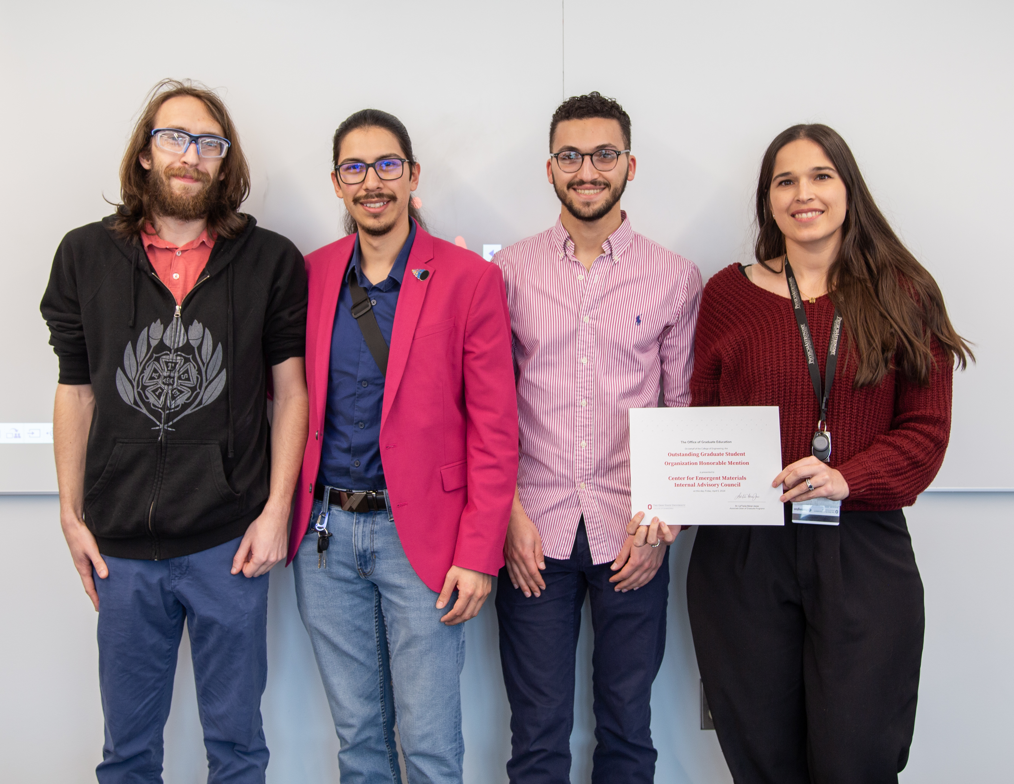
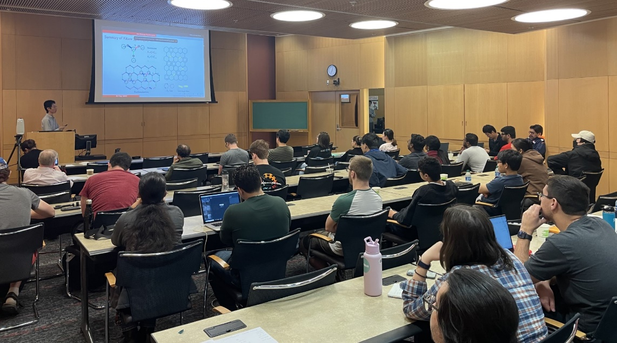
Ohio State University MRSEC
DMR-2011876
Internal Advisory Council: Promoting the Student Perspective
Mohamed Nawwar, Janeth Garcia-Monge, Francisco Ayala Rodriguez,
Harshad Gajapathy, and Arch Williams Ohio State University
CEM Student Internal Advisory Council
Advises CEM in the interests of students and postdocs
Organizes technical and team-building Events
TopoMag23 crash course: Introduced students to workshop topics
CEM Day: A Center-wide workshop to plan future DEI, outreach, and scientific endeavors
Mini-courses: Short reviews of research topics prior to weekly IRG meetings
Coffee Hour: Hosts an informal weekly coffee hour
Received 2024 Honorable Mention, Graduate Student Organization of the Year, College of Engineering
a
IAC members receiving the Honorable Mention Award;
Students at the TopoMag23 Crash Course.
b
Notes:
What Has Been Achieved: Add your narrative here.
Importance of the Achievement: Add your narrative here.
How is the achievement related to the IRG, and how does it help it achieve its goals? Add your narrative here.
Where the findings are published: Enter citation and DOI here.

