Slide 1
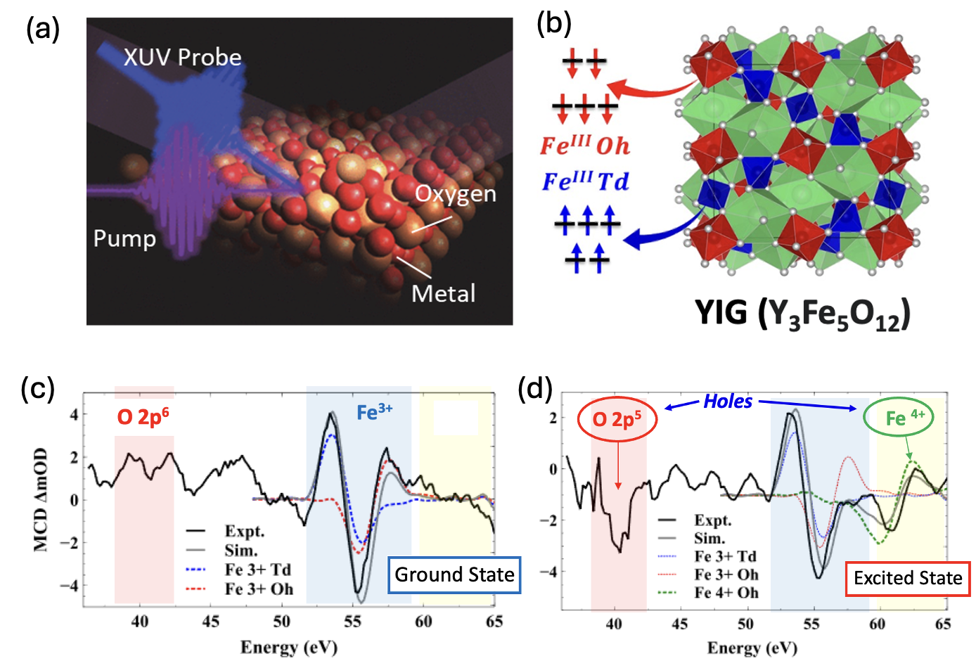
Ohio State University MRSEC
DMR-2011876
Ultrafast Spin Polarized Electron Dynamics of Magnetic Insulator Yttrium Iron Garnet
Robert Baker, Fengyuan Yang, Ohio State University
XUV-MCD Spectroscopy and Optical Control of Magnetic Moments in Yttrium Iron Garnet (YIG) Interfaces
Understanding the ultrafast dynamics of charge/spin transitions in magnetic insulators (MI) is crucial for developing new materials interfaces for spin-electronics and quantum information science applications.
Developed ultrafast X-ray absorption spectroscopy (XUV) combined with optical pumping, enabling the study of charge and spin dynamics at MI interfaces with femtosecond time resolution.
XUV, coupled with magnetic circular dichroism (MCD) measurements, has revealed site-specific (octahedral vs. tetrahedral) charge distribution and spin configuration in YIG.
Following optical excitation, XUV-MCD captures the intricacies of how the charge and spin states change at ultrafast timescales, laying the groundwork for understanding charge/spin dynamics at the YIG/metal interface.
This work was published in Gajapathy et al., Chemical Science in January 2024.
Figure 1. (a) Schematic of XUV with optical pump. (b) Structure of YIG with octahedral (red) and tetrahedral (blue) Fe sites with their ground state spin configurations. XUV-MCD data showing the charge and spin states of O and Fe sites (c) before and (d) after optical excitation.
Notes:
Changes in charge and spin states at MI/NM interfaces induced by spin-orbit torque and ultrafast optical methods may involve dynamics across many decades of timescales. Understanding the fundamentals of charge/spin transition dynamics and magnetic switching at different timescales is important, as it can lead to new ways of utilizing spins to control magnetic states. Supported by CEM, the groups of Yang and Baker reported a femtosecond extreme UV (XUV) spectroscopy of yttrium iron garnet (Y3Fe5O12, YIG), one of the important MI garnets for the NM/MI interfaces in this IRG. XUV can be performed in many different modes, including XUV magnetic circular dichroism (MCD) mode that was used in this work, with ~ 50 femtosecond time resolution. This capability can provide information, such as femtosecond spin transport, spin-phonon interaction, element specific charge and spin transport between the atomic sites (sublattices) as well across interfaces
YIG exhibits significantly higher photocurrent density in comparison to other extensively studied oxides like hematite (α-Fe2O3). Investigation into the electrical and magnetic properties using surface-focused XUV spectroscopy reveals the underlying reasons for YIG's enhanced performance relative to hematite. This improvement can be attributed to two key factors: firstly, a reduction in the formation of electron-polaron pairs on the surface of YIG compared to hematite. Secondly, YIG demonstrates an intrinsic polarization of photocurrents. XUV observations shown in Fig. 1 illustrate a decrease in the generation of surface electron-polaron pairs in YIG due to variations in electron-phonon interactions at different lattice sites. Consequently, this results in the production of spin-polarized photocurrents in YIG, where efficient charge separation primarily occurs on the Td sub-lattice, rather than rapid trapping and subsequent recombination of electron-hole pairs on the Oh sub-lattice. These lattice-specific dynamics lead to a sustained presence of spin-aligned holes at the YIG surface, which can be directly detected through XUV magnetic circular dichroism. Comparative examination of Fe M2,3 and O L1-edges suggests that these spin-aligned holes represent a hybrid of O 2p and Fe 3d valence band states, indicating transient magnetization of the interface.

