Slide 1
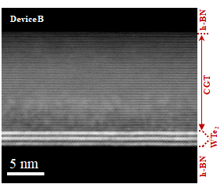
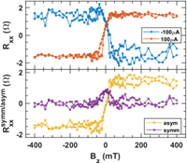
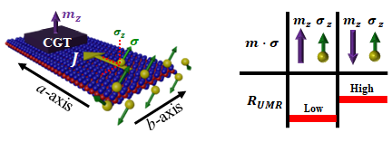
Ohio State University MRSEC
DMR-2011876
Discovery of a New Type of Magnetoresistance
Simranjeet Singh (CMU), Jyoti Katoch (CMU), Jinwoo Hwang (OSU)
Unconventional unidirectional magnetoresistance in heterostructures of a topological semimetal and a ferromagnet
Currently, spin-orbit torque based two-terminal magnetic memory device, like commercially available magnetic-tunnel-junction-based magnetic memory devices, is missing due to the lack of identified magnetoresistance phenomena to distinguish the up and down states of a perpendicular polarized magnet in bilayer heterostructure.
Unidirectional magnetoresistance (UMR) is a change in the longitudinal resistance of a heterostructure, composed of a spin-source material and a magnetic layer, due to magnetization reversal and its interaction with non-equilibrium spin accumulation.
Atomically clean bilayer heterostructures consisting of a low-symmetry semimetal (WTe₂) and a ferromagnetic semiconductor (Cr₂Ge₂Te₆, CGT) was employed.
Unconventional UMR originates from the interplay of crystal symmetry-breaking in WTe₂ and magnetic exchange interaction across the WTe₂/CGT interface.
This work was published in Kao et al., Nature Materials in March 2025.
(a)
(c)
(d)
(b)
Figure 1. (a) Atomically clean WTe₂/CGT interface. (b) Left: Generation of nonequilibrium spin accumulation with an out-of-plane spin polarization ($σ_{z}$), when a charge current ($J$) is applied along the a-axis of WTe₂. Right: Concept of unconventional UMR in heterostructures, i.e., change of longitudinal resistance ($R_{UMR}$) depending on the relative orientation of out-of-plane magnetization ($m_{z}$) and spin polarization ($σ_{z}$). (c) A schematic showing the measurement configuration to read the out-of-plane magnetic state of CGT employing 2-point longitudinal resistance ($R_{xx})$. (d) UMR signal measured with +/- current. The step-like change in 2-point $R_{xx}$is due to UMR switching sign when the current is reversed, with symmetric and antisymmetric components shown (lower panel).
Notes:
What Has Been Achieved: We report the first experimental demonstration of an unconventional unidirectional magnetoresistance (UMR)in heterostructures consisting of a topological semimetal and ferromagnetic insulator, which allows us to electrically read the up and down states of the magnetic layer, which has perpendicular magnetic anisotropy (PMA), through longitudinal resistance measurements in bilayer heterostructures
Importance of the Achievement: Electrical readout of magnetic states is of fundamental importance and a key to realize novel spintronics devices for efficient computing and data storage. There is lack of identified magnetoresistance phenomena to distinguish the up and down magnetic states of a PMA magnet in widely used bilayer heterostructures for spin-orbit torque (SOT) magnetic switching devices in the planar geometry. Our findings, which enables electrical readout of magnetic states of the PMA magnet through longitudinal resistance measurements employing unconventional UMR, provide a new pathway to realize SOT based two-terminal magnetic memory devices for the development of next-generation non-volatile and low-power consumption data storage technologies. is critically missing
How is the achievement related to the IRG, and how does it help it achieve its goals? This research is directly related to the goal of the IRG1 because it is focused on creation of atomically clean interfacial system of a topological semimetal and a ferromagnetic insulator to achieve control and read of the magnetic states.
Where the findings are published: Kao et al., Nature Materials (2025), DOI: https://doi.org/10.1038/s41563-025-02175-0

