Slide 1
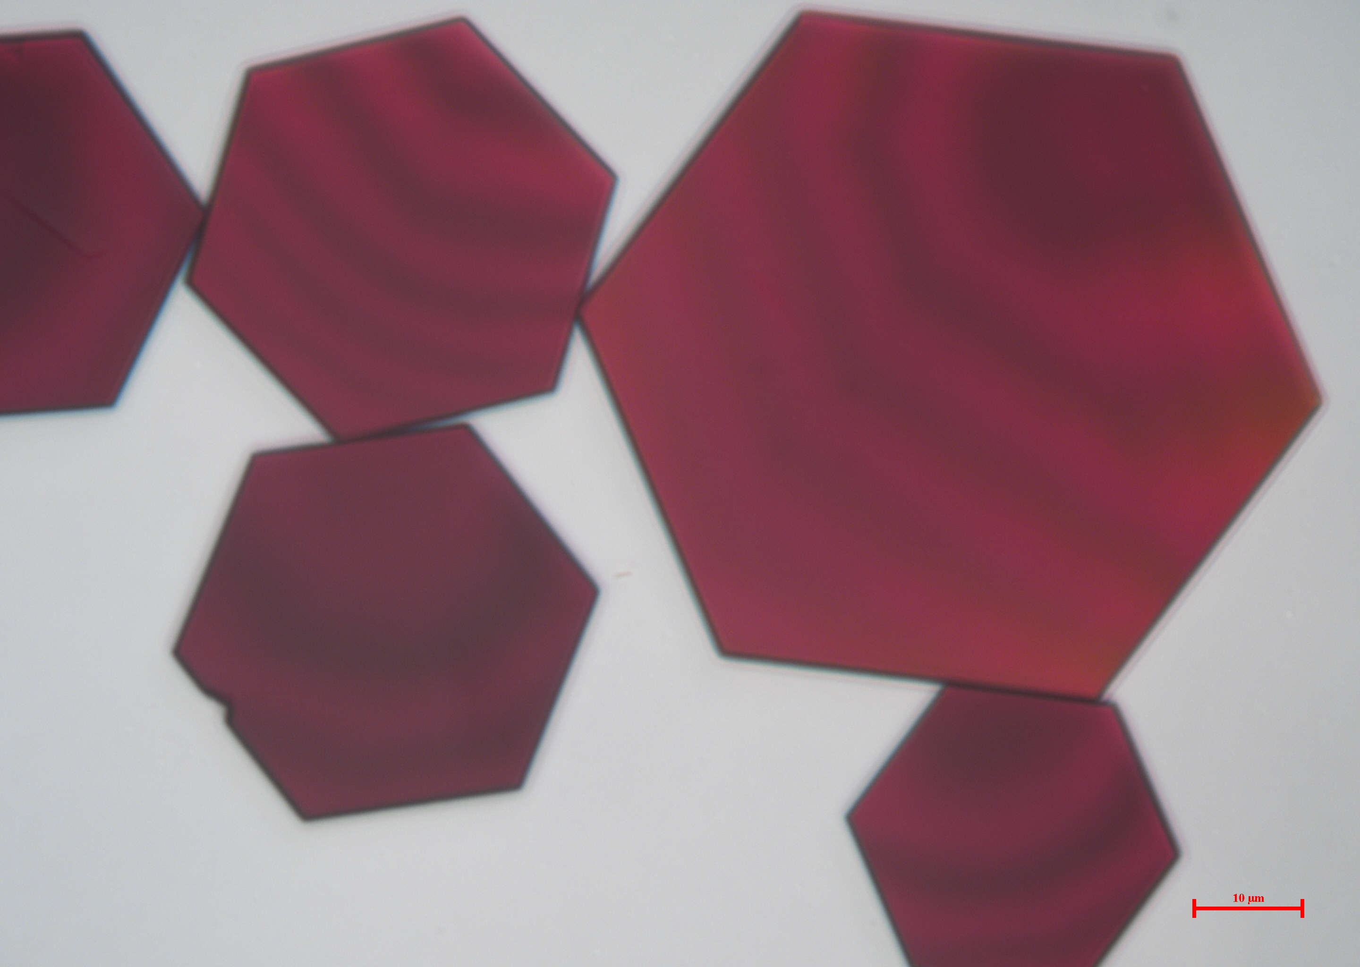
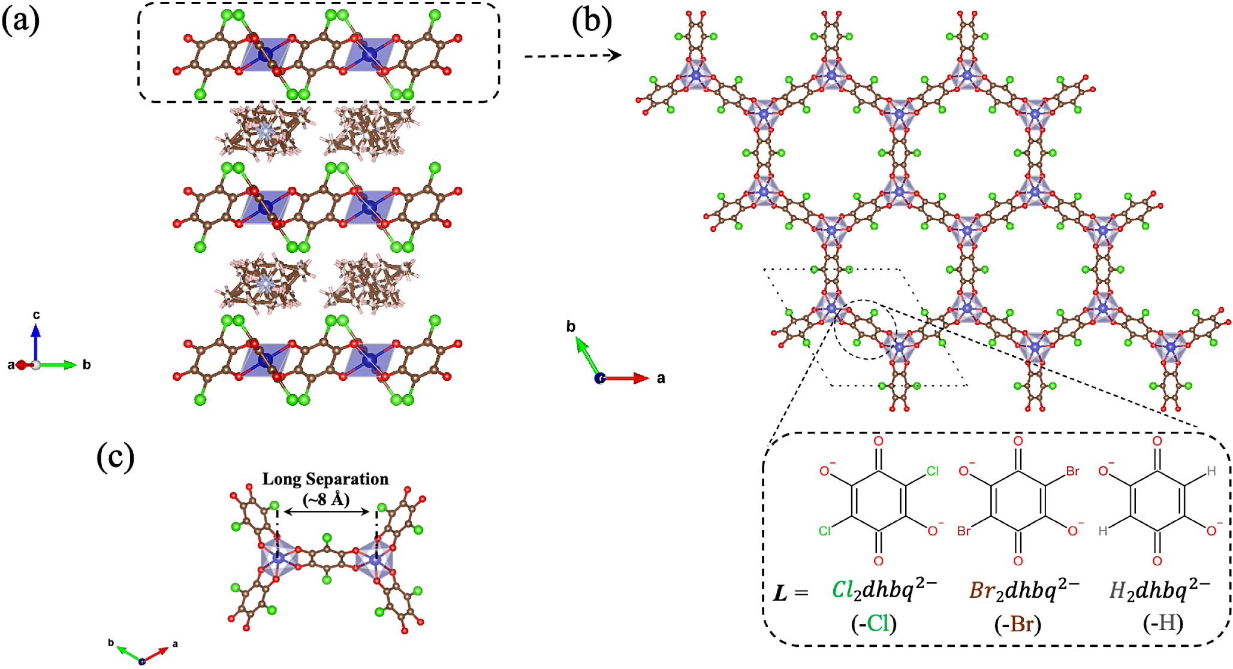
Ohio State University MRSEC
DMR-2011876
Co-based metal-organic frameworks as spin liquid candidates
Prof. Yiying Wu, Jos Heremans, Nandini Trivedi, Yuanming Lu (OSU), Sara Haravifard (Duke)
IRG-2 has synthesized and characterized a novel, cobalt-based metal-organic framework (MOF) which is a promising candidate for realizing a Kitaev spin liquid.
The material has high-spin d⁷ Co²⁺ ions arranged in a honeycomb lattice, each with pseudospin-1/2 ground-state doublets that act as Kitaev spins. Benzoquinone-based linkers mediate interactions between these spins in away that produces frustration. We show that choosing different chemical composition of the linkers allows one to alter the strength of the coupling.
Magnetization data shows antiferromagnetic interactions, but measurements of magnetic susceptibility and specific heat show no spin ordering down to 55 mK.
Thus, the team has demonstrated a novel, promising, and tunable platform for realizing spin liquid physics.
Above: optical image of the novel MOFs, which grows as plates (10 µm scale bar).
Top-right: chemical structure showing a hexagonal lattice of Co²⁺ ions. We demonstrate chemical control over the linker between them, which mediates spin interactions.
Bottom-right: The magnetic susceptibility shows no magnetic ordering down to sub-kelvin temperatures.
“Two-Dimensional Cobalt(II) Benzoquinone Frameworks for Putative Kitaev Quantum Spin Liquid Candidates”, Zhang et al, J. Am. Chem. Soc. 2024, 146 (22), 15061–15069 (2024). https://doi.org/10.1021/jacs.3c14537
Notes:
What Has Been Achieved: We have developed a new type of metal-organic framework which is a promising candidate for spin liquid physics based on the Kitaev honeycomb model. High-spin d⁷ Co²⁺ ion have pseudospin-1/2 ground-state doublets that act as Kitaev spins. We develop the use of 2,5-dihydroxy-1,4-benzoquinone (X₂dhbq, X = Cl, Br, H) as the linkers. Different choices of X yield different strength of the magnetic interaction. The benzoquinone-based linkers not only provide two separate superexchange pathways that create bond-dependent frustrated interactions but also allow for chemical tunability to mediate magnetic coupling.
Importance of the Achievement: This material represents a new and highly-tunable platform for realizing the Kitaev model of spin liquid physics, which is a prominent goal of modern quantum condensed matter physics. All measurements so far are consistent with frustrated interactions that produce fractionalized excitations.
How is the achievement related to the IRG, and how does it help it achieve its goals? Our IRG aims to identify and realize new physics at the intersection of topology and magnetism. The fractionalized excitations in the Kitaev model are fundamentally topological in nature, and providing a sharp and tunable realization of the Kitaev model would be a major achievement in physics and materials science.
Where the findings are published: Songwei Zhang, Xu Yang, Brandi L. Wooten, Rabindranath Bag, Lalit Yadav, Curtis E Moore, Smrutimedha Parida, Nandini Trivedi*, Yuanming Lu*, Joseph P. Heremans*, Sara Haravifard*, Yiying Wu*. “Two-Dimensional Cobalt(II) Benzoquinone Frameworks for Putative Kitaev Quantum Spin Liquid Candidates.” J. Am. Chem. Soc. 2024, 146 (22), 15061–15069 (2024).
DOI: https://doi.org/10.1021/jacs.3c14537

