Slide 1


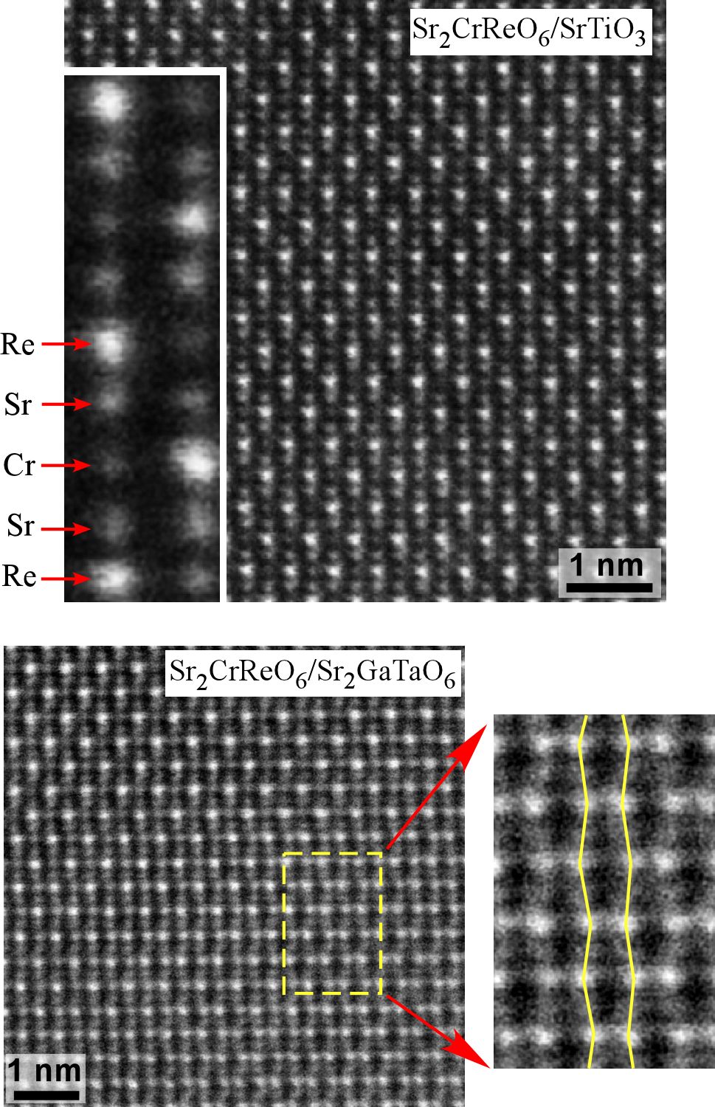
Center for Emergent Materials
The Ohio State University
http://cem.osu.edu
Strain tunable room temperature magnetism
The properties of epitaxial Sr₂CrReO₆ films shows remarkable substrate dependence
The presence of strong spin–orbit coupling in oxides containing 5d transition metal ions provides a mechanism for direct coupling between magnetization and the crystal lattice. In epitaxial films of such compounds strain arising from lattice mismatch with the substrate can in principle be used to tune the magnetic properties.
Using a novel deposition technique, IRG-2 researchers have grown fully-ordered Sr₂CrReO₆ films which are semiconducting and highly magnetic at room temperature. When grown on different substrates dramatic changes in magnetization and resistivity occur. The largest effects are seen when Sr₂CrReO₆ is grown on Sr₂GaTaO₆ buffer layers (1.6% tensile strain) where the low temperature resistivity increases by more than two orders of magnitude, and the saturation magnetization more than doubles, with respect to films grown on a lattice matched substrate (e.g. SrTiO₃). Electron microscopy images suggest that changes in the local atomic structure may be responsible for the change in properties (see the zig-zag columns of Re on the right). This effect could potentially be exploited in a variety of ways, including strain sensors and magnetoelectric composite films.
Scanning Transmission Electron Microscopy (STEM) images
Sr₂CrReO₆ on SrTiO₃
Almost perfect lattice match and clear ordering of Re/Sr/Cr atoms
  Sr₂CrReO₆ is a semiconductor, not a metal as previously believed
Record high saturation magnetization of 1.38 μ_{B} per formula unit for Sr₂CrReO₆
  confirm strong spin-orbit coupling
Sr₂CrReO₆ on Sr₂GaTaO₆
Lattice mismatch of +1.6% and zig-zag pattern of atomic columns
  Sr₂GaTaO₆ buffer layer greatly reduced interfacial defects in Sr₂CrReO₆.
Greatly enhanced magnetization: 3.28 μ_{B}/f.u. (a factor of 2.4) compared to films grown on SrTiO₃
Co Au Co
Hauser, Williams, Dixit, Soliz, Susner, Sumption, Fraser, Woodward, Yang (unpublished)
An NSF Materials Research Science and Engineering Center (MRSEC)
Supported under Award Number DMR-0820414
Notes:
Sr₂CrReO₆ epitaxial films were grown on a number of substrates and buffer layers by off-axis magnetron sputtering in an ultrahigh vacuum sputtering system with a base pressure of 5 × 10⁻¹⁰ Torr. The substrates/buffer layers cover a range of lattice mismatch with the films, including SrTiO₃ (−0.1% compressive strain), LSAT (−0.9% compressive strain), strained Sr₂CrNbO₆ buffer layer (−0.1% compressive strain) on SrTiO₃, and Sr₂GaTaO₆ (+1.6% tensile strain). The structural and magnetic properties of the Sr₂CrReO₆ films were characterized by several techniques, including triple-axis x-ray diffraction, four-probe transport and vibrating sample magnetometry measurements using a Physical Property Measurement System in a magnetic field up to 14 T and temperatures down to 2 K. X-ray diffraction scans of the Sr₂CrReO₆ films grown on SrTiO₃ show pronounced Laue oscillations and narrow rocking curve with FWHM of 0.0066°, indicating high crystalline quality. Resistivity and magnetization of the Sr₂CrReO₆ films exhibit dramatic strain dependence. Scanning Transmission Electron Microscopy (STEM) images show a high degree of Cr/Re ordering on SrTiO₃ and a clear zig-zag bending of the atomic columns on Sr₂GaTaO₆. The links between magnetization and the atomic structure are under investigation.

