Slide 1
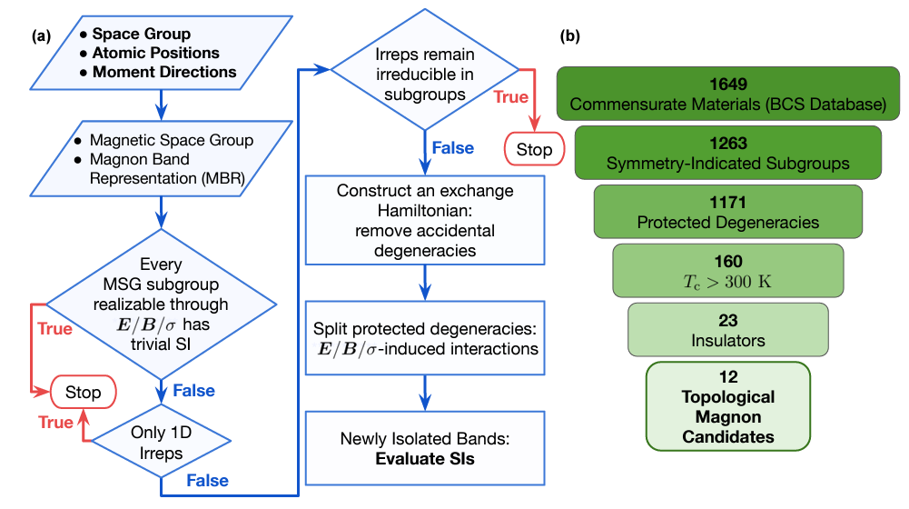
The Ohio State University
MRSEC DMR-2011876
An efficient material search for room-temperature topological magnons
Lu (OSU Physics), Goldberger (OSU Chemistry),
Doan-Nguyen (OSU MSE)
IRG-2 developed a symmetry-based approach that uses only few inputs, to carry out an efficient yet systematic search for topological magnons in magnetic insulators. Robust against disorders and decoherence, they serve as potential platforms for magnon-based spintronic devices.
Unlike weakly interacting electronic materials that are well captured by density functional theory and ab initio calculations, it is very difficult to make reliable predictions on strongly correlated magnetic materials. IRG-2’s symmetry-based approach overcome this challenge, and our search results greatly expand the list of high-Tc candidate materials for topological magnons.
This work is achieved by an interdisciplinary collaboration between IRG-2 physicists, chemists and material scientists, and is impossible without the center environment and funding of MRSEC. The obtained database provides a pool of candidate materials, facilitating the selection and synthesis of high quality materials and future experimental characterization of topological magnons.
(a) Flowchart of the search process, and (b) a summary of our search results from the Bilbao Crystallographic Server (BCS) magnetic materials database. From Karaki et al, Sci. Adv. vol 9 number 7, eade7731 (2023).
Notes:
What Has Been Achieved:
Importance of the Achievement: Add your narrative here.
How is the achievement related to the IRG, and how does it help it achieve its goals? Add your narrative here.
Where the findings are published: Karaki et al, Sci. Adv. vol 9 number 7, eade7731 (2023) DOI: 10.1126/sciadv.ade7731

