Slide 1
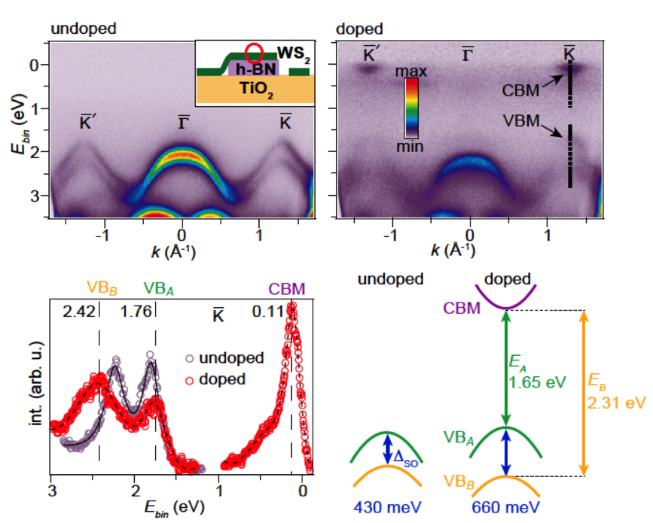
Control of Spin-Orbit Splitting in 2D Semiconductors
Probing and manipulating electronic band structures of 2D materials
Postdoctoral researcher Jyoti Katoch leads IRG-2 efforts using angle-resolved photoemission spectroscopy (ARPES) at the Advanced Light Source to investigate electronic band structures of novel 2D materials and heterostructures.
Discovered the ability to tune the valence band spin-orbit splitting of monolayer WS₂, a 2D semiconductor, using electron doping by potassium adatoms.
Ultrasharp ARPES spectra¹ are obtained when 2D materials are placed on flat h-BN flakes instead of oxide substrates.
Monolayer WS₂ on h-BN
¹S. Ulstrup et al. “Spatially Resolved Electronic Properties of Single-Layer WS2 on Transition Metal Oxides.” ACS Nano, 10, 11 (2016).
J. Katoch et al. “Giant spin-splitting and gap renormalization driven by trions in single-layer WS2/h-BN heterostructures.” arXiv:1705.04866.
R. Kawakami, J. Goldberger, W. Windl
The Ohio State University
Notes:
The ability to tune the spin-orbit coupling is important for developing 2D topological states and spintronic devices. Through angle-resolved photoemission spectroscopy (ARPES) with micron-sized photon beams, IRG-2 postdoc Jyoti Katoch has worked at the Advanced Light Source to measure electronic band structure of monolayer WS₂ on h-BN. Using potassium adatoms to generate electron doping, she discovered a strong tuning of spin-splitting of the WS₂ valence band (~50% effect, from 430 to 660 meV). This is the first time such an effect has been observed for a monolayer TMD, and the result was enabled by the ultrasharp ARPES spectrum obtained by stacking the WS₂ onto a flat h-BN flake. The band gap is also found to be renormalized. Tuning of the band structure depends on electron density and is believed to originate from strong Coulomb interactions.

