Slide 1
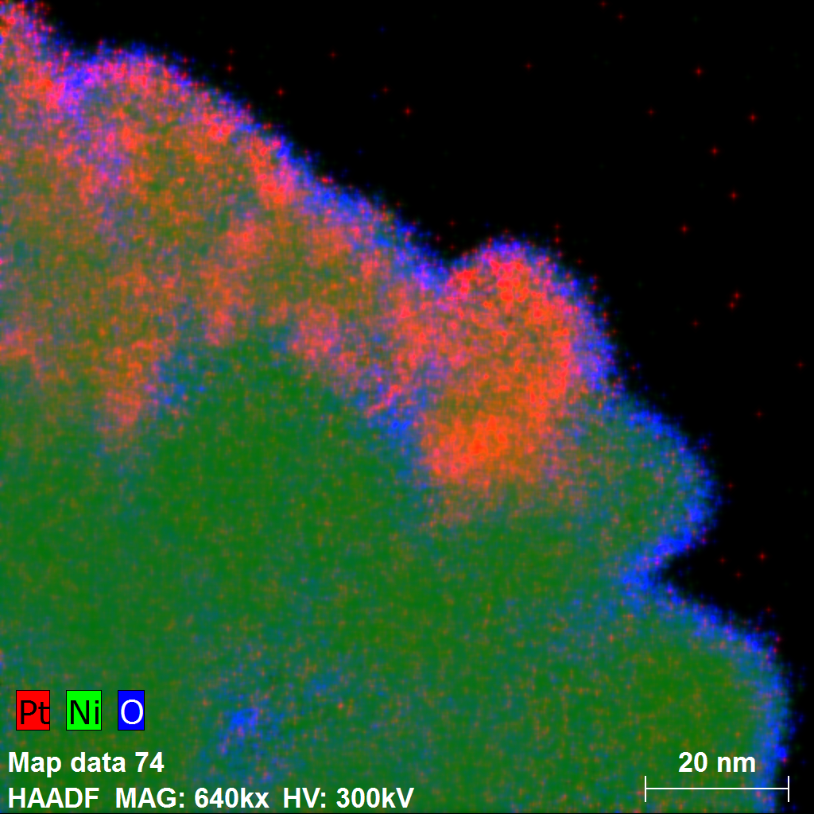
Translating Spin Seebeck Effect Physics into Practice
Study reveals thin film physics also manifests in random nanocomposite geometry
The spin Seebeck effect (SSE) holds enormous potential for use in converting thermal energy (such as waste heat) into electricity
Conventional SSE experiments are performed on delicate thin film heterostructures, which are impractical for energy conversion applications
We have now shown that SSE can be observed in bulk materials by embedding ‘normal metal’ nanoparticles (Pt or Au) within conducting ferromagnets (Ni or MnBi)
This proof-of-principle study establishes a viable approach for translating SSE physics into more practical bulk materials that can be produced using low-cost synthesis methods like powder processing and wet chemistry
With further study, the energy conversion efficiency may be significantly enhanced and even become competitive with conventional thermoelectric materials
Elemental mapping image of Ni-Pt nanoparticles obtained by a scanning transmission electron microscope
S. R. Boona, K. Vandaele, I. N. Boona, D. W. McComb, and J. P. Heremans, "Observation of spin Seebeck contribution to the transverse thermopower in Ni-Pt and MnBi-Au bulk nanocomposites," Nature Communications 7, 13714 (2016). *supported by the Center for Emergent Materials, an NSF MRSEC (DMR1420451) and by MURI (W911NF-14-1-0016)
Notes:
Ni-Pt and MnBi-Au nanocomposites (along with Ni and MnBi control samples) were synthesized via wet chemistry and sintered into porous bricks of material. The transverse thermopower (Nernst coefficient) of each material was measured at a variety of temperatures by applying heat along one direction, then measuring the voltage across the sample perpendicular to the direction of heat flow, while varying an applied magnetic field in the third mutually perpendicular direction. Since the spin Seebeck effect (SSE) occurs in the same geometry as the (anomalous) Nernst effect (ANE), it has already been shown that ANE and SSE can combine to produce enhanced transverse thermopower in conducting ferromagnets combined with ‘normal metal’ thin films, such as Fe3O4 coated with Pt. When compared to the reference samples, the composites all showed a positive magnetization-dependent shift in transverse thermopower, consistent with a spin Seebeck contribution from thermal spin currents injected into the Pt/Au nanoparticles from the surrounding FM matrix, which then produced an inverse spin Hall electric field inside the Pt/Au particles.

