Slide 1
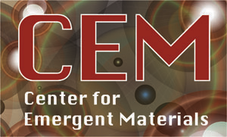

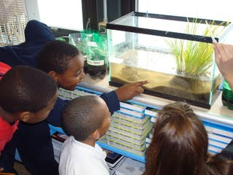
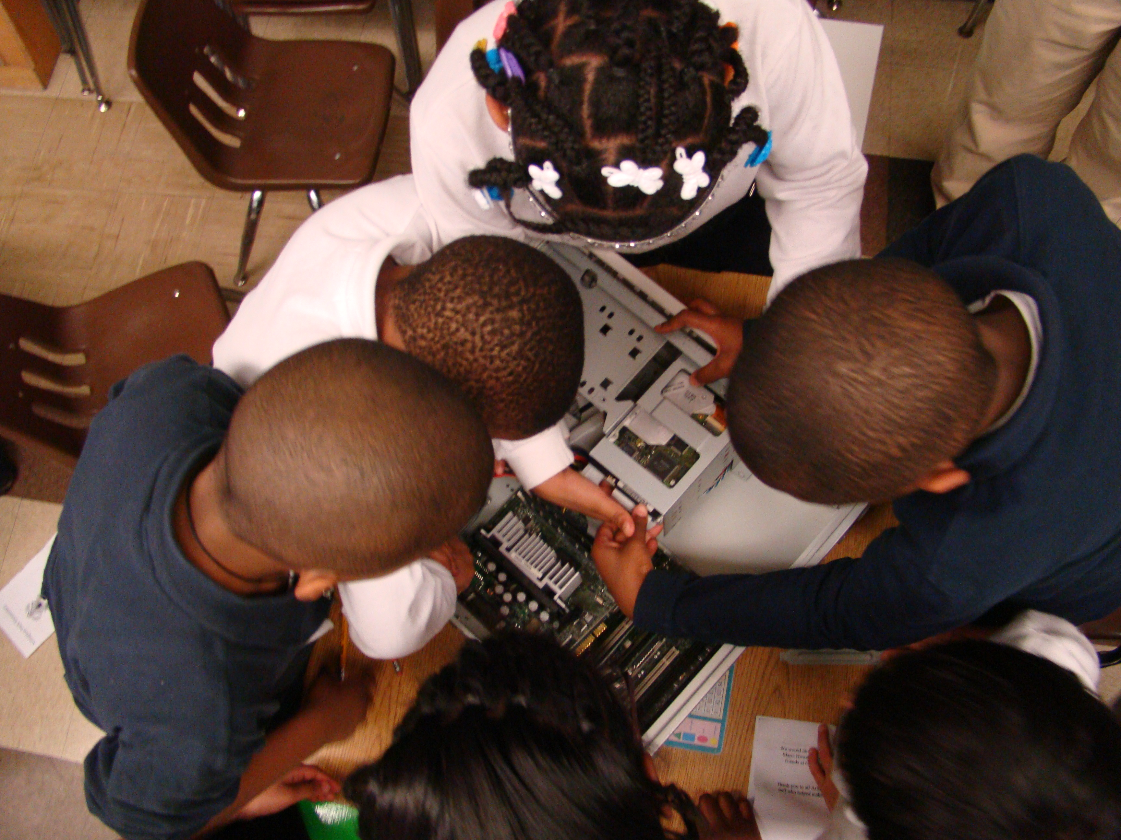
Center for Emergent Materials
The Ohio State University
http://cem.osu.edu
Little Scientists in Action
Scientific Thinkers at Arlington Park Elementary
The Scientific Thinkers Program is a year-long effort to regularly expose 4th and 5th graders at Arlington Park Elementary School to scientists and scientific inquiry. This program strives to help the students in this economically disadvantaged Columbus City School enjoy science and gain confidence in their abilities as students and scientific thinkers through the collaborative efforts of teachers and graduate and undergraduate student volunteers teaching inquiry-based lessons.
There are three main aspects to the in-class methods:
Meet a Scientist – The volunteer introduces the students to one interesting topic in his or her field of research explained at a basic level. This is presented in a discussion-based format, allowing the students to relate to the volunteer as a scientist.
Be a Scientist –The volunteer designs and delivers an inquiry-based lesson aligned with the state science standards that engages the students in hands-on experiments and scientific thinking.
Learn about other Scientists – At least 3 projects per year expand beyond the curriculum to more complex science topics. For example, the students might learn about graphene, starting with a closer look at pencil lead and leading to a discussion of the Nobel Prize.
Marci Howdyshell, Michelle McCombs, Nandini Trivedi & Katharine Flores
Students excited while learning about terrariums (above) and how a computer works (below).
Co Au Co
An NSF Materials Research Science and Engineering Center (MRSEC)
Supported under Award Number DMR-0820414
Notes:
The Scientific Thinkers Program is a year-long effort to regularly expose 4th and 5th graders at Arlington Park Elementary School to scientists and scientific inquiry. This program strives to help the students in this economically disadvantaged Columbus City School enjoy science and gain confidence in their abilities as students and scientific thinkers through the collaborative efforts of teachers and graduate and undergraduate student volunteers teaching inquiry-based lessons.
There are three main aspects to the in-class methods:
Meet a Scientist – The volunteer introduces the students to one interesting topic in his or her field of research explained at a basic level. This is presented in a discussion-based format, allowing the students to relate to the volunteer as a scientist.
Be a Scientist –The volunteer designs and delivers an inquiry-based lesson aligned with the state science standards that engages the students in hands-on experiments and scientific thinking.
Learn about other Scientists – At least 3 projects per year expand beyond the curriculum to more complex science topics. For example, the students might learn about graphene, starting with a closer look at pencil lead and leading to a discussion of the Nobel Prize.

