Slide 1


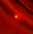
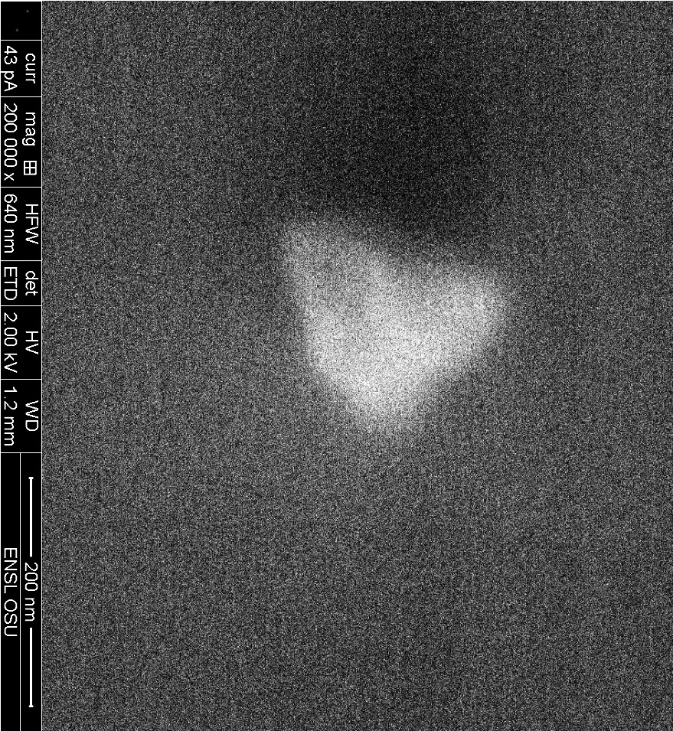
Center for Emergent Materials
The Ohio State University
http://cem.osu.edu
Mechanical Functions of the Genome
Probing Genomic Materials with Magnetic Resonance
The human genome is a highly complex multi-scale material that is composed of nucleic acids and proteins. The mechanical properties of our genomes play essential roles in its function. Unfortunately, the structure and dynamics of the human genome is not well-understood and is a major limitation it determining how it functions.
Ohio State researchers are developing three complimentary magnetic resonance based methods to probe the structure and dynamics of short sections of the genome called chromatin. Solid State Nuclear Magnetic Resonance is being developed to probe chromatin structure, Electron Paramagnetic Resonance is being developed to probe chromatin dynamics. And Optically Detected Magnetic Resonance is being developed for single molecule magnetic resonance studies of chromatin dynamics.
Min Gao, Richelle Teeling, Morgan Welsh, Philippe Nadaud, Chris Hammel, Chris Jaroniec, Michael Poirier
Co Au Co
200nm
An example of a nano-diamond crystal used to optically detect magnetic resonance within a single chromatin molecule. The top and bottom images are a fluorescence and an electron micrograph image of the same particle, respectively.
An NSF Materials Research Science and Engineering Center (MRSEC)
Supported under Award Number DMR-0820414
Notes:
The human genome is a highly complex multi-scale material that is composed of nucleic acids and proteins. The mechanical properties of our genomes play essential roles in its function. Unfortunately, the structure and dynamics of the human genome is not well-understood and is a major limitation it determining how it functions.
Ohio State researchers are developing three complimentary magnetic resonance based methods to probe the structure and dynamics of short sections of the genome called chromatin. Solid State Nuclear Magnetic Resonance is being developed to probe chromatin structure, Electron Paramagnetic Resonance is being developed to probe chromatin dynamics. And Optically Detected Magnetic Resonance is being developed for single molecule magnetic resonance studies of chromatin dynamics.
**----

