Slide 1
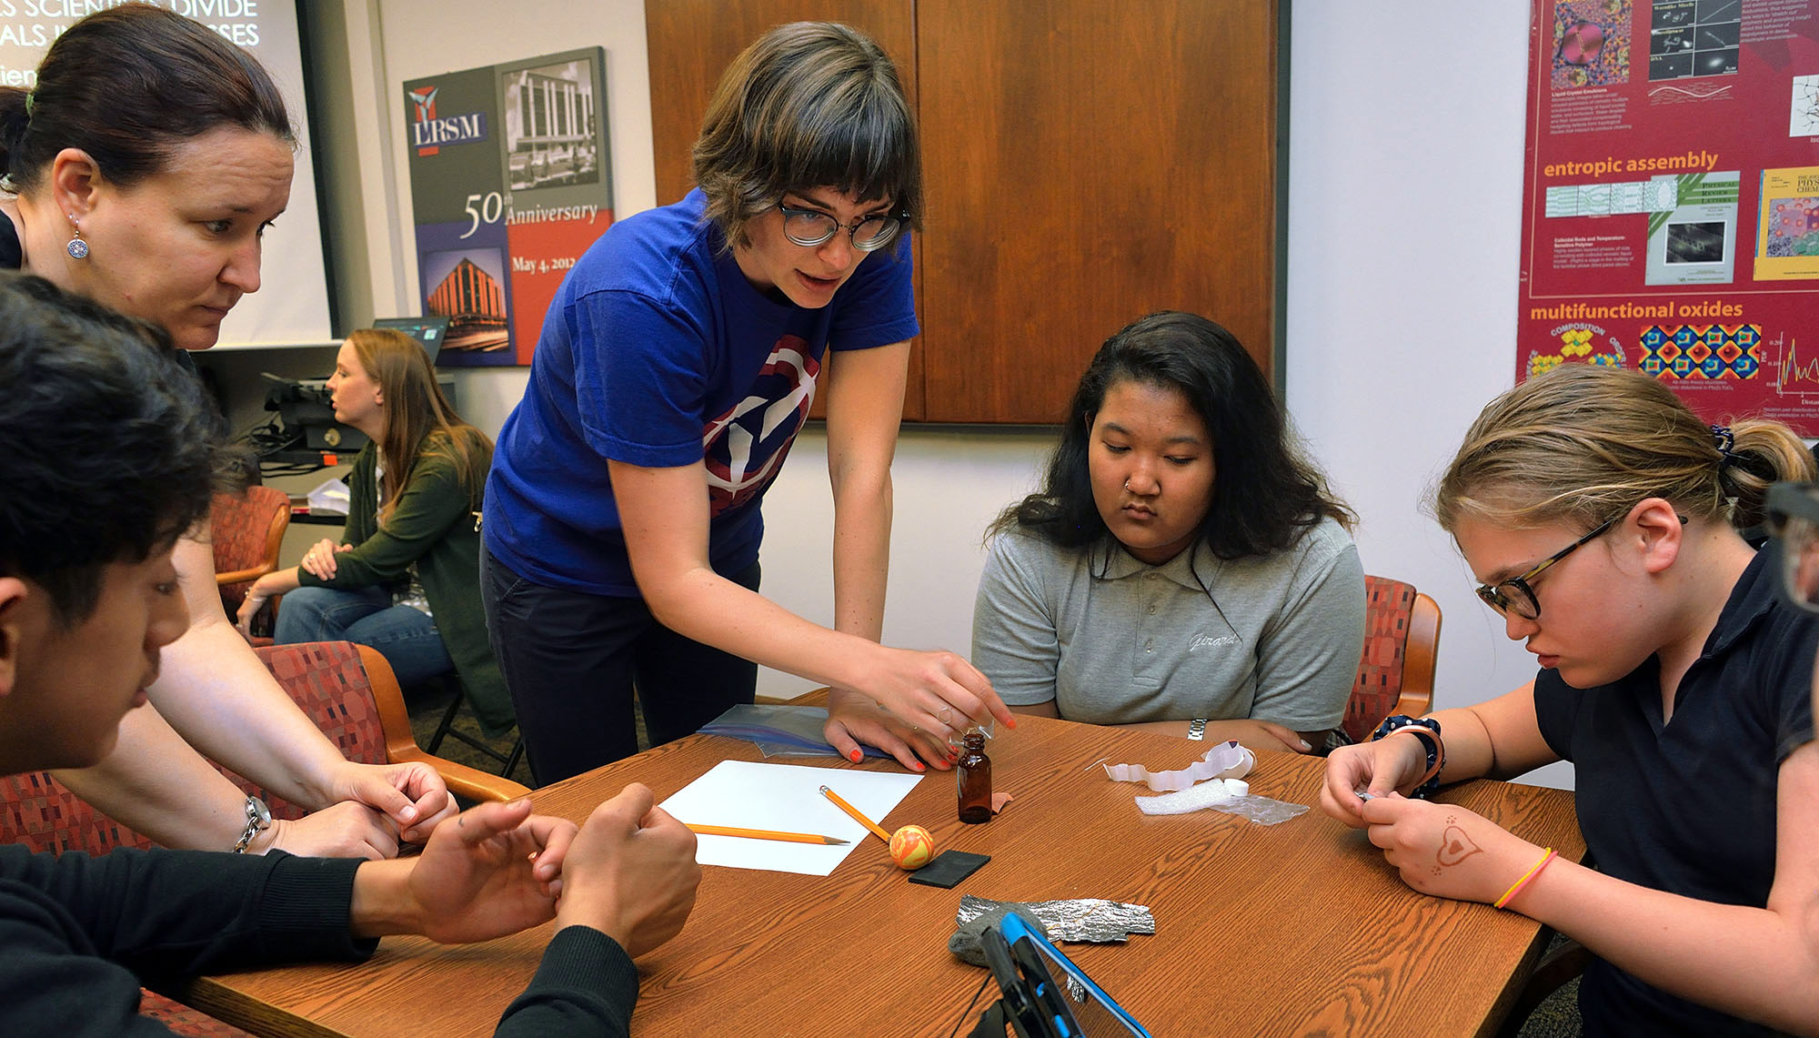
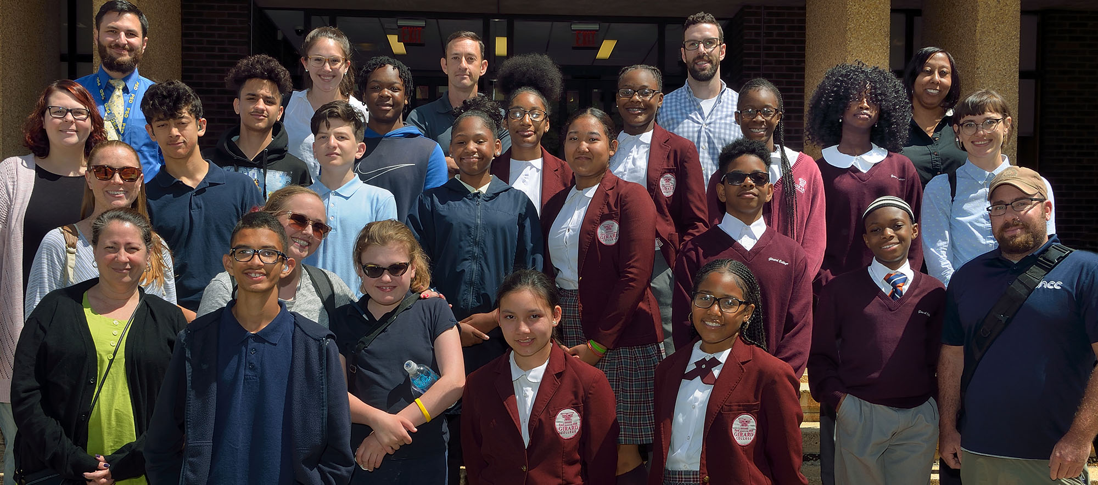
Middle School Summer Program: Girard College and Pennsylvania School for the Deaf
DMR: 1720530
2018
University of Pennsylvania
Since 2011, 7th grade students from Girard College have spent one week on campus at the LRSM. Girard College is a Philadelphia boarding school for economically disadvantaged students from single-parent households. In 2018, students from The Pennsylvania School for the Deaf (PSD) joined the camp. All students participate in lab experiments, materials science lessons, and visits to various Penn facilities. 19 students participated in the program whose primary purpose is to introduce URG students to STEM at an early age: 9 from Girard College & 10 students from PSD. The new combination provided a truly unique experience.
“It was awesome because I got to learn [both] sign language and … more about physics.”
–Girard College Student
“It was awesome, because I liked to learn new things like drones, engineers... and social[izing] with [the] hearing school.”
-PSD Student
Notes:
The summer camp was conceived, planned, and run by Mark Licurse and Sophia Siefert of the University of Pennsylvania MRSEC’s Education and Outreach group, with help from Professor Eric Detsi (MSE), a faculty member at Penn with special interest in the school for the deaf.

