Slide 1
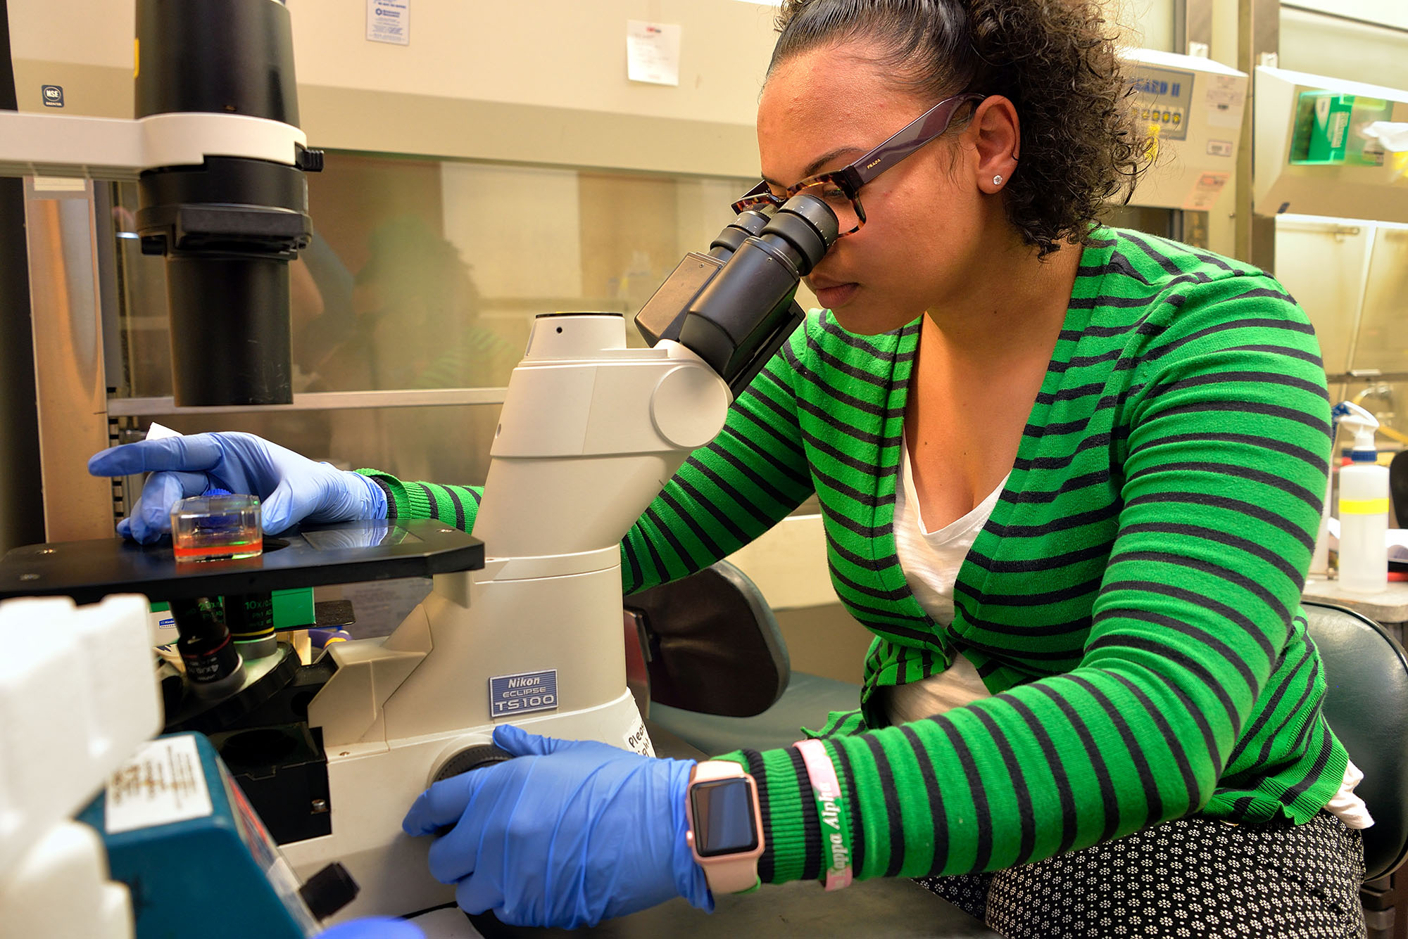
IRG2 Structural Chemo-Mechanics of Fibrous Networks / Broader Impacts
DMR: 1720530
2018
University of Pennsylvania
As part of our commitment to outreach, two students working with David Chenoweth in this IRG (Alexander Kasznal and Samuel Melton) are involved in Spark mentoring programs. Spark Students are paired with a mentor based on mutual interests. Students visit their mentor’s workplace once a week for 10-13 weeks. Students experience the value of planning, implementation and practice with the creation of a Spark Project. Mentorships culminate in Share Your Spark, an event where students and mentors present their projects–anything from working electrical circuits to marketing plans– to their colleagues, friends, families and the community.
http://sparkprogram.org/learn/our-program/
A Philadelphia school district high school teacher supported by the RET program in 2017 (Alexis Rylander Bennett, of Boys' Latin of Philadelphia Charter School) is now a full time researcher working with the Janmey lab for the summer and will continue when the school year starts again in Philadelphia.

