Slide 1
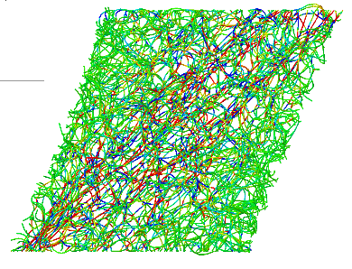
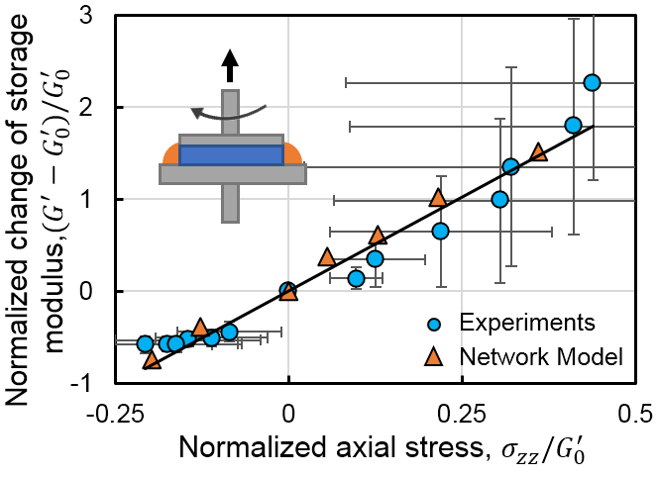
Structural Chemo-Mechanics of Fibrous Networks
DMR: 1720530
2019
Shenoy group in the IRG led a study on the multiaxial behavior of collagen networks. When stretched, the network models exhibited drastic contractions transverse to the direction of loading (yellow arrows in the top left image). The networks exhibited an anomalous Poisson effect, with apparent Poisson’s ratios larger than 1. Experiments validated this result and showed increases of apparent Poisson’s ratio with decreasing collagen concentration (top right image).
Janmey lab in the IRG used rheometry to study the behavior of collagen networks in combined axial and shear loading. The networks exhibited a linear variation of network shear stiffness with normal stresses (bottom right image). This result agreed with the behavior of the network model from Shenoy group (bottom left image). The results of this study were published in the Proceedings of the National Academy of Sciences of the USA.
E. Ban, H. Wang, J. M. Franklin, J. T. Liphardt, P. A. Janmey, and V. B. Shenoy, Strong Triaxial Coupling and Anomalous Poisson Effect in Collagen Networks, Proc. Natl. Acad. Sci. U. S. A. (2019)
Ehsan Ban, Paul Janmey, Vivek Shenoy University of Pennsylvania
Concentration(mg/mL)
Apparent Poisson’s ratio
Stretch ratio
0.02+
0.00
-0.02
Axial Strain

