Slide 1
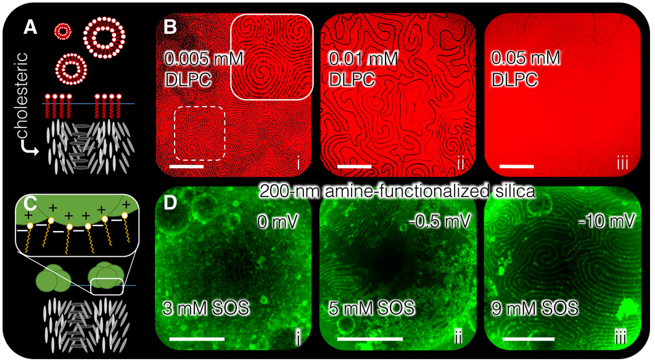
Shaping Nanoparticle Fingerprints at the Interface of Cholesteric Droplets
DMR: 1720530
2019
Shu Yang, Kathleen Stebe & Randall Kamien University of Pennsylvania
This work reports the first experimental realization of nanoparticles templated at the interface of liquid crystals into reconfigurable, periodic structures. We establish that nanoparticles can segregate into highly ordered stripes, with tunable organization and thickness, forming the basis for the assembly of patchy colloids and nanowires. Our technique is advantageous over other methods, as the resultant assemblies can dynamically respond to changes within the underlying liquid crystal.
L. Tran, H.-N. Kim, N. Li, S. Yang, K.J. Stebe, R.D. Kamien, and M.F. Haase, Science Advances, 12 Oct 2018:Vol. 4, no. 10, eaat8597

